Slide 1
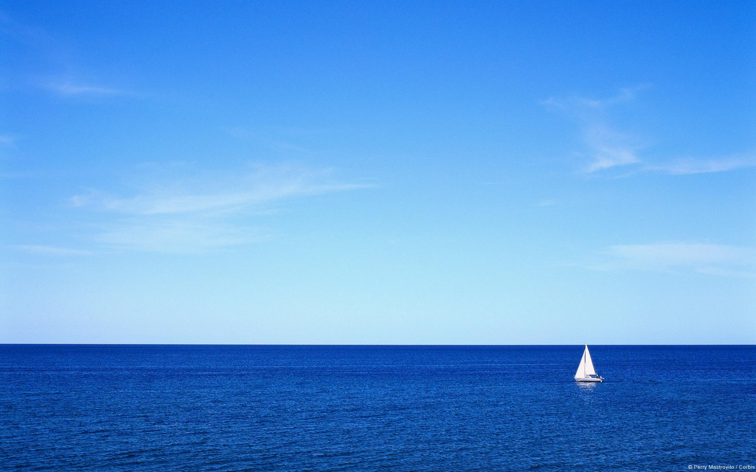
Khuong Dinh Secondary school
Unit 9- Skills 1
Teacher: To Thi Ha Phuong

Slide 2

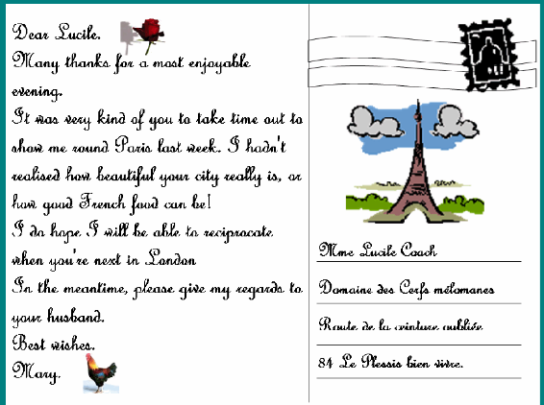
UNIT 9: CITIES OF THE WORLD
Lesson 5: Skills 1
Saturday, February 18th, 2017
A: Reading
1. Vocabulary
* Postcard (n): bưu thiếp
* Purpose (n): mục đích
* Swedish (a): thuộc về Thụy Điển
* Rent (v): thuê
* Discover (v): khám phá

Slide 3
UNIT 9: CITIES OF THE WORLD
Lesson 5: Skills 1
Saturday, February 18th, 2017
A: Reading
2. Read the post and answer the questions
1. Vocabulary
1.What is the picture on the postcard of?
-> The photo is of Stockholm, Sweden
* Postcard (n): bưu thiếp
2 . What do you think is written on this postcard?
->The sender writes about his/her stay in the city.
3. What is the purpose of writing and sending postcards while you are on holiday?
->We send postcards to tell our family and/or friends that we are having a good time, but we still miss them and want to send some photos of the place where we are so that, although they cannot be with us there they can still see how beautiful it is.
* Purpose (n): mục đích
* Swedish (a): thuộc về Thụy Điển
* Rent (v): thuê
* Discover (v): khám phá

Slide 4

UNIT 9: CITIES OF THE WORLD
Lesson 5: Skills 1
A.Reading
1. Vocabulary
2. Read the blog again and answer the questions
1. What city is Mai in?
2. Who is with her?
3. What has the weather been like?.
4. Where is Mai staying?
5. What has she done so far?
6. What do you think ‘fika’ means?
7. What will she do tomorrow?
8. How is Mai feeling? How do you know?

Slide 5
UNIT 9: CITIES OF THE WORLD
Lesson 5: Skills 1
A.Reading
1. Vocabulary
2. Read the blog again and answer the questions
5. What has she done so far?
->She has visited the Royal Palace and had ‘fika’ in a café in the Old Town.
6. What do you think ‘fika’ means?
->‘Fika’ (a Swedish word) means a leisure break when one drinks tea/coffee and perhaps has some biscuits with friends and family.
7. What will she do tomorrow?
->She will cycle to discover the city.
8. How is Mai feeling? How do you know?
-> Mai is feeling happy. She used the words such as “fantastic”, “perfect”, “amazing”, “too beautiful for words

Slide 6
UNIT 9: CITIES OF THE WORLD
Lesson 5: Skills 1
A.Reading
1. Vocabulary
2. Read the blog again and answer the questions
1. What city is Mai in?
-> Mai is in Stockholm.
2. Who is with her?
-> She is there with her family (Mum, Dad, and her brother Phuc)
3. What has the weather been like?
->The weather has been perfect. It is sunny.
4. Where is Mai staying?
-> Mai is staying in a hotel

Slide 7
UNIT 9: CITIES OF THE WORLD
Lesson 5: Skills 1
A.Reading
3. Read the text again and match the headings with the numbers.
a. Address of the person/people who get the postcard Weather/hotel/food c. Opening d. What you have seen or done e. Closing f. A very popular sentence used for postcards, near the closing g. What you will do next h. An overall feeling about the place i. Date
KEY: 1. i 2. c 3. h 4. b 5. d
6. g 7. f 8. e 9. a

Slide 8
UNIT 9: CITIES OF THE WORLD
Lesson 5: Skills 1
B. Speaking
4. Choose a city. Imagine you have just arrived in that city and want to tell your friends about it. Make notes below
When did you arrive? Who are you with ? Where are you staying? What have you done? What are you doing tomorrow? How are you feeling ?

Slide 9
UNIT 9: CITIES OF THE WORLD
Lesson 5: Skills 1
B. Speaking
5. In pair, use your notes to tell your partner about your city. Then, listen and write down notes about your partner’s city in the space below.
-------------------------------------------------------------------------------
-------------------------------------------------------------------------------
-------------------------------------------------------------------------------
-------------------------------------------------------------------------------
-------------------------------------------------------------------------------
-------------------------------------------------------------------------------

Slide 10


