Slide 1








Slide 2
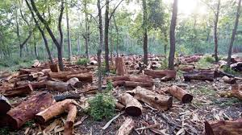
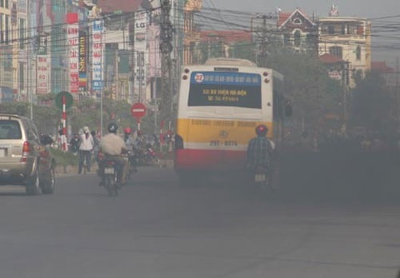


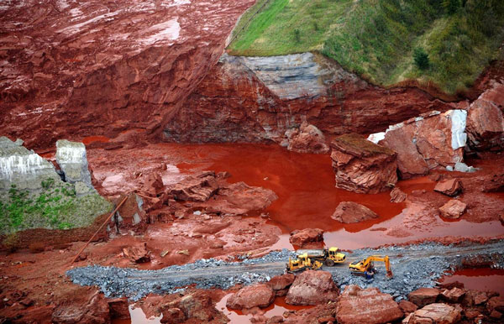
1.
Deforestation
2.
Air pollution
3.
Noise pollution
4.
Water pollution
5.
Soil pollution

Slide 3

UNIT 11: OUR GREENER WORLD
Period 91 : Lesson 5: Skills 1/p.54

Slide 4

I. Reading
1. Find these words or phrases in the text and underline them.
recycling bins
swap
charity
3Rs Club
creative
reusable

Slide 5

I. Reading
Read the 3Rs club poster about tips to become ‘green’.
3Rs Club
If you follow the tips below, you will become ‘greener’.
1. Talk to teachers at school about putting recycling bins in every classroom.
2. Reuse your plastic bags.
3. Use refillable pens and pencils.
4. Use reusable water bottles instead of plastic ones.
5. Give last year’s clothes to charity instead of throwing them away.
6. Swap your clothes with your friends or cousins.
7. Grow your own vegetables.
8. Turn the tap off when you brush your teeth or wash the dishes.
9. Walk more.
10. Find creative ways to reuse old items before throwing them away.

Slide 6
I. Reading
Read the 3Rs club poster about tips to become ‘green’.
3Rs Club
If you follow the tips below, you will become ‘greener’.
1. Talk to teachers at school about putting recycling bins in every classroom,
2. Reuse your plastic bags.
3. Use refillable pens and pencils.
4. Use reusable water bottles instead of plastic ones.
5. Give last year’s clothes to charity instead of throwing them away.
6. Swap your clothes with your friends or cousins.
7. Grow your own vegetables.
8. Turn the tap off when you brush your teeth or wash the dishes.
9. Walk more.
10. Find creative ways to reuse old items before throwing them away.
recycling bins
reusable
charity
Swap
creative

Slide 7
I. Reading
2. Match the words with their meanings(P.54)
1. Creative | give something to a person and receive something from him/her.
2. Charity | can be used again.
3. Swap | containers for things that can be recycled.
4. Reusable | giving things to people in need.
5. Recycling bins | unique and interesting.

Slide 8
I. Reading
3. Answer the questions.
1. What will you try to put in every classroom?
2. What can you do with your old clothes?
3. What kinds of pen and pencils should you use?
4. How can you save water?
5. If you bring water bottles to a picnic, what type of bottles should you bring?

Slide 9
Rules of game
Each right answer, you get 5 points.
If your answer is wrong, the rest team will have right to answer.
If you have a lucky star, you can get 5 points, you don’t have to answer and choose the other star at the same time.
The team having more points will become the winner.
Good luck to you !

Slide 10


1
2
3
7
4
5
6
Reduce
Recycle

Slide 11


1. What will you try to put in every classroom?
We will try to put recycling bins
in every classroom.

Slide 12

2. What can you do with your old clothes?
We can give them to charity or swap them with your friends or cousins.

Slide 13





Congratulations !
Lucky number

Slide 14

3. What kind of pens and pencils should you use?
We should use refillable ones.

Slide 15

4. How can you save water?
We can turn the tap off when you brush your teeth or wash the dishes.

Slide 16

Congratulations !
Lucky number

Slide 17

5. If you bring water bottles to a picnic, what
type of bottles should you bring?
We should bring reusable bottles.

Slide 18
II. Speaking
4. Do you think you can follow the tips for ‘going greener’? Discuss with your group and put the tips in order from the easiest to the most difficult.
If you follow the tips below, you will become ‘greener’.
1. Talk to teachers at school about putting recycling bins in every classroom.
2. Reuse your plastic bags.
3. Use refillable pens and pencils.
4. Use reusable water bottles instead of plastic ones.
5. Give last year’s clothes to charity instead of throwing them away.
6. Swap your clothes with your friends or cousins.
7. Grow your own vegetables.
8. Turn the tap off when you brush your teeth or wash the dishes.
9. Walk more.
10. Find creative ways to reuse old items before throwing them away.

Slide 19
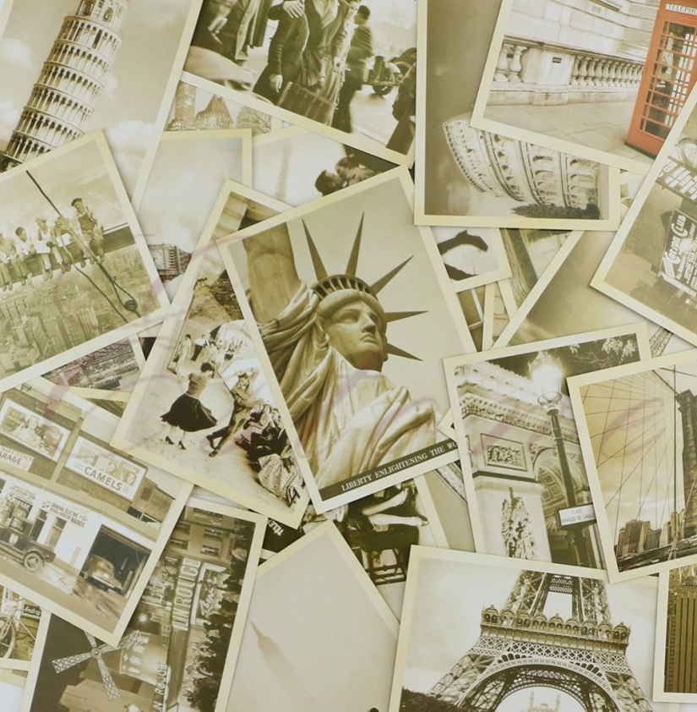

II. Speaking
5. The last tip tells you to find creative ways to reuse items before throwing away. Can you think of any creative ways to reuse:
Old envelopes
- Collect them and organize envelope- collecting club

Slide 20
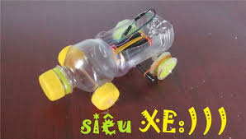
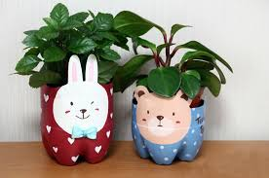
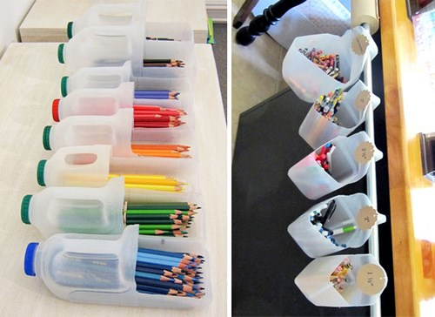
II. Speaking
5. The last tip tells you to find creative ways to reuse items before throwing away. Can you think of any creative ways to reuse:
b. used water bottles.
use them to make small projects
decorate them to make new products

Slide 21
II. Speaking
5. The last tip tells you to find creative ways to reuse items before throwing away. Can you think of any creative ways to reuse:
b. used water bottles.
use them to make small projects
decorate them to make new products
C. used books.
- set up a few book fairs. Students can swap their old books or used books.
-

Slide 22


Slide 23

Homework
Read “3Rs Club” again.
Add more tips in Ex 4/p54
Find creative ways to reuse “ used books”
Do exercises D1,2 in workbook/ p. 36,37
Prepare: Skills 2/p 55.

