Slide 1
Welcome to my class
Giáo viên dạy : Nguyễn Thị Huyền
THCS Khương Đình

Slide 2
Kiểm tra bài cũ
Past simple or present perfect? Put the verb in blankets into the correct form 1. They (clean) the beach one week ago.
2. They (collect) hundreds of books so far.
3. I (collect) stamps when I was a child.
4. She (fly) to Da Nang many times but last year she (go)
there by train.
5. you ever (see) a real lion? No, but I (see) a real elephant when we went to the zoo last month
cleaned
have collected
collected
has flew
went
Have
seen
saw

Slide 3
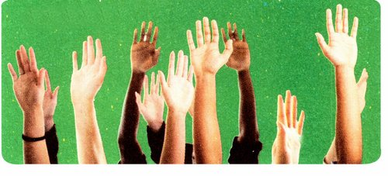
Monday, October 10th 2016
Period 20: Unit 3: Community Service
Lesson 5: Skills 1
Reading
Ex 1: Read the text about volunteer work in the United States
In the United States, almost everyone, at one time or another, has been a volunteer. According to U.S. government statistics, about one-fifth of the American population does volunteer work each year. Americans have had the tradition of volunteering and helping one another since the early days of the country.
Americans volunteer not because they are forced or paid to do it. They enjoy it! Traditional volunteer activites include raising money for people in need, cooking and giving food, doing general labour (such as clean-up projects and home repair), providing transportation (such as giving rides to the erderly), and tutoring/mentoring young people
(adaped from “Volunteering: An American Tradition” by Susan J.Ellis and Katherine H. Campbell in eJournal USA: The spririt of Volunteerism. U.S. Department of State,2012)

Slide 4
Period 20: Unit 3: Community Service
Lesson 5: Skills 1
Monday, October 10th 2016
Reading
Ex 2: Decide if the following statements are true (T) or false (F)
 | T | F
1. According to the text, nearly every American has done volunteer work in his or her life
2. Every year almost one in five Americans works as a volunteer
3. Americans have been volunteering for less than 50 years.
4. Americans volunteer because they are forced to do it
x
x
x
x

Slide 5
Period 20: Unit 3: Community Service
Lesson 5: Skills 1
Monday, October 10th 2016
Reading
Ex 3: Which of the activities below are traditional volunteer activities in the United States? Tick (√ ) the boxes
1. Providing care for animals
2. Raising money
3. Cooking meals
4. Donating blood
5. Cleaning streets
6. Teaching young children
√
√
√
√

Slide 6
Period 20: Unit 3: Community Service
Lesson 5: Skills 1
Monday, October 10th 2016
Speaking
Ex 4: Idea bank: Fill in the table with your ideas for volunteer activites.
To raise money, we could ... | To provide food, we could ... | To help repair things, we could... | To help people with transportation, we could ... | To tutor yong children, we could ...
* Make postcards and sell them | * Cook food and bring it to street children
- Provide them the materials..
- Support them money or labour.
-Set up the
Organizations to support them.
-Pick them up.
-Call others to join your organization
-Set up the evening classes free.
-Encourage poor children or street children to join.

Slide 7
Period 20: Unit 3: Community Service
Lesson 5: Skills 1
Monday, October 10th 2016
Speaking
Ex 5: Work in groups. Share the ideas in your idea bank with your group members. Then, use the most interesting ideas to create a new group idea bank and share it with the class
Example:
A: we could make postcards and sell them to raise money.
B: what types of postcards?
C: what are the postcards made of?
D: who can make the postcards?
E: where should we sell them?
F: what should we do to tell people about our project?

Slide 8
Thử tài suy nghĩ

Slide 9
Homework: - Do excercise D1,2 - Prepare : Skills 2

