Slide 1
Unit 2: What does she look like?
Lesson 3: The real world

Slide 2
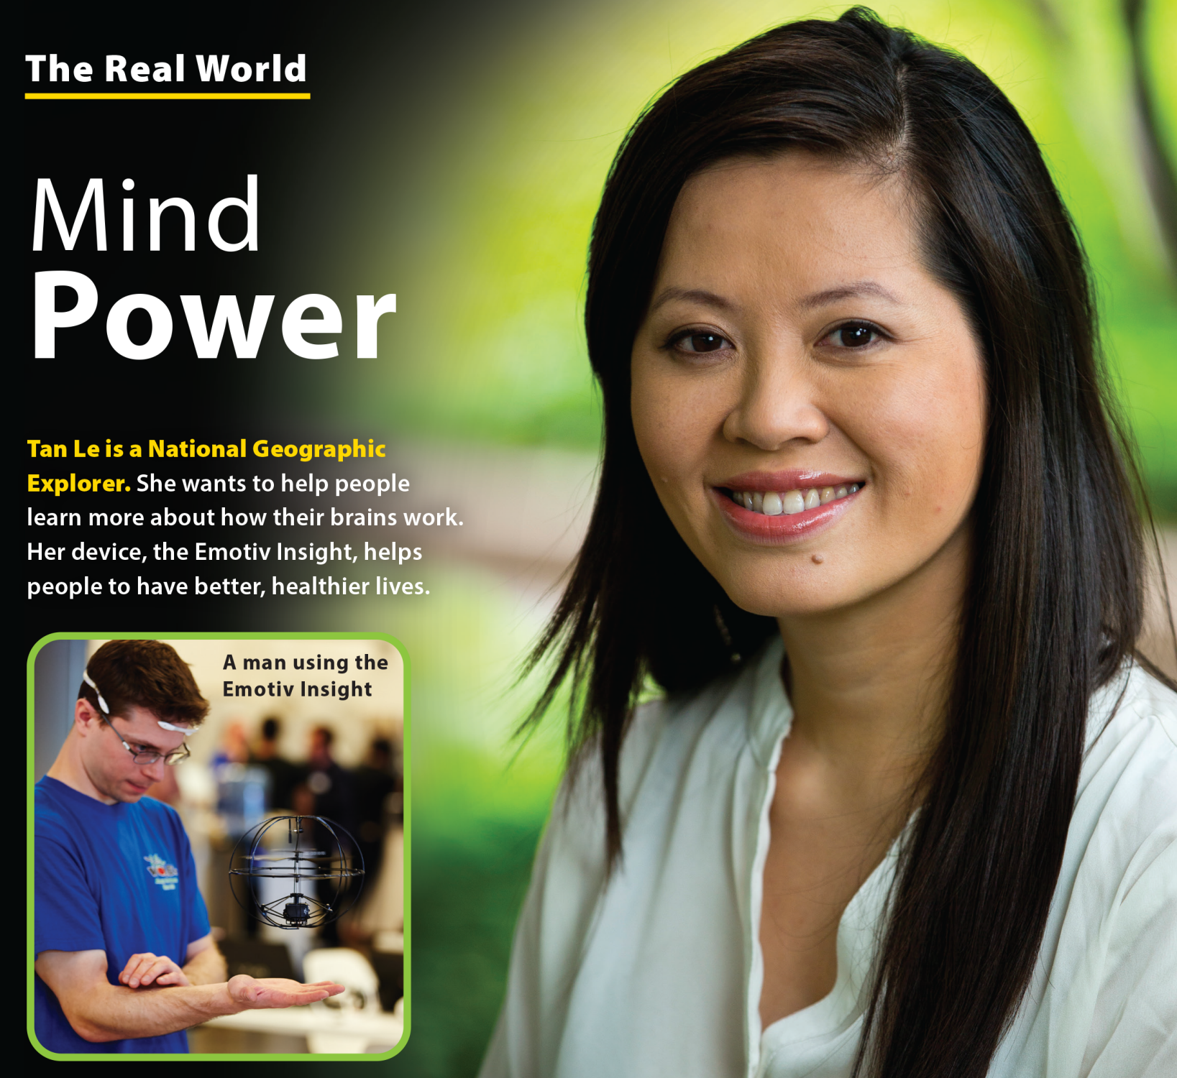
UNIT 2
WHAT DOES SHE LOOK LIKE?
THE REAL WORLD

Slide 3
UNIT 2
WHAT DOES SHE LOOK LIKE?
THE REAL WORLD

Slide 4
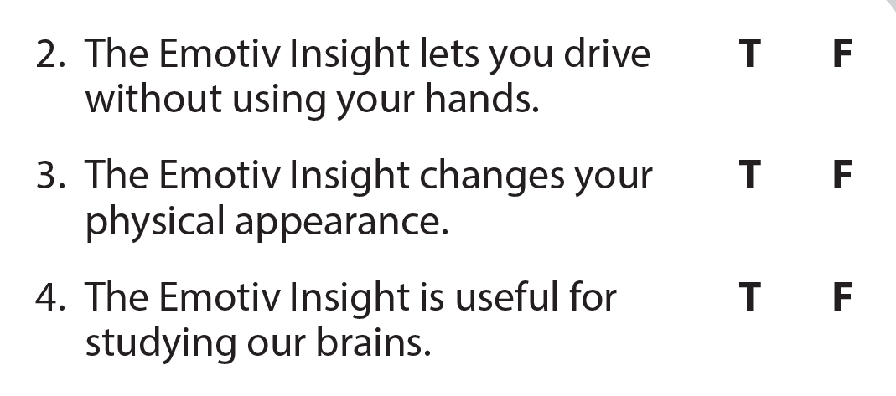
UNIT 2
WHAT DOES SHE LOOK LIKE?
THE REAL WORLD

