Slide 1
Unit 2: What does she look like?
Lesson 6: Writing

Slide 2
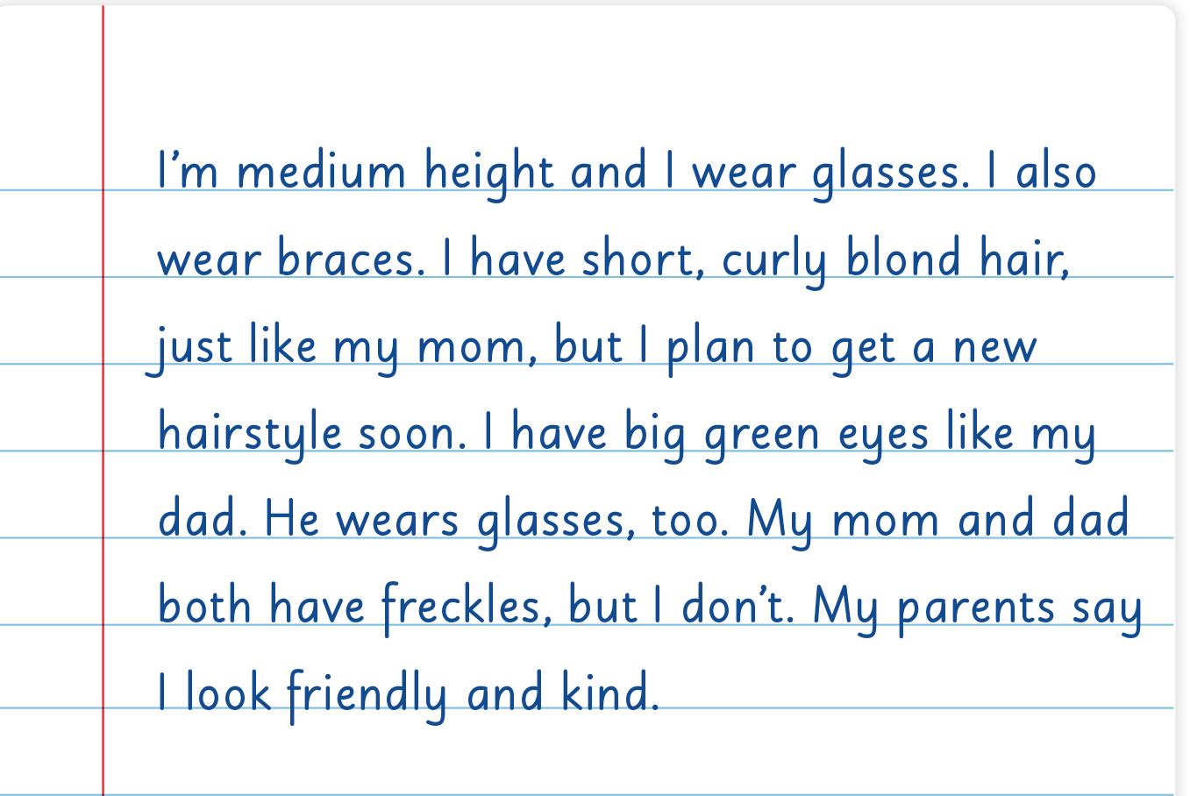
UNIT 2
WHAT DOES SHE LOOK LIKE?
WRITING

Slide 3
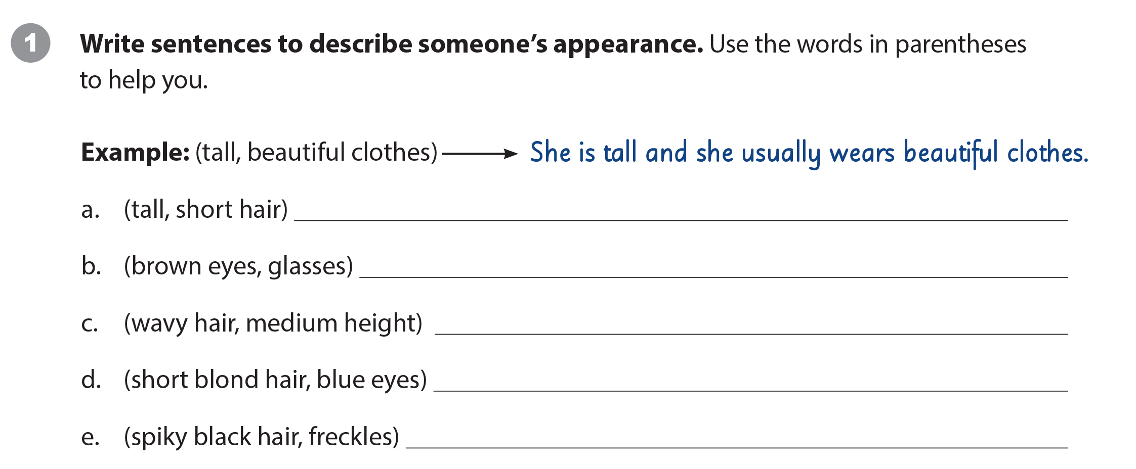
UNIT 2
WHAT DOES SHE LOOK LIKE?
WRITING WORKSHEET
Suggested answers
She’s tall and she has short hair.
Mike has brown eyes and he wears glasses.
My mother has wavy hair and she is medium height.
Ann’s sister has short blond hair and blue eyes.
He has spiky black hair and freckles.

Slide 4
UNIT 2
WHAT DOES SHE LOOK LIKE?
WRITING WORKSHEET

Slide 5
UNIT 2
WHAT DOES SHE LOOK LIKE?
WRITING WORKSHEET

