Slide 1
TRƯỜNG THCS KHƯƠNG ĐÌNH
BÀI GIẢNG ĐIỆN TỬ:
UNIT 5 : ARE CATS BETTER THAN DOGS? – LESSON 4: READING + WRITING
Tác giả: Nguyễn Thị Thu

Slide 2
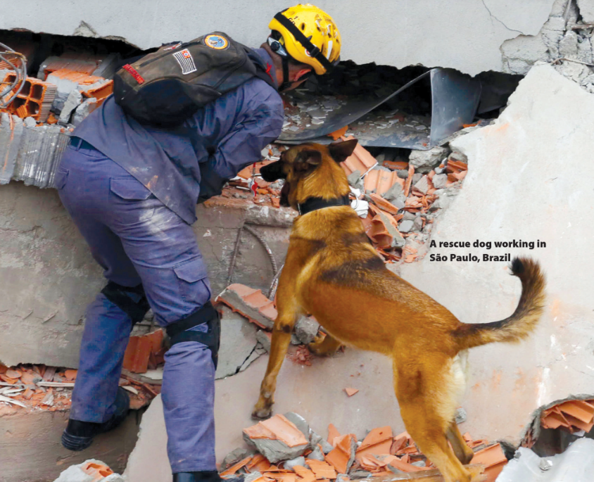
UNIT 5
ARE CATS BETTER PETS THAN DOGS?
READING

Slide 3
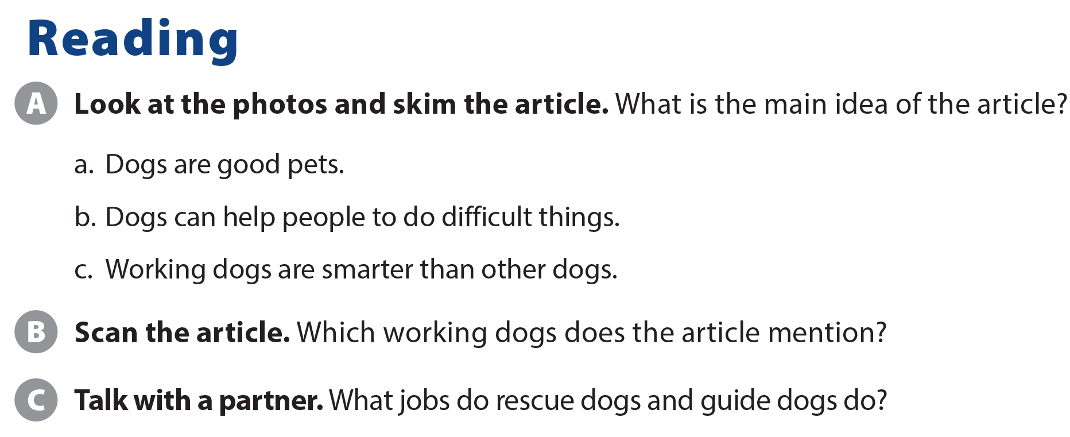
UNIT 5
ARE CATS BETTER PETS THAN DOGS?
READING
Rescue dogs and guide dogs
Rescue dogs help people in trouble. Guide dogs help blind people.

Slide 4
UNIT 5
ARE CATS BETTER PETS THAN DOGS?
COMPREHENSION

Slide 5
UNIT 5
ARE CATS BETTER PETS THAN DOGS?
COMPREHENSION
are gentler
are more intelligent
are friendlier
have better ears and noses

Slide 6
UNIT 5
ARE CATS BETTER PETS THAN DOGS?
PROJECT

Slide 7
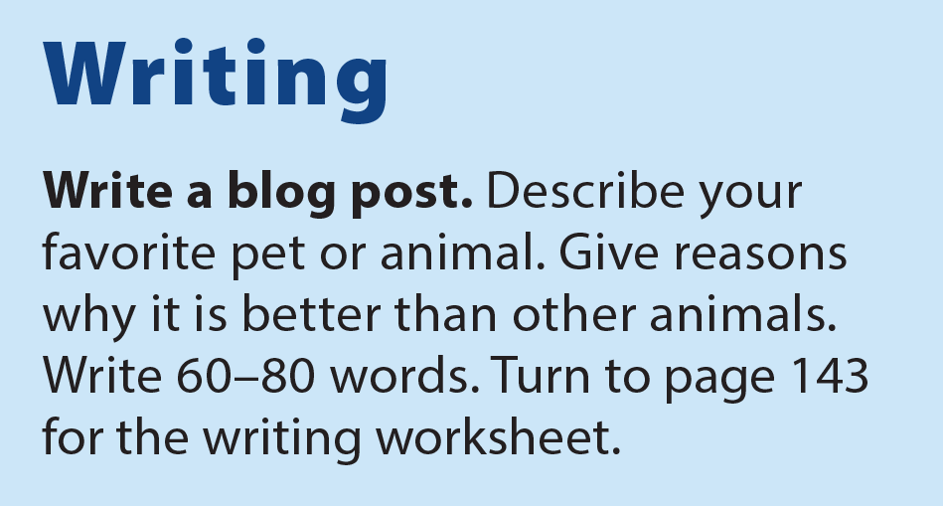
UNIT 5
ARE CATS BETTER PETS THAN DOGS?
WRITING

Slide 8
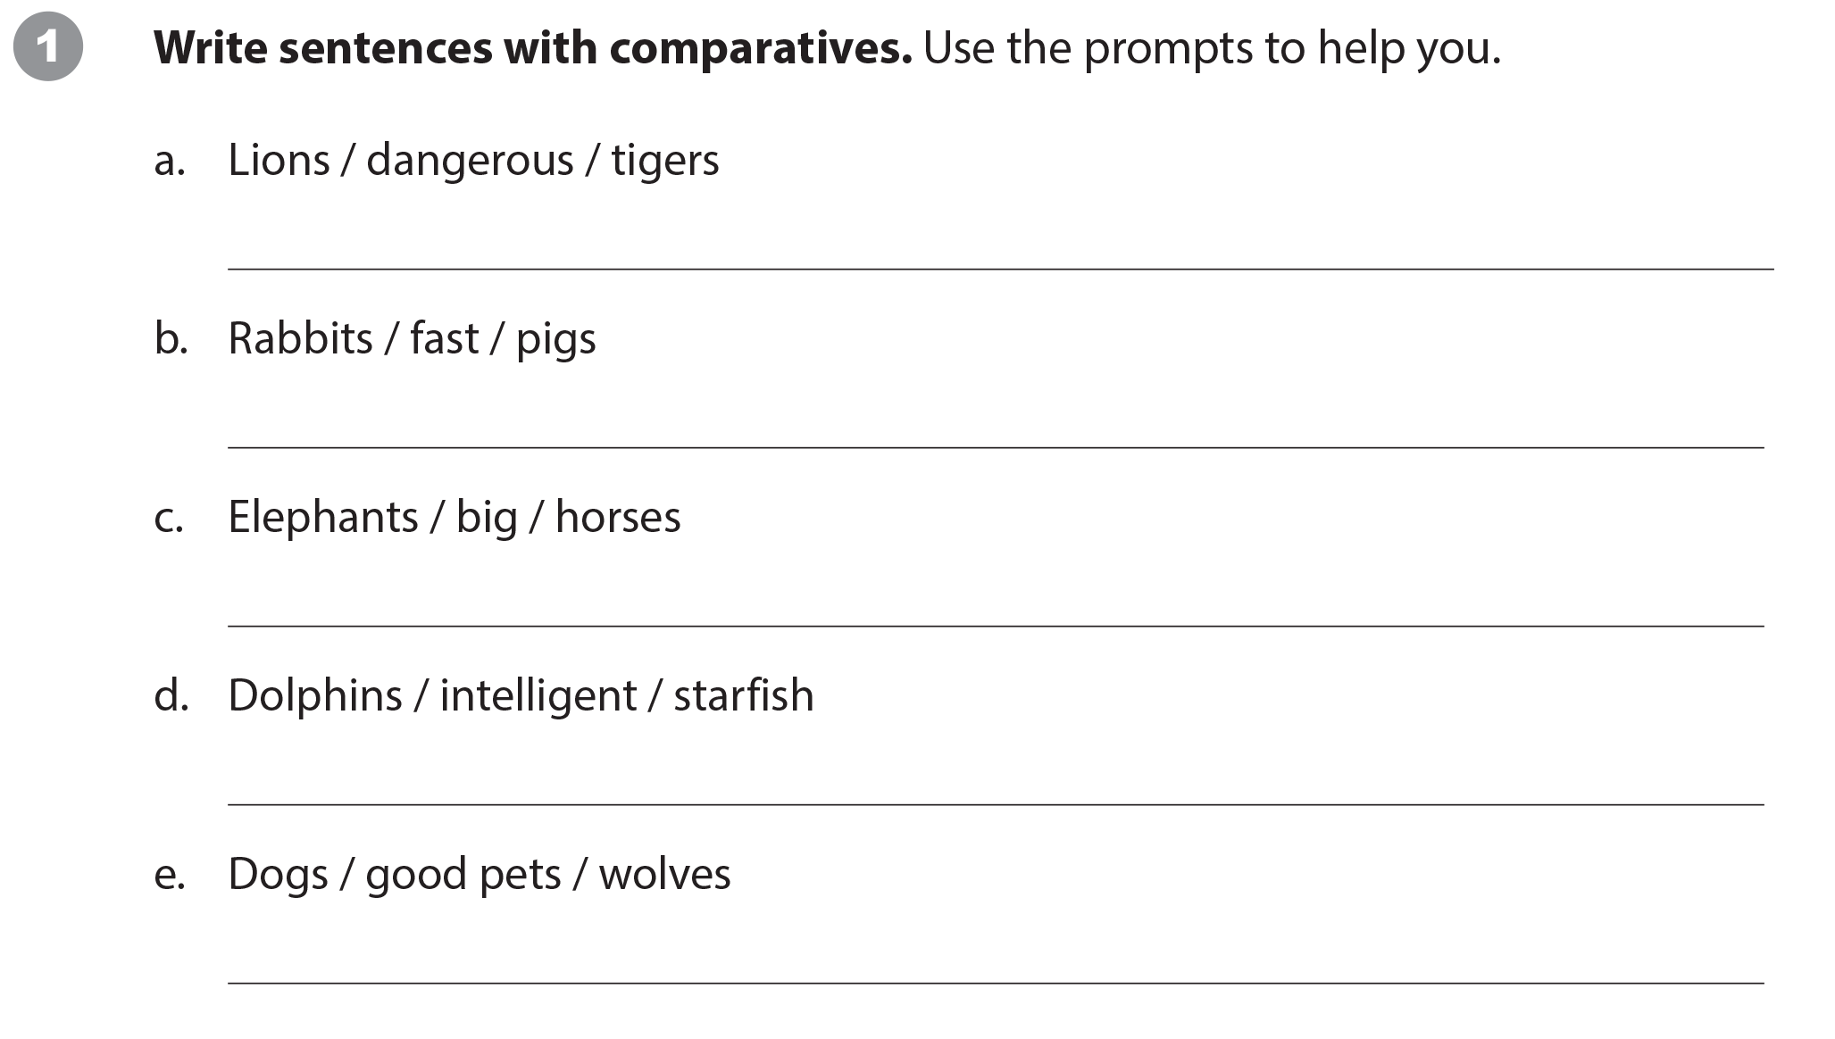
UNIT 5
ARE CATS BETTER PETS THAN DOGS?
WRITING WORKSHEET
Suggested answers:
Lions are as dangerous as tigers.
Rabbits are faster than pigs.
Elephants are bigger than horses.
Dolphins are more intelligent than starfish.
Dogs are better pets than wolves.

Slide 9
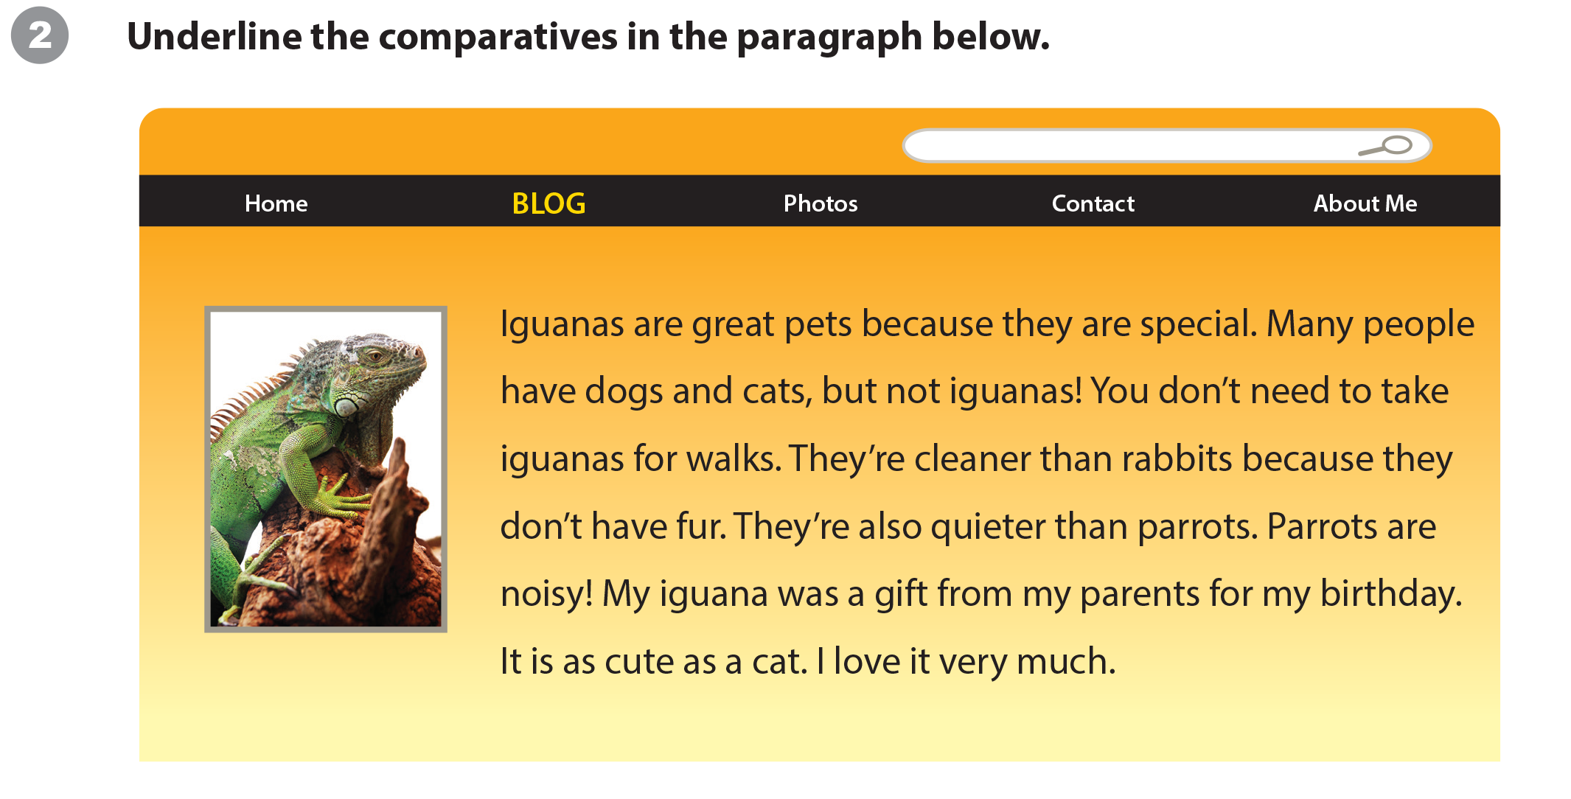
UNIT 5
ARE CATS BETTER PETS THAN DOGS?
WRITING WORKSHEET

Slide 10
UNIT 5
ARE CATS BETTER PETS THAN DOGS?
WRITING WORKSHEET

