Slide 1
TRƯỜNG THCS KHƯƠNG ĐÌNH
UNIT 6: I REALLY LIKE ELECTRONIC MUSIC
LESSON 3: THE REAL WORLD
Tác giả: ĐỒNG THỊ THÚY HƯỜNG

Slide 2
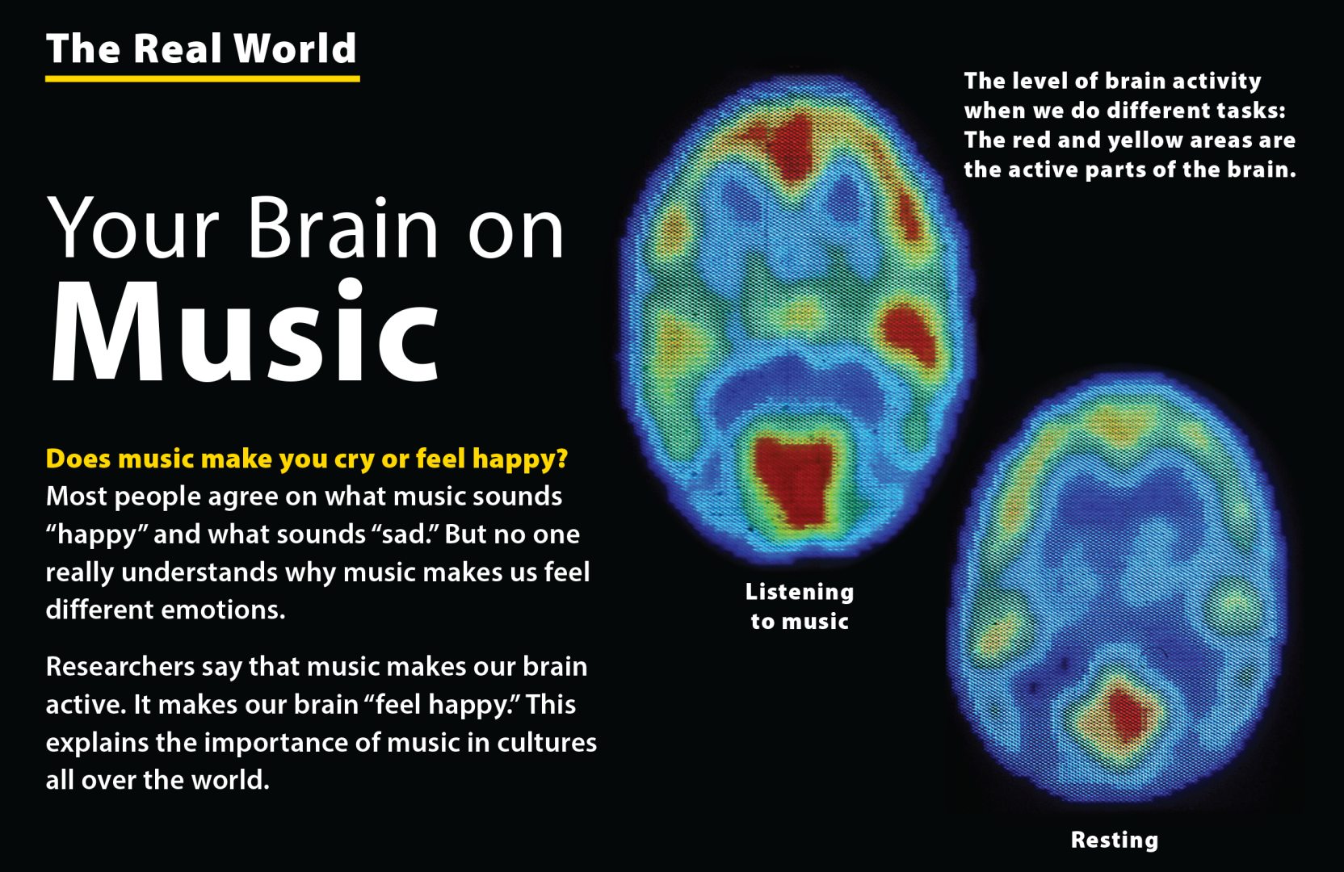
UNIT 6
I REALLY LIKE ELECTRONIC MUSIC!
THE REAL WORLD

Slide 3
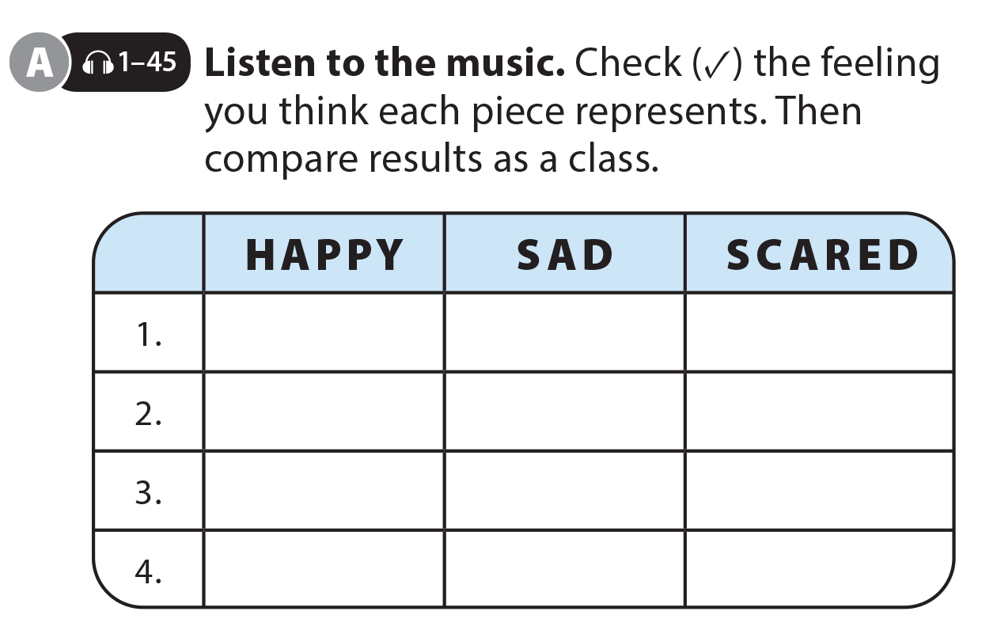
UNIT 6
I REALLY LIKE ELECTRONIC MUSIC!
THE REAL WORLD

Slide 4
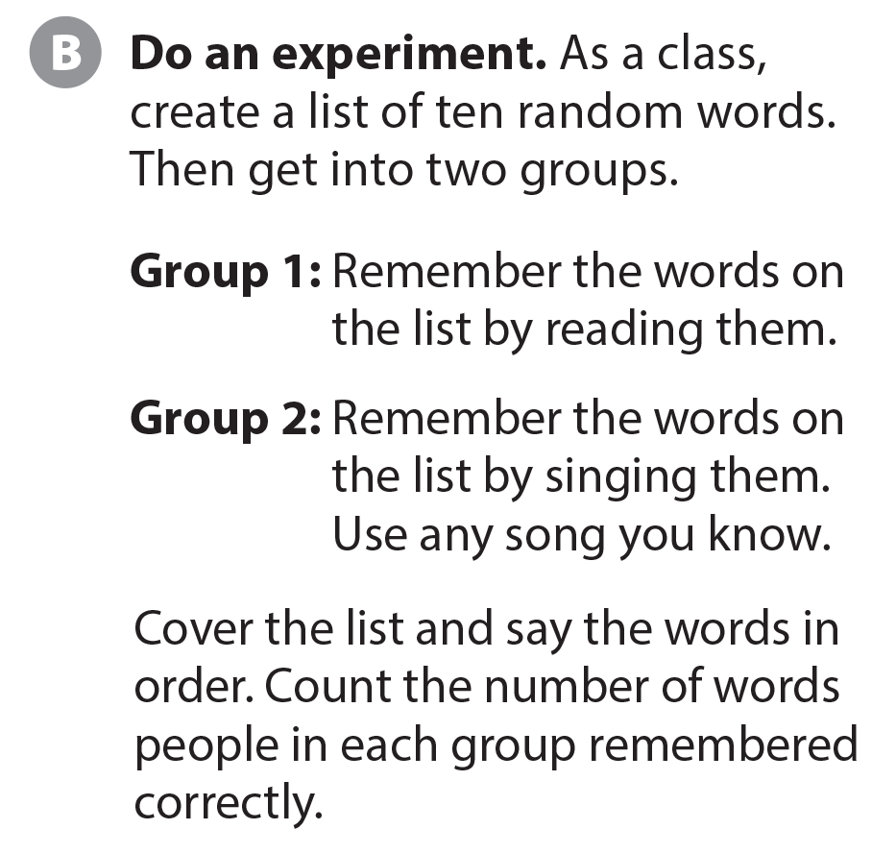
UNIT 6
I REALLY LIKE ELECTRONIC MUSIC!
THE REAL WORLD
National Geographic Learning, a Cengage Company © 2022 Cengage Learning, Inc. ALL RIGHTS RESERVED. This presentation tool is intended for teaching purposes only and may not be scanned, copied, duplicated, or posted to a publicly accessible platform in whole or in part.

Slide 5
UNIT 6
I REALLY LIKE ELECTRONIC MUSIC!
PRONUNCIATION
3
4
3
2
3
3
4
3

Slide 6
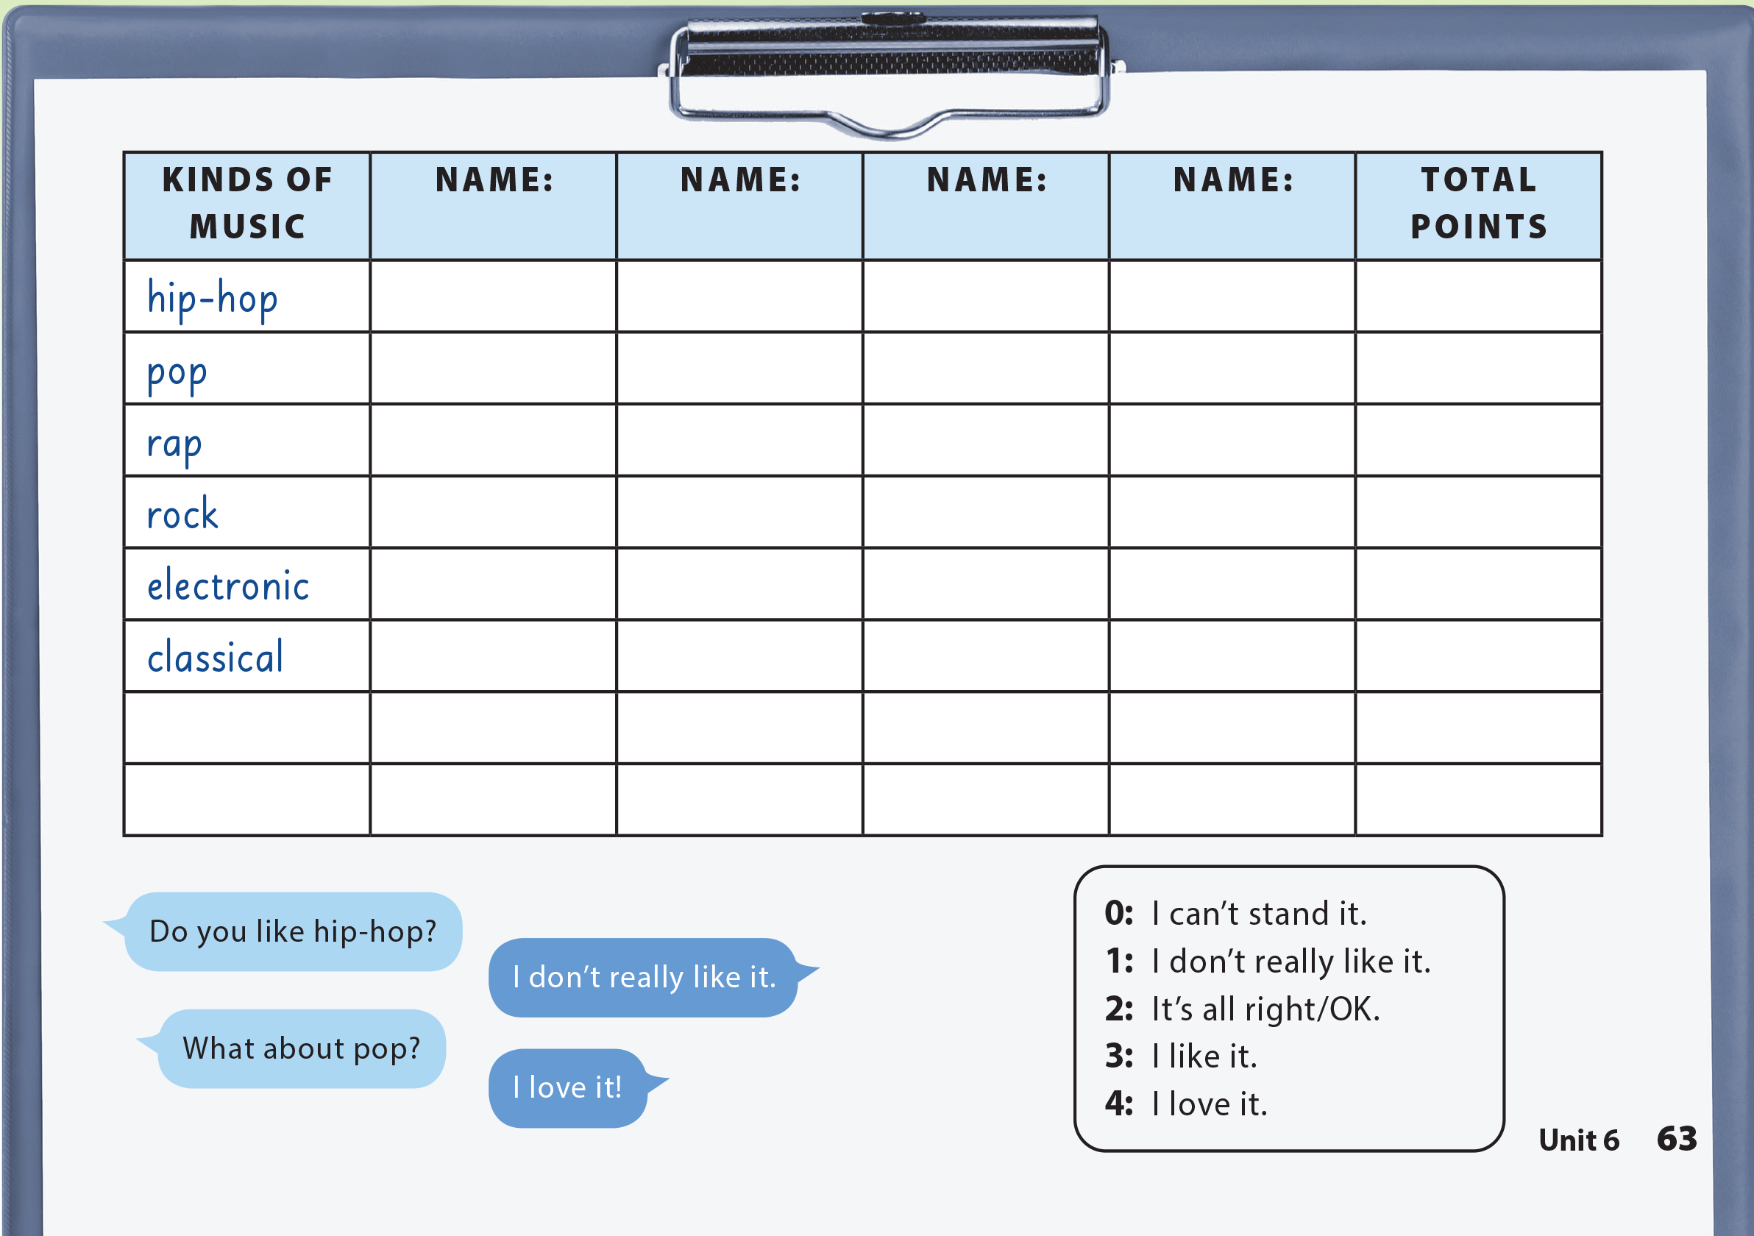
UNIT 6
I REALLY LIKE ELECTRONIC MUSIC!
COMMUNICATION

