Slide 1
TRƯỜNG THCS KHƯƠNG ĐÌNH
UNIT 6: I REALLY LIKE ELECTRONIC MUSIC
LESSON 4: VIDEO
Tác giả: ĐỒNG THỊ THÚY HƯỜNG

Slide 2
UNIT 6
I REALLY LIKE ELECTRONIC MUSIC!
VIDEO

Slide 3
UNIT 6
I REALLY LIKE ELECTRONIC MUSIC!
VIDEO

Slide 4
UNIT 6
I REALLY LIKE ELECTRONIC MUSIC!
VIDEO
culture
invented
created
proud
share

Slide 5
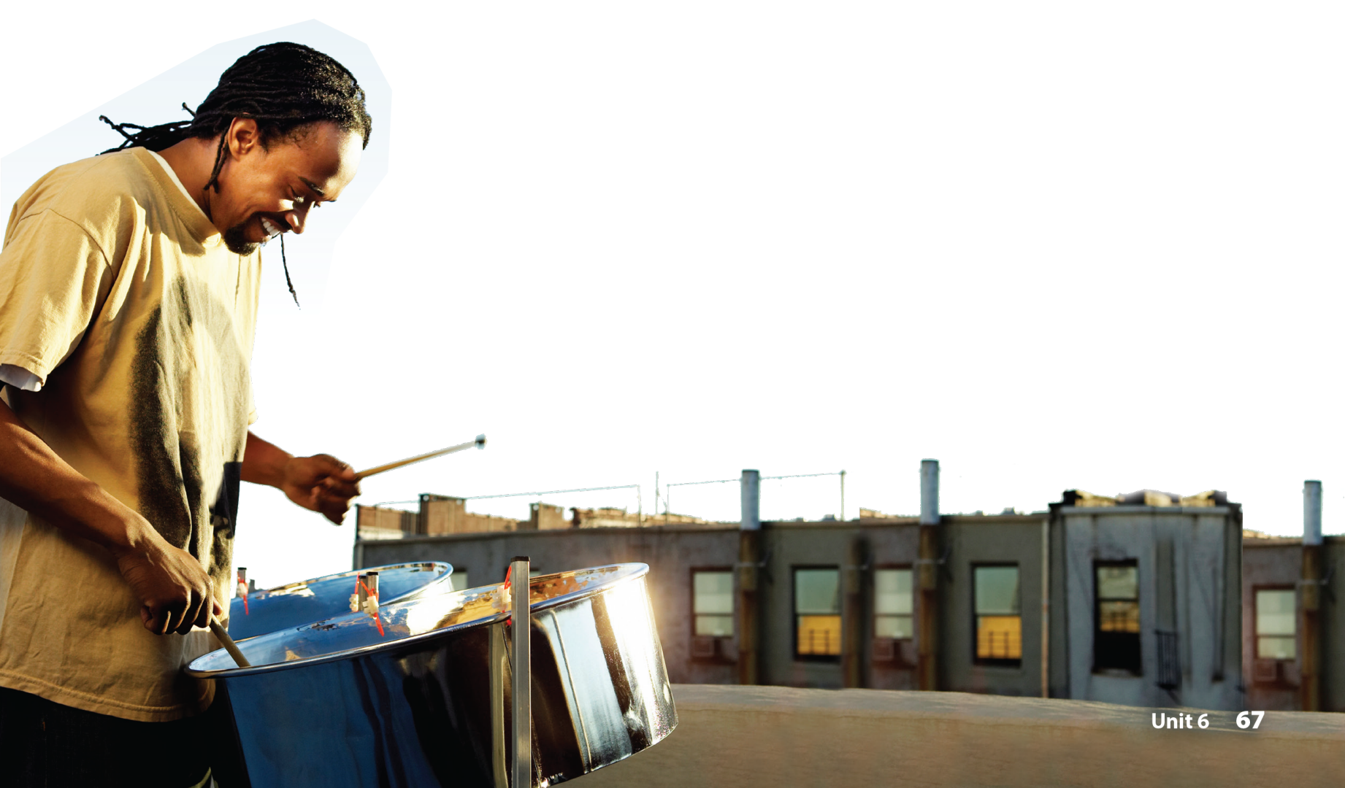
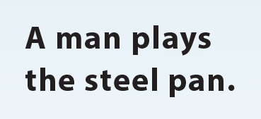
UNIT 6
I REALLY LIKE ELECTRONIC MUSIC!
VIDEO
National Geographic Learning, a Cengage Company © 2022 Cengage Learning, Inc. ALL RIGHTS RESERVED. This presentation tool is intended for teaching purposes only and may not be scanned, copied, duplicated, or posted to a publicly accessible platform in whole or in part.

Slide 6
UNIT 6
I REALLY LIKE ELECTRONIC MUSIC!
Thank you!

