Slide 1
TRƯỜNG THCS KHƯƠNG ĐÌNH
UNIT 10: HOW DO YOU GET TO THE MALL!
LESSON 1
Tác giả: Nguyễn Thảo trà

Slide 2
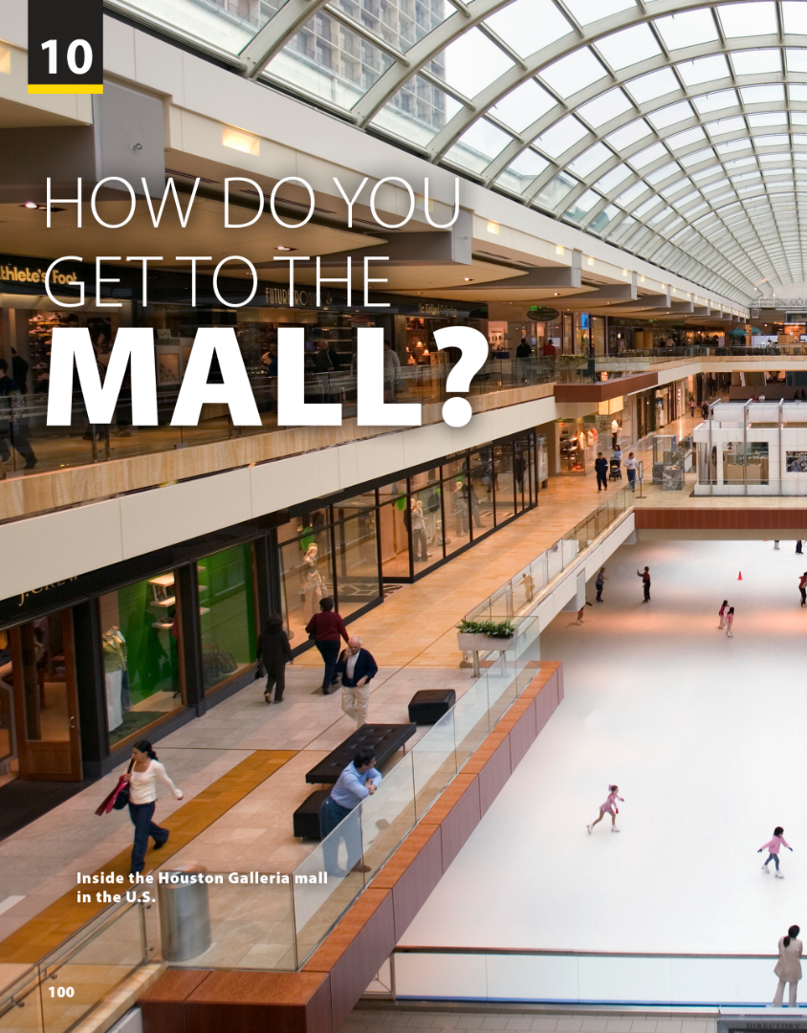
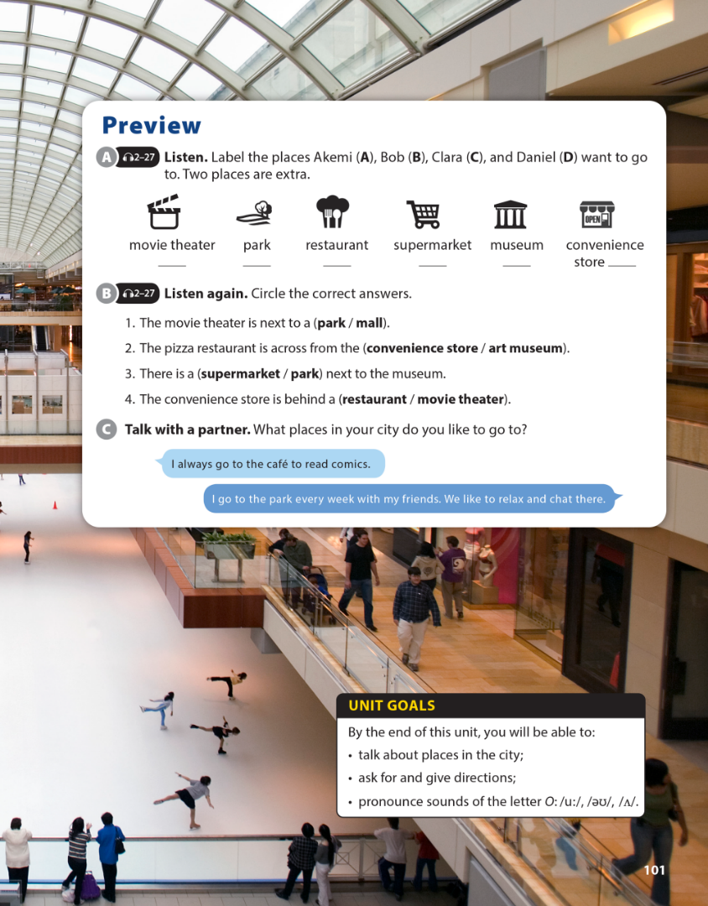
National Geographic Learning, a Cengage Company © 2022 Cengage Learning, Inc. ALL RIGHTS RESERVED. This presentation tool is intended for teaching purposes only and may not be scanned, copied, duplicated, or posted to a publicly accessible platform in whole or in part.

Slide 3
UNIT 10
HOW DO YOU GET TO THE MALL?
PREVIEW
A
B
C
D

Slide 4
UNIT 10
HOW DO YOU GET TO THE MALL?
PREVIEW

Slide 5
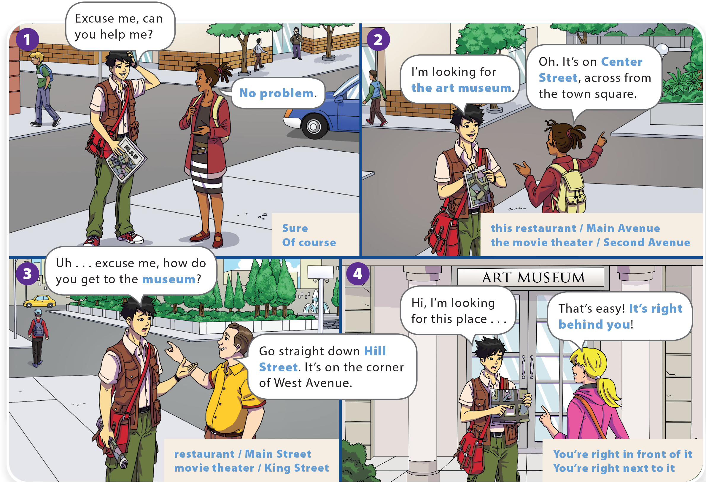
YOU SHOULD SEE A DOCTOR!
HOW DO YOU GET TO THE MALL?
UNIT 10
WHAT DO YOU LIKE TO DO?
UNIT 8
LANGUAGE FOCUS
LANGUAGE FOCUS

Slide 6
HOW DO YOU GET TO THE MALL?
UNIT 10
WHAT DO YOU LIKE TO DO?
LANGUAGE FOCUS

Slide 7
UNIT 10
HOW DO YOU GET TO THE MALL?
LANGUAGE FOCUS

Slide 8
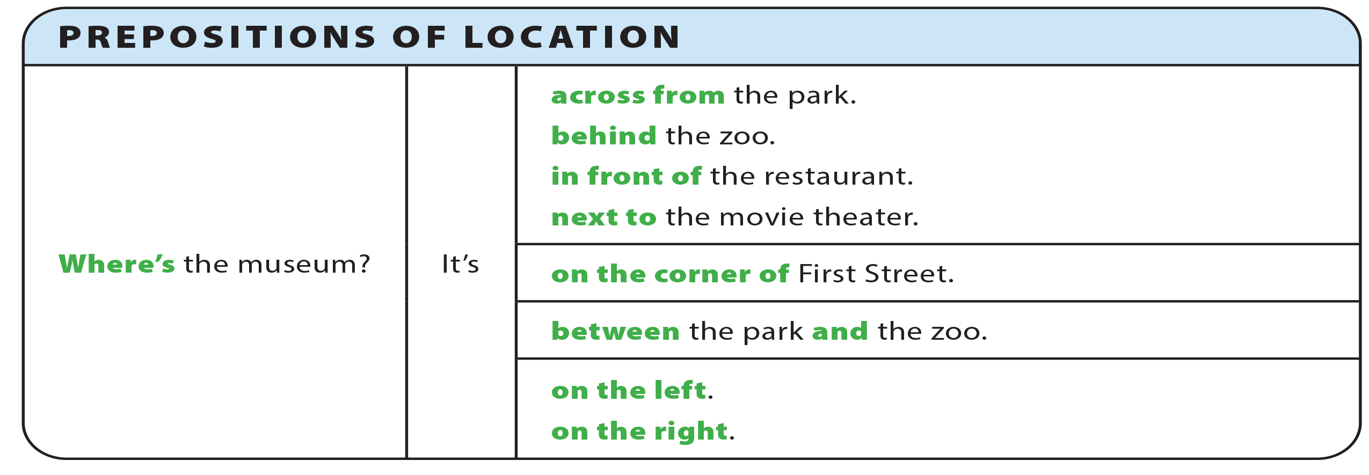
UNIT 10
HOW DO YOU GET TO THE MALL?
GRAMMAR REFERENCE

Slide 9
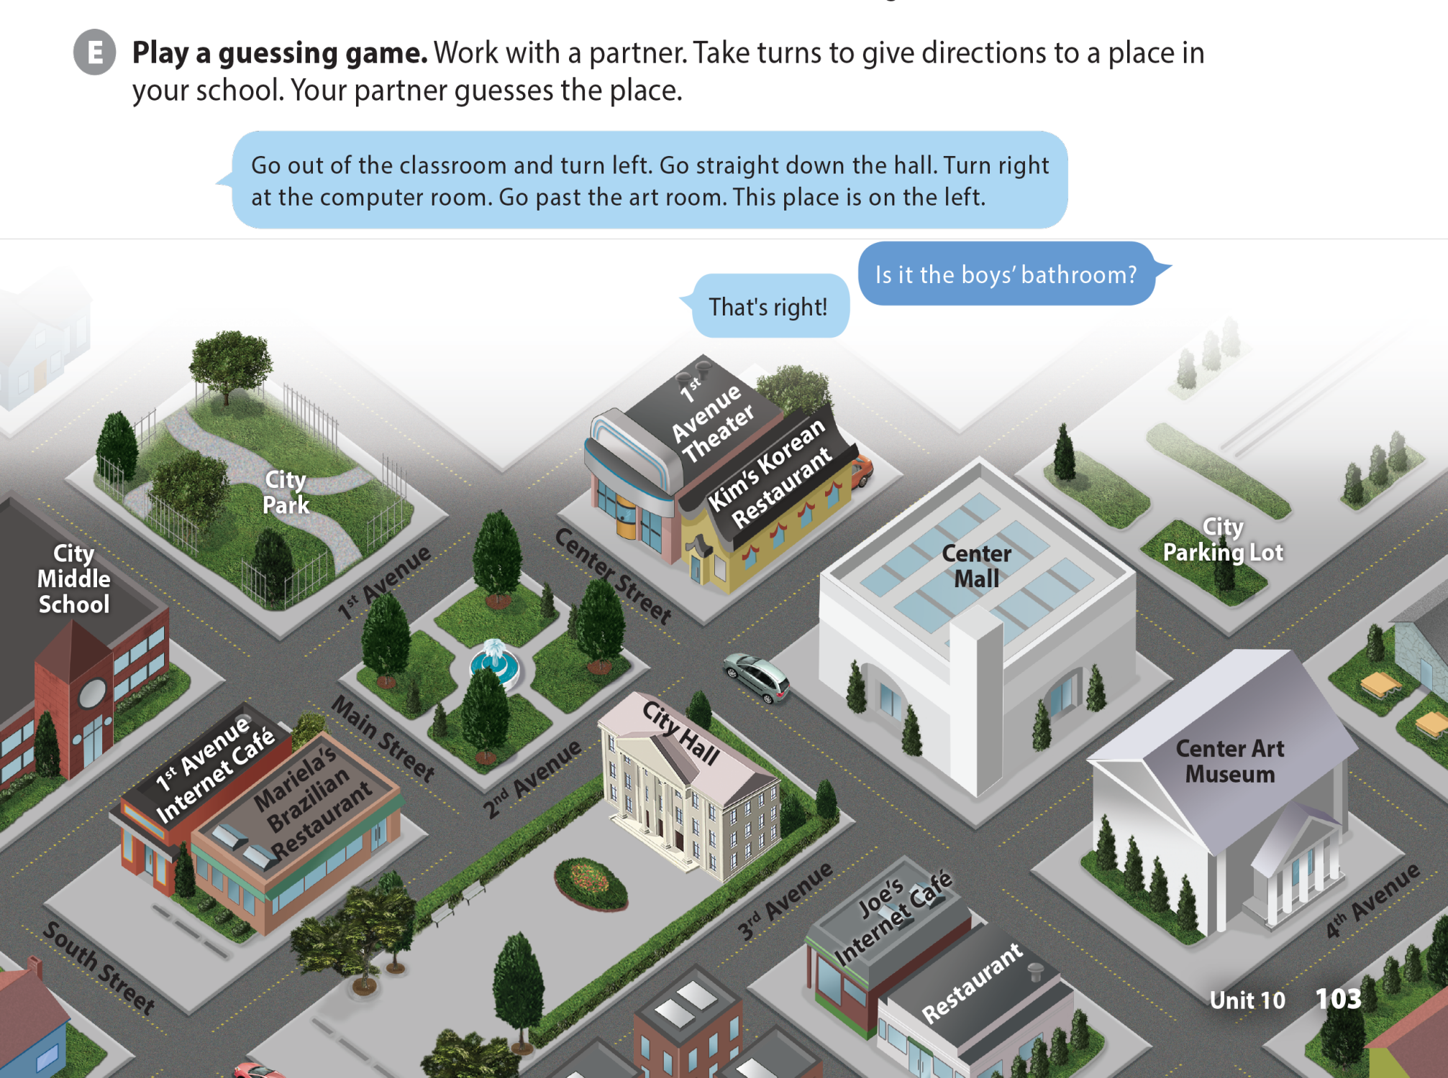
UNIT 10
HOW DO YOU GET TO THE MALL?
LANGUAGE FOCUS

Slide 10
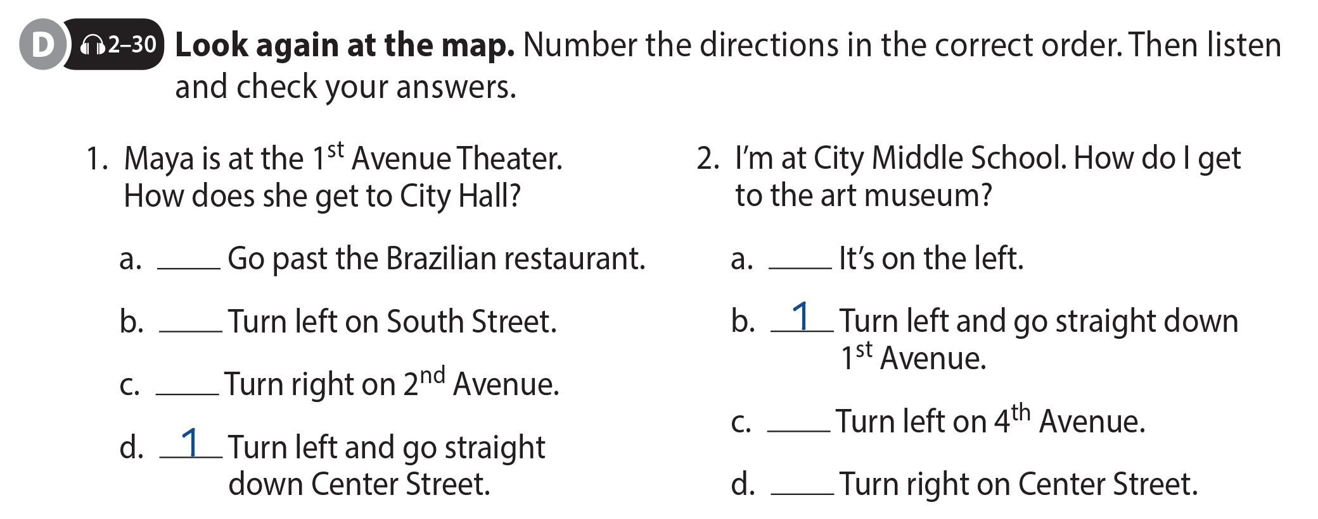
UNIT 10
HOW DO YOU GET TO THE MALL?
LANGUAGE FOCUS
3
4
4
2
3
2

Slide 11
UNIT 10
HOW DO YOU GET TO THE MALL?
LANGUAGE FOCUS

Slide 12
UNIT 10
HOW DO YOU GET TO THE MALL?
THE REAL WORLD

Slide 13
UNIT 10
HOW DO YOU GET TO THE MALL?
THE REAL WORLD

Slide 14
UNIT 10
HOW DO YOU GET TO THE MALL?
THE REAL WORLD
National Geographic Learning, a Cengage Company © 2022 Cengage Learning, Inc. ALL RIGHTS RESERVED. This presentation tool is intended for teaching purposes only and may not be scanned, copied, duplicated, or posted to a publicly accessible platform in whole or in part.

Slide 15
UNIT 10
HOW DO YOU GET TO THE MALL?
PRONUNCIATION
Tony
no
open
oh
come
London
two

Slide 16
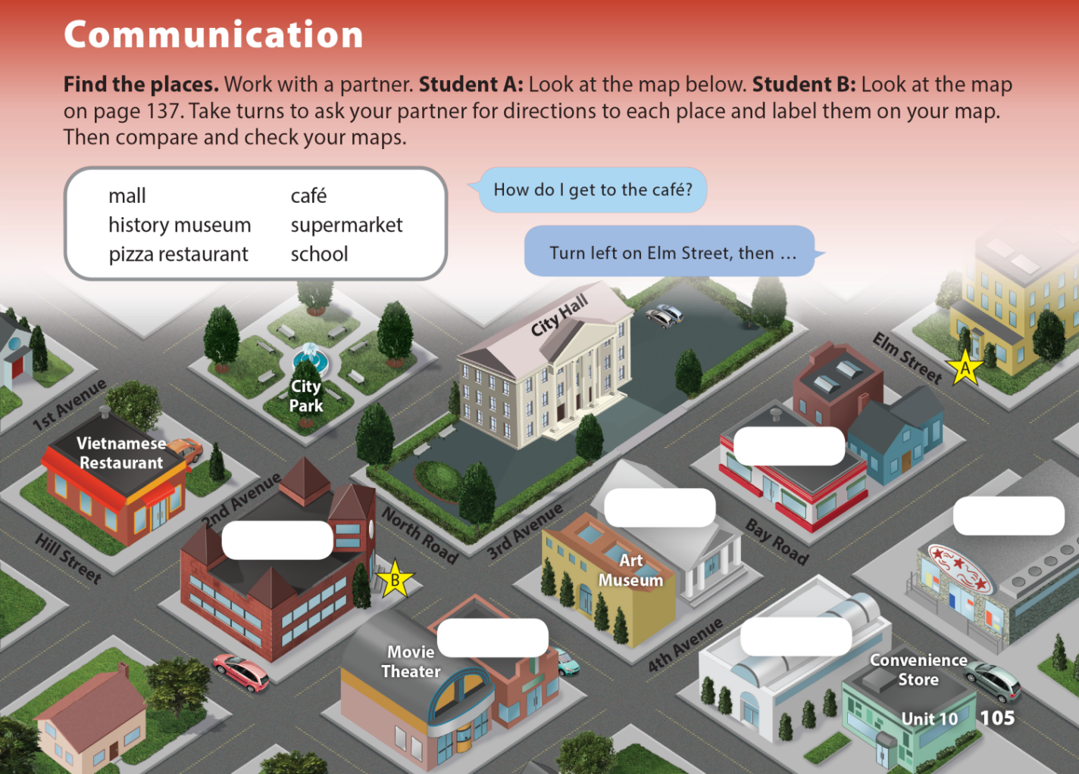
UNIT 10
HOW DO YOU GET TO THE MALL?
COMMUNICATION
Pizza Restaurant
History Museum
Supermarket
School
Café
Mall

Slide 17
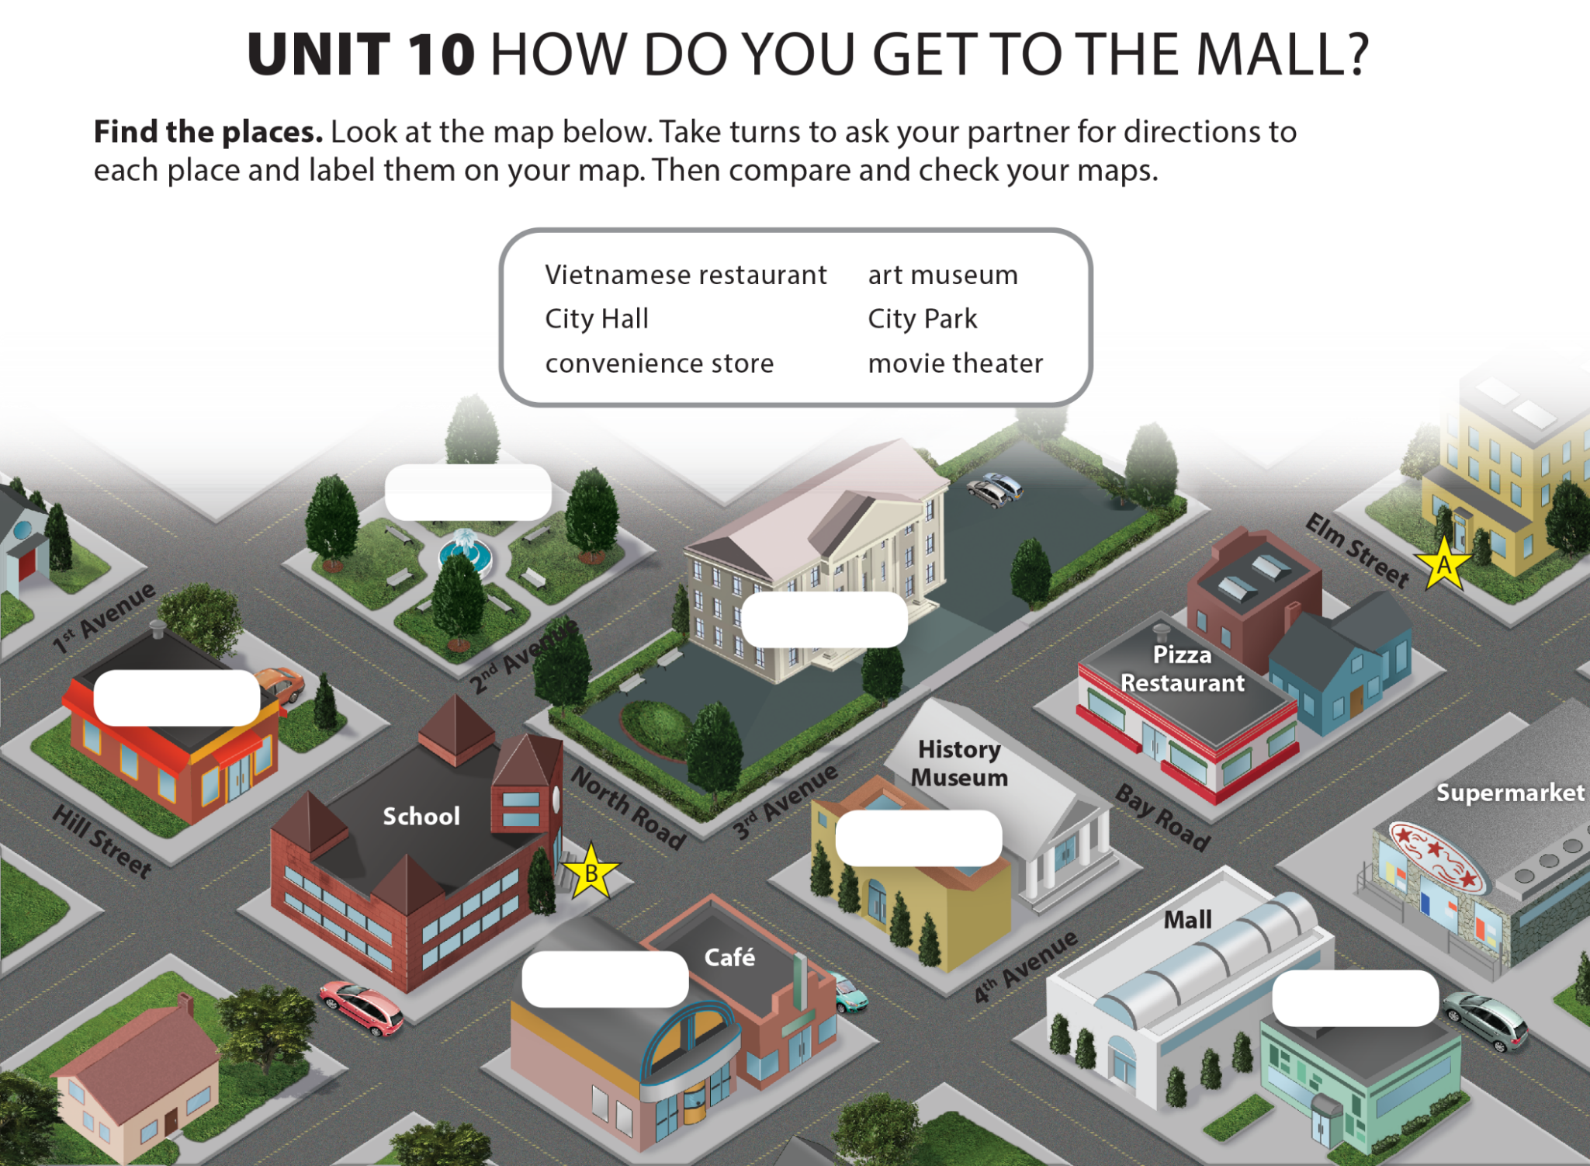
UNIT 10
HOW DO YOU GET TO THE MALL?
COMMUNICATION
City Park
City Hall
Vietnamese Restaurant
Art Museum
Movie Theater
Convenience Store

