Slide 1
TRƯỜNG THCS KHƯƠNG ĐÌNH
UNIT 10: HOW DO YOU GET TO THE MALL!
LESSON 2
Tác giả: Nguyễn Thảo trà

Slide 2
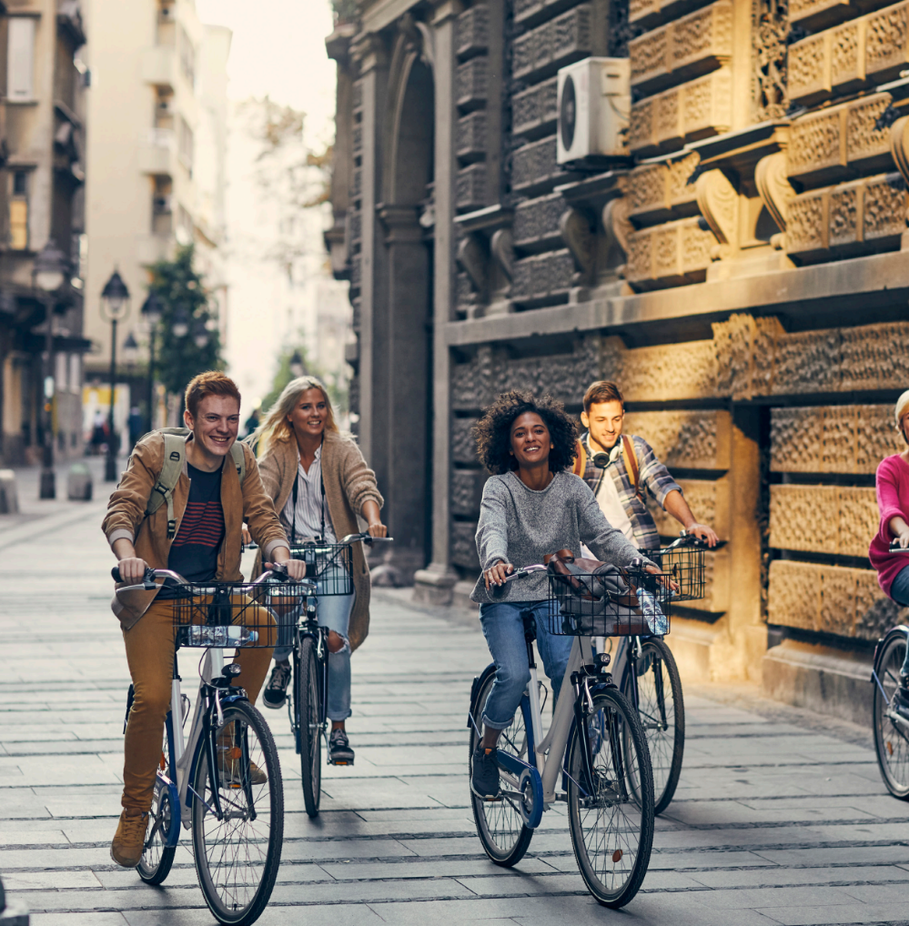
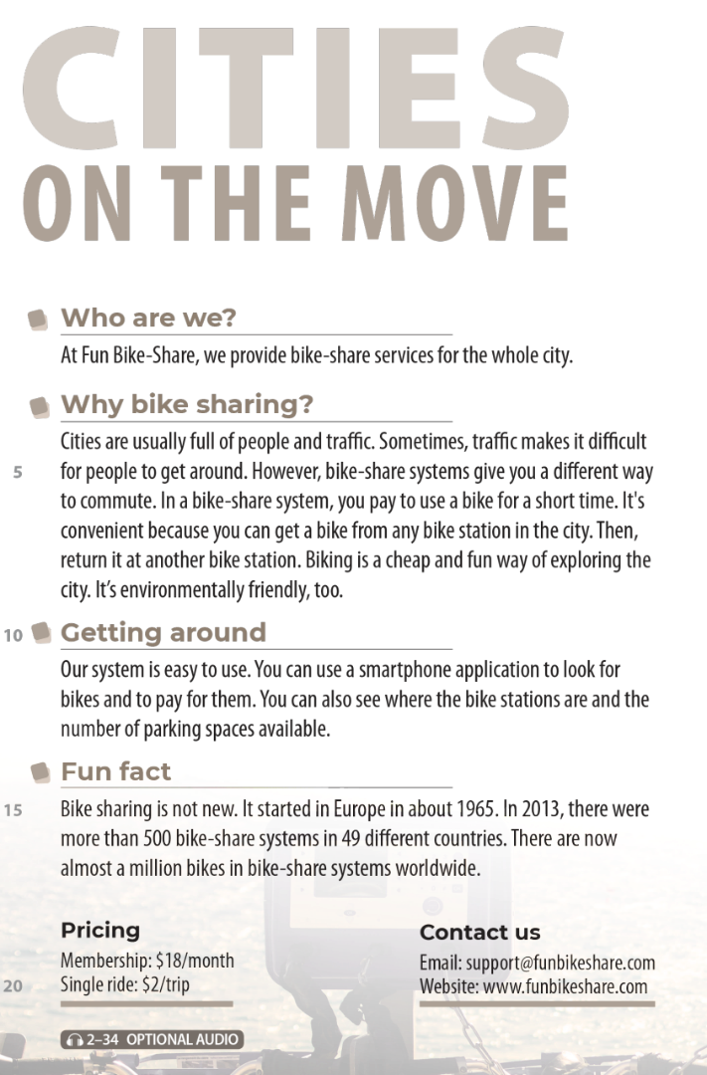
UNIT 10
HOW DO YOU GET TO THE MALL?
READING
National Geographic Learning, a Cengage Company © 2022 Cengage Learning, Inc. ALL RIGHTS RESERVED. This presentation tool is intended for teaching purposes only and may not be scanned, copied, duplicated, or posted to a publicly accessible platform in whole or in part.

Slide 3
UNIT 10
HOW DO YOU GET TO THE MALL?
READING
✓
✓
✓

Slide 4
UNIT 10
HOW DO YOU GET TO THE MALL?
COMPREHENSION

Slide 5
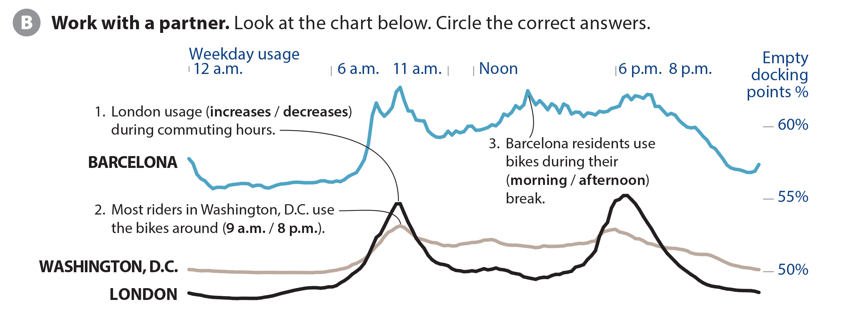
UNIT 10
HOW DO YOU GET TO THE MALL?
COMPREHENSION

Slide 6
UNIT 10
HOW DO YOU GET TO THE MALL?
PROJECT

Slide 7
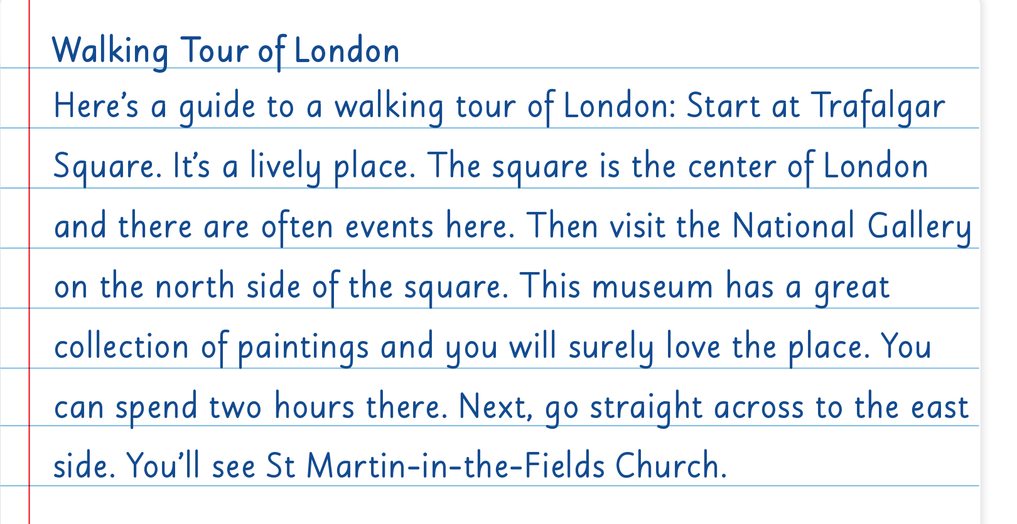
UNIT 10
HOW DO YOU GET TO THE MALL?
WRITING

Slide 8
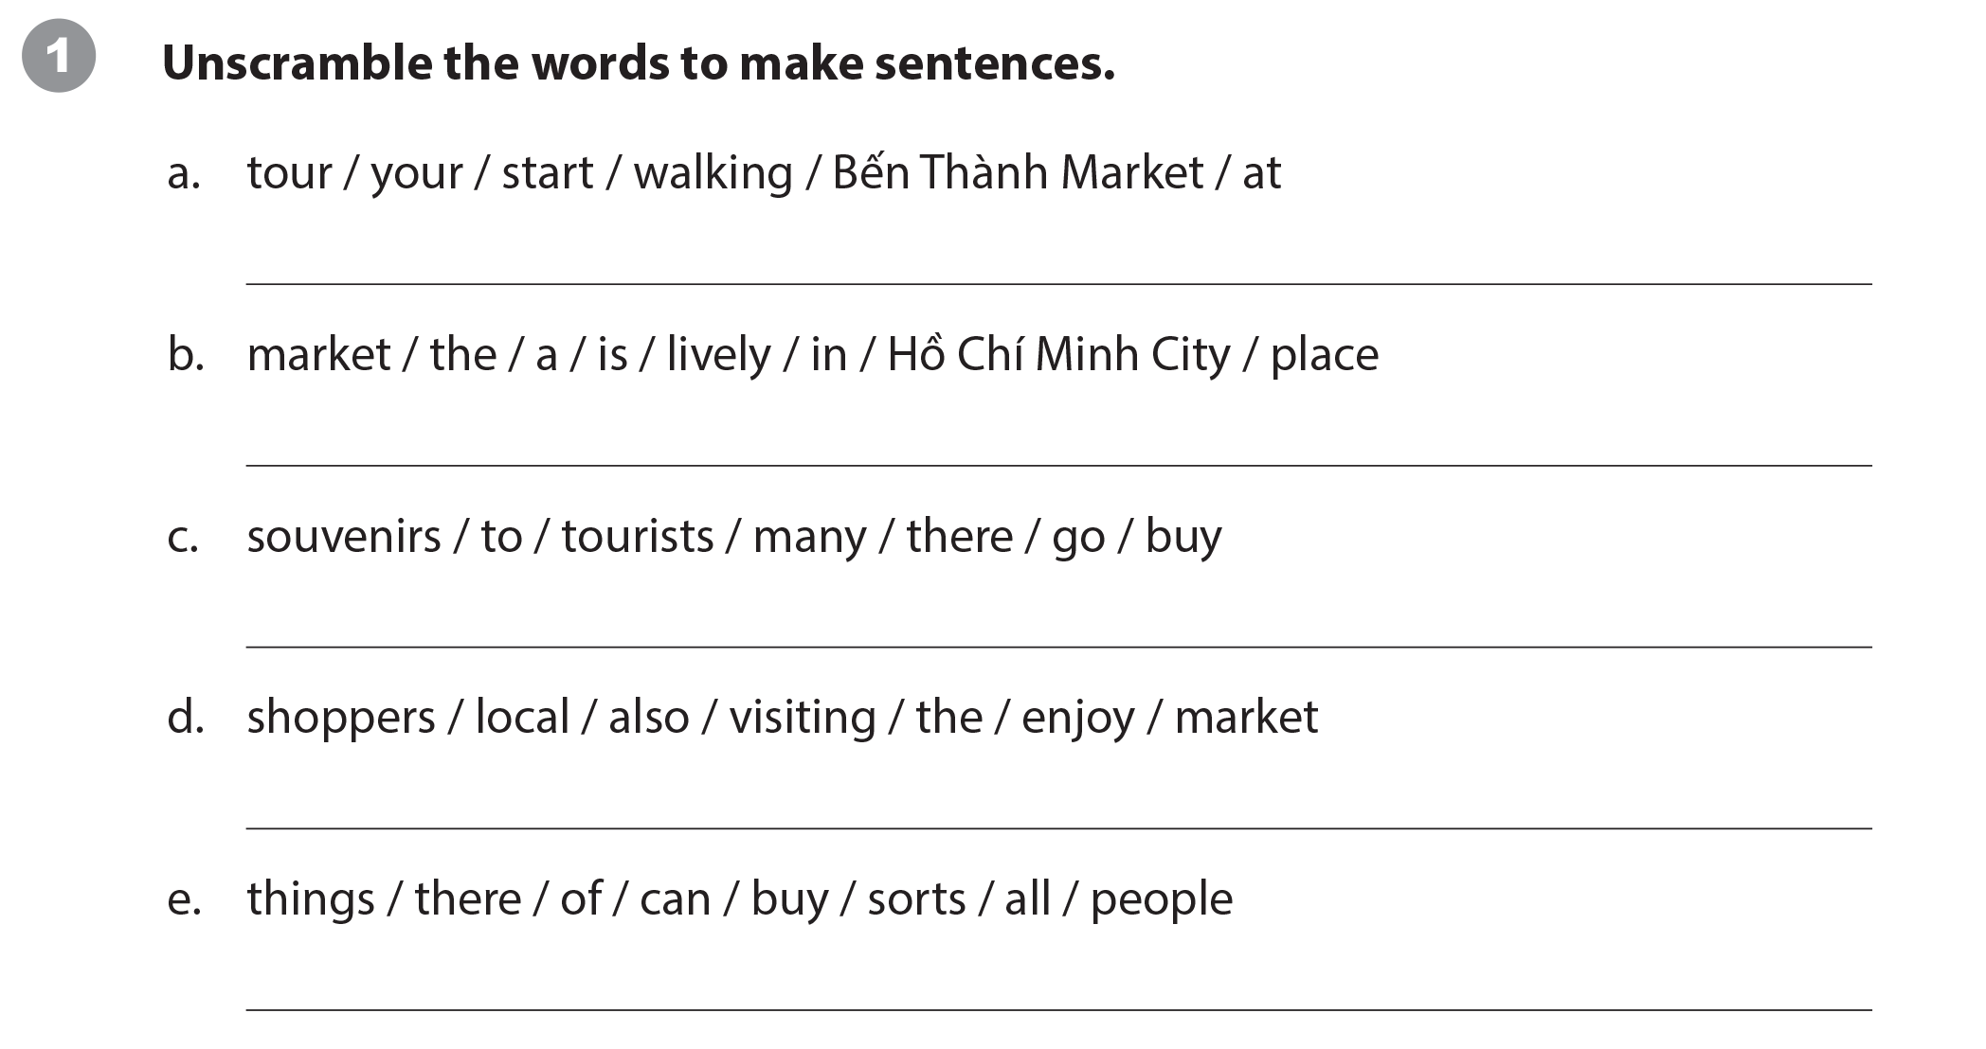
UNIT 10
HOW DO YOU GET TO THE MALL?
WRITING WORKSHEET
Start your walking tour at Bến Thành market.
The market is a lively place in Hồ Chí Minh City. / In Hồ Chí Minh City, the market is a lively place.
Many tourists go there to buy souvenirs.
Local shoppers also enjoy visiting the market.
People can buy all sorts of things there.

Slide 9
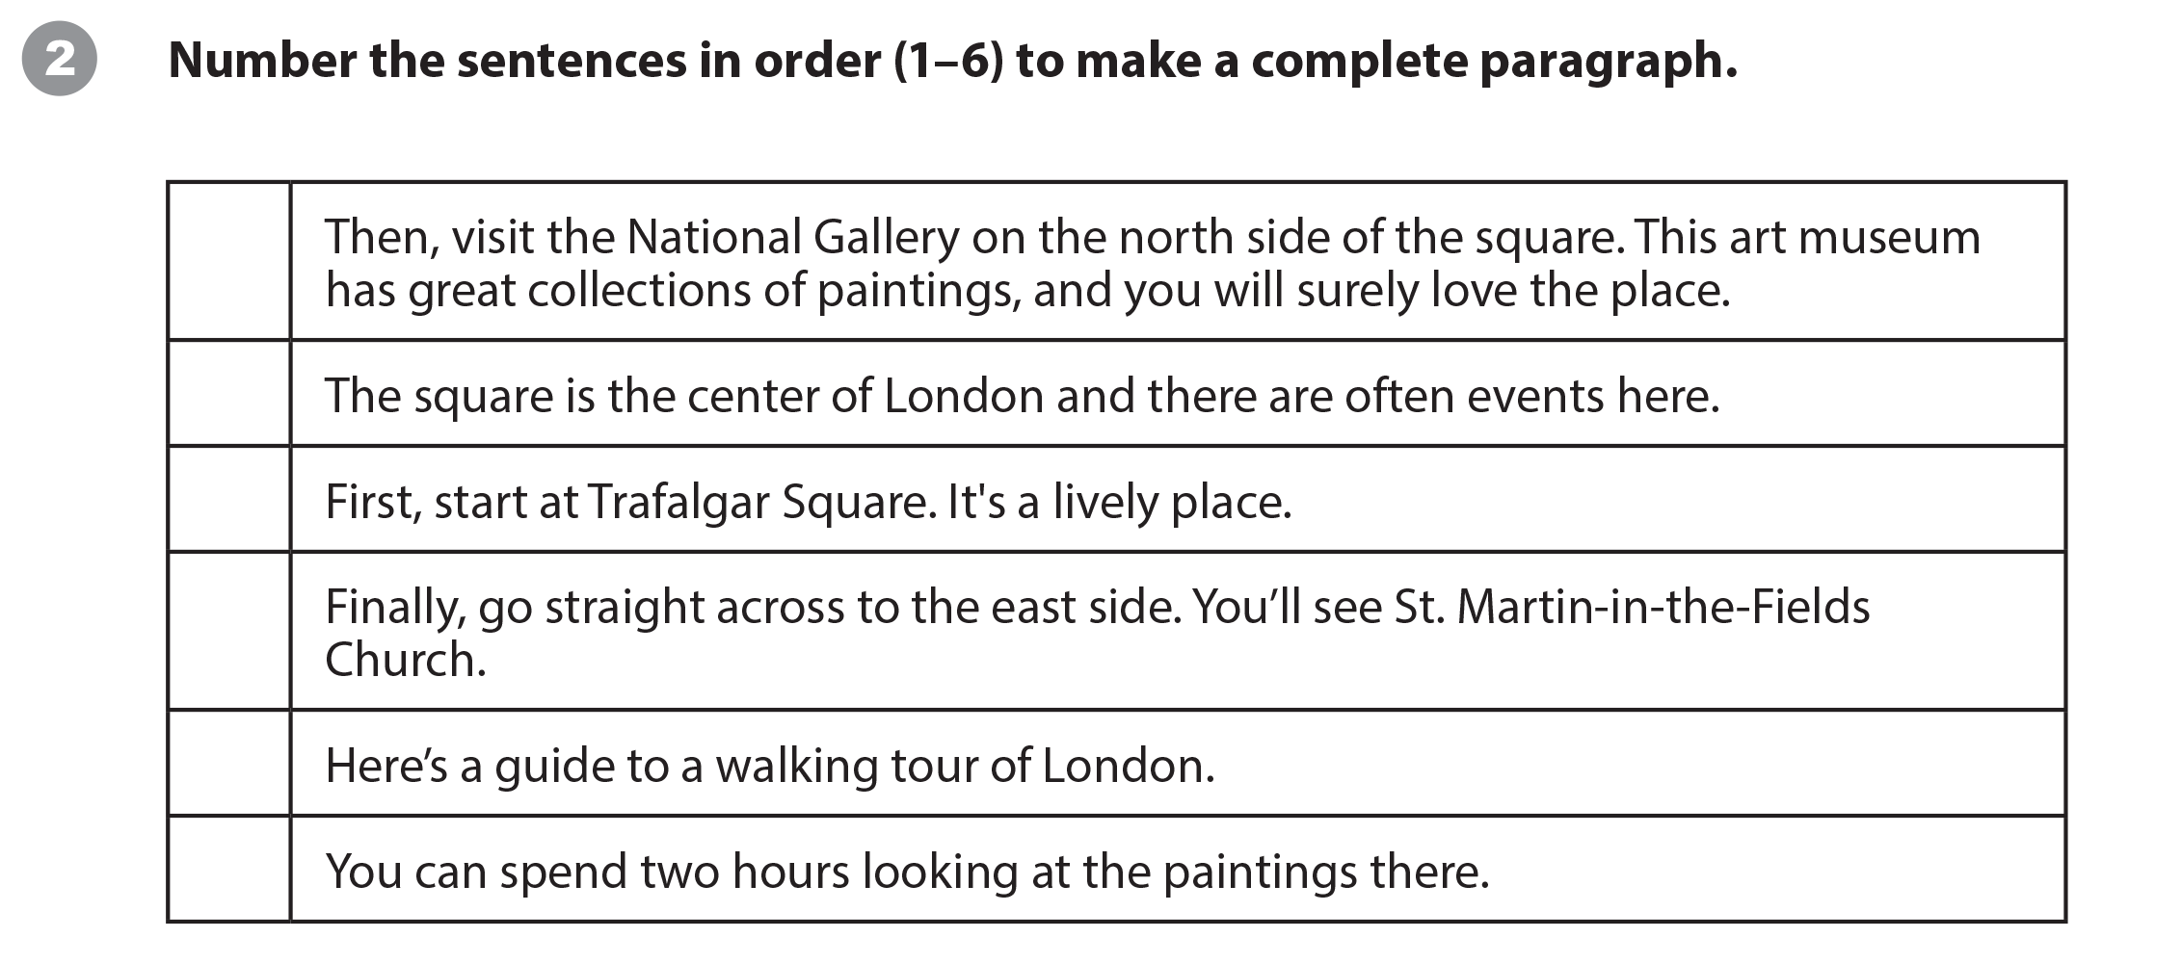
UNIT 10
HOW DO YOU GET TO THE MALL?
WRITING WORKSHEET
4
3
2
6
1
5

Slide 10
UNIT 10
HOW DO YOU GET TO THE MALL?
WRITING WORKSHEET

Slide 11
UNIT 10
HOW DO YOU GET TO THE MALL?
VIDEO

Slide 12
UNIT 10
HOW DO YOU GET TO THE MALL?
VIDEO

Slide 13
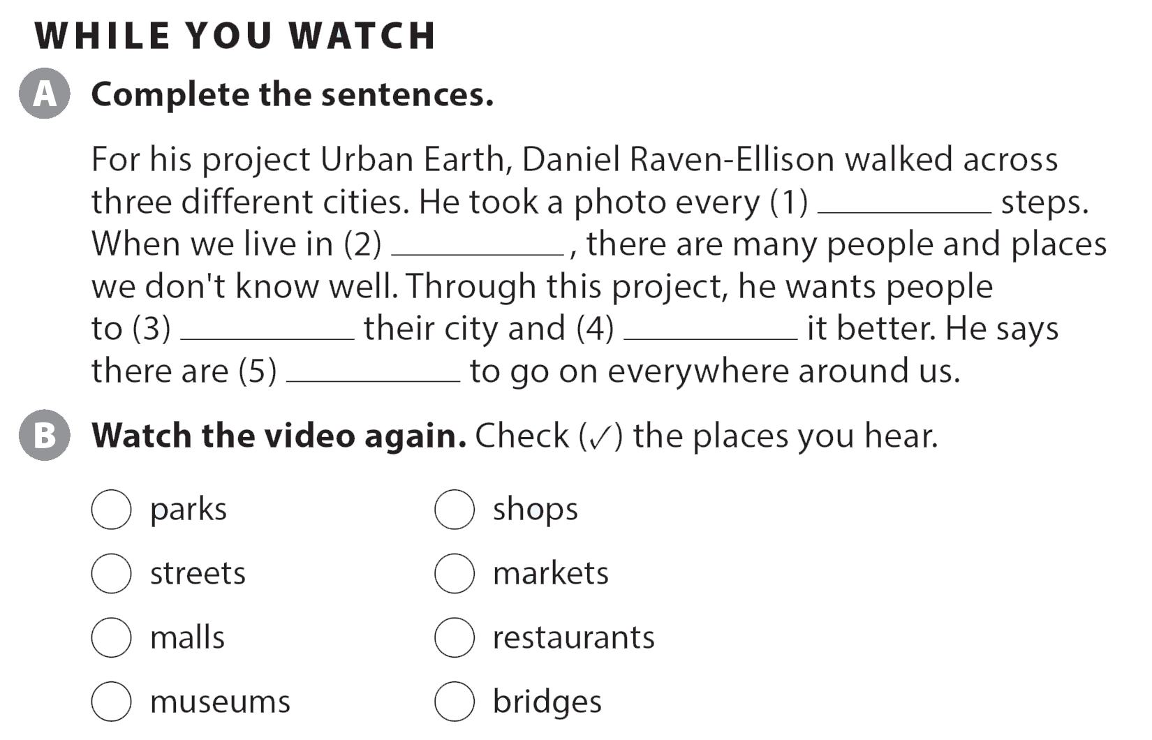
UNIT 10
HOW DO YOU GET TO THE MALL?
VIDEO
eight
a big city
explore
understand
adventures
✓
✓
✓
✓

Slide 14
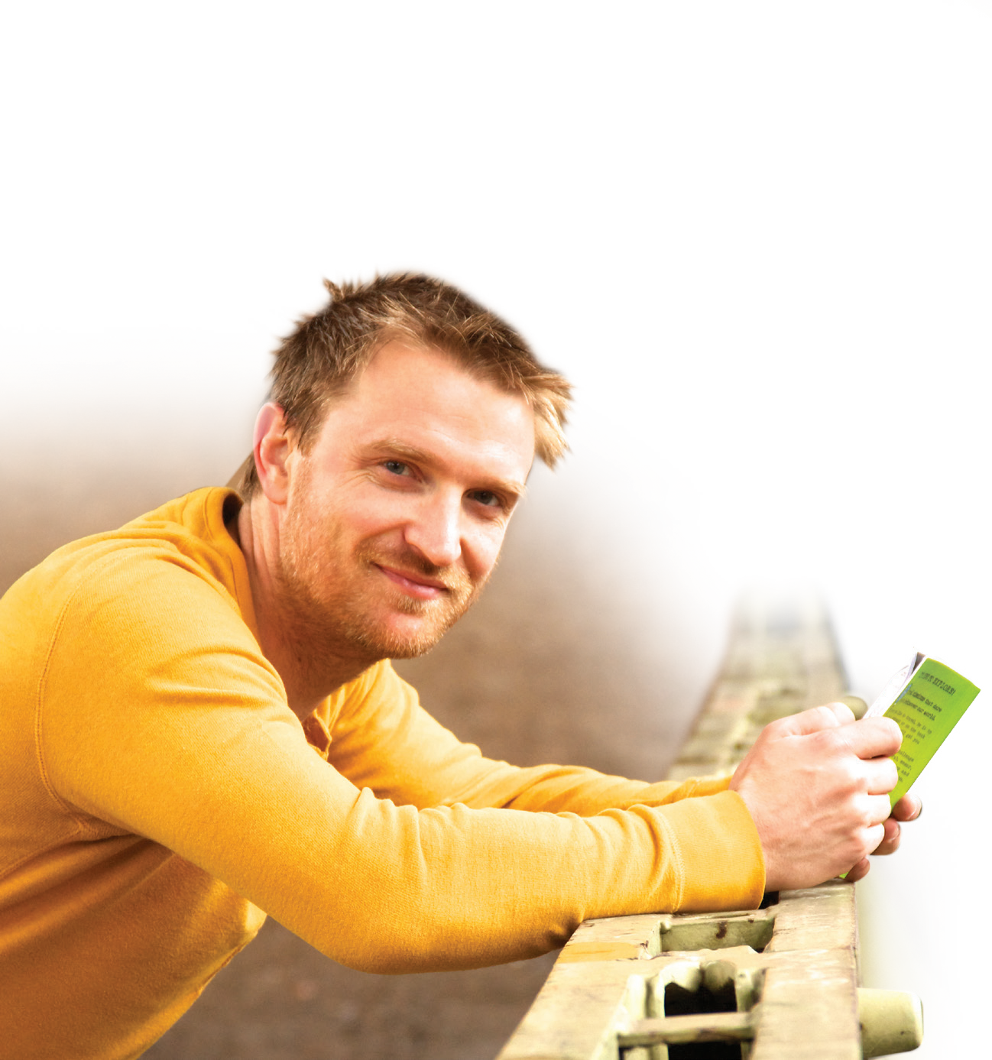
UNIT 10
HOW DO YOU GET TO THE MALL?
VIDEO
Daniel Raven-Ellison

Slide 15
UNIT 10
HOW DO YOU GET TO THE MALL?
Thank you!

