Slide 1
TRƯỜNG THCS KHƯƠNG ĐÌNH
UNIT 11: WHAT ARE YOU DOING?
LESSON 1
Tác giả: Nguyễn Thảo trà

Slide 2
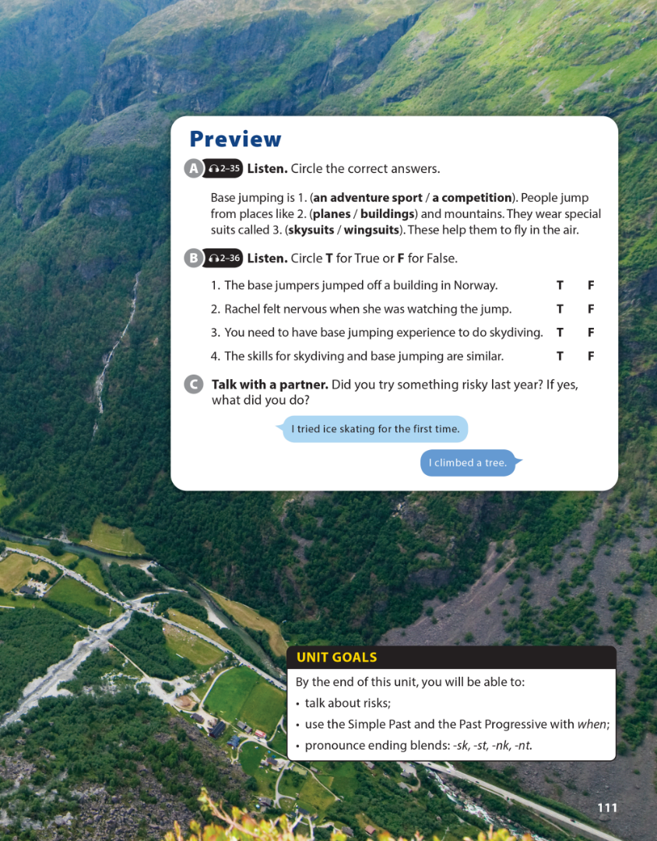
National Geographic Learning, a Cengage Company © 2022 Cengage Learning, Inc. ALL RIGHTS RESERVED. This presentation tool is intended for teaching purposes only and may not be scanned, copied, duplicated, or posted to a publicly accessible platform in whole or in part.

Slide 3
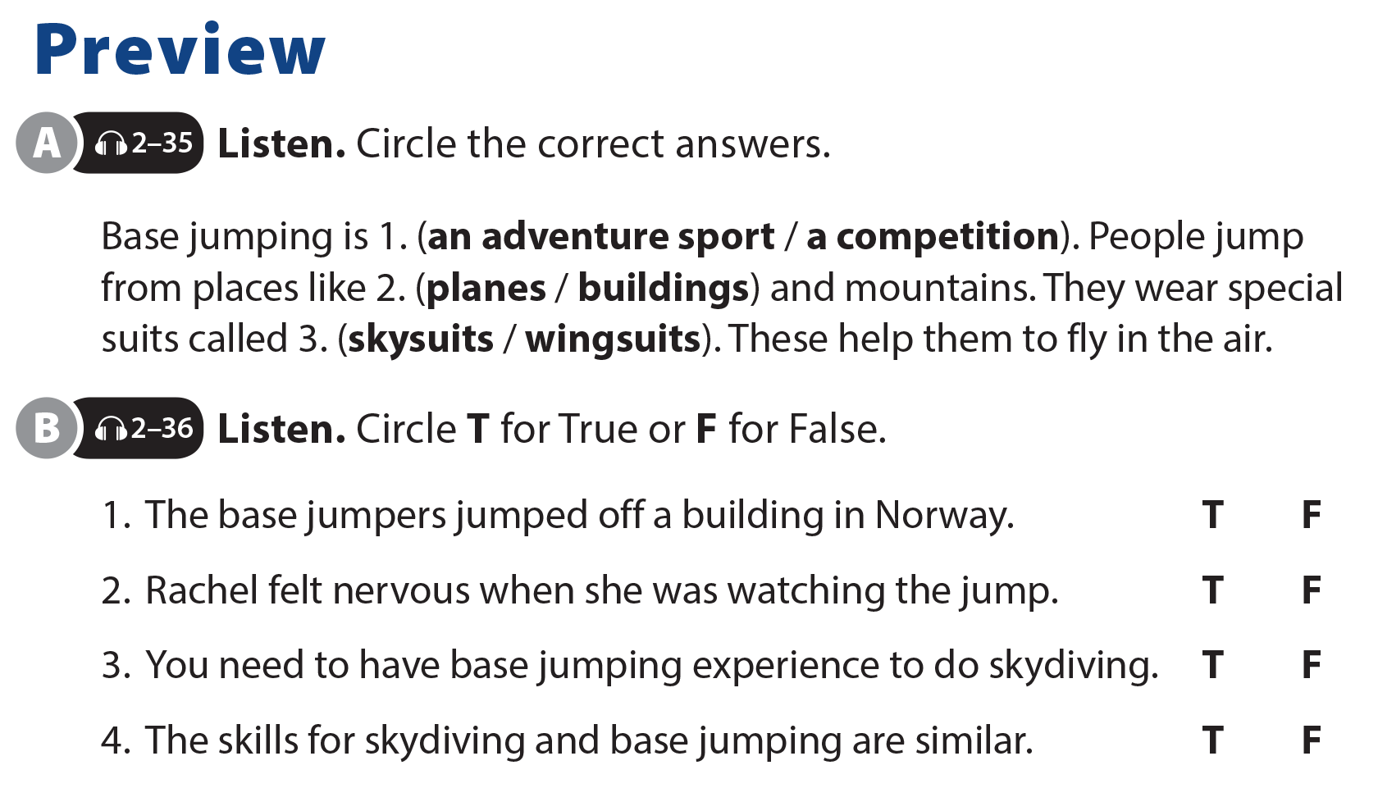
UNIT 11
WHAT WERE YOU DOING?
PREVIEW

Slide 4
UNIT 11
WHAT WERE YOU DOING?
PREVIEW

Slide 5
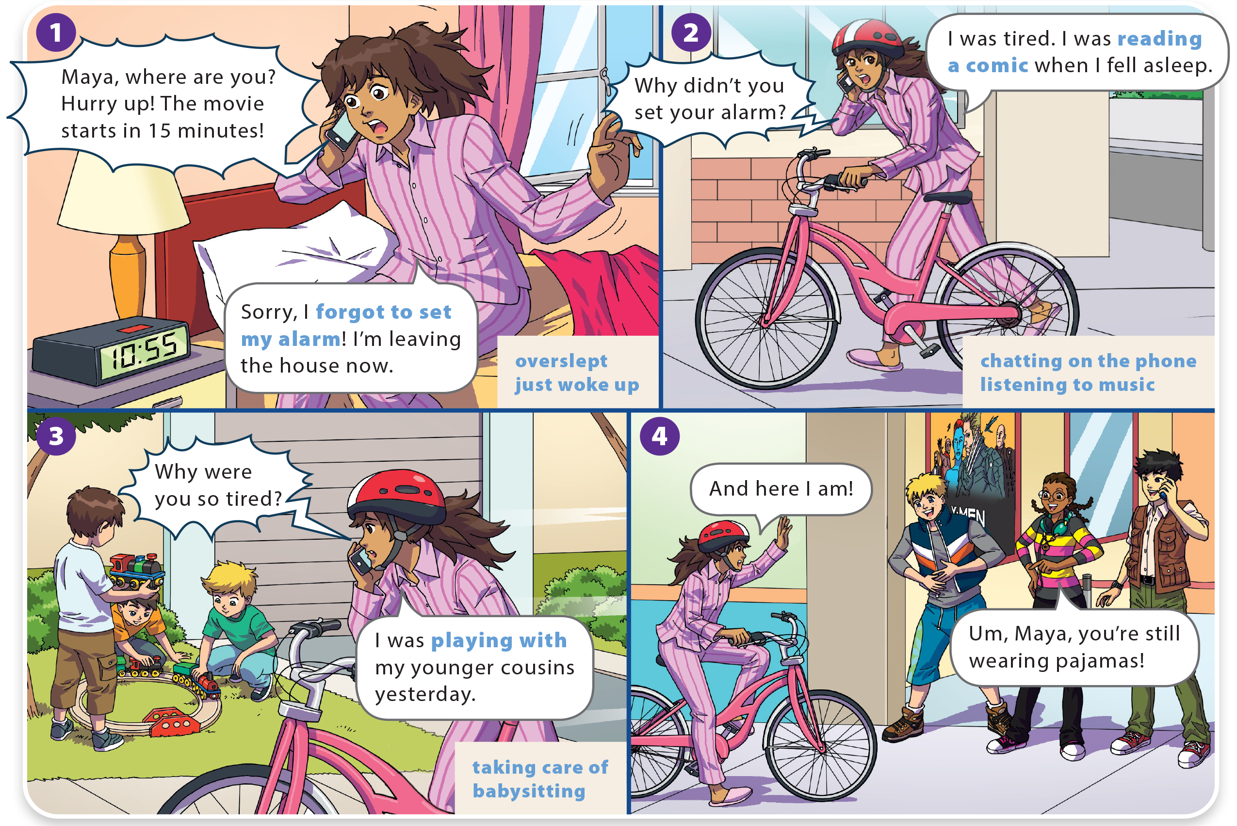
WHAT WERE YOU DOING?
UNIT 11
WHAT DO YOU LIKE TO DO?
LANGUAGE FOCUS

Slide 6
WHAT DO YOU LIKE TO DO?
UNIT 11
WHAT WERE YOU DOING?
LANGUAGE FOCUS

Slide 7
UNIT 11
WHAT WERE YOU DOING?
LANGUAGE FOCUS

Slide 8
UNIT 11
WHAT WERE YOU DOING?
GRAMMAR REFERENCE

Slide 9
UNIT 11
WHAT WERE YOU DOING?
LANGUAGE FOCUS

Slide 10
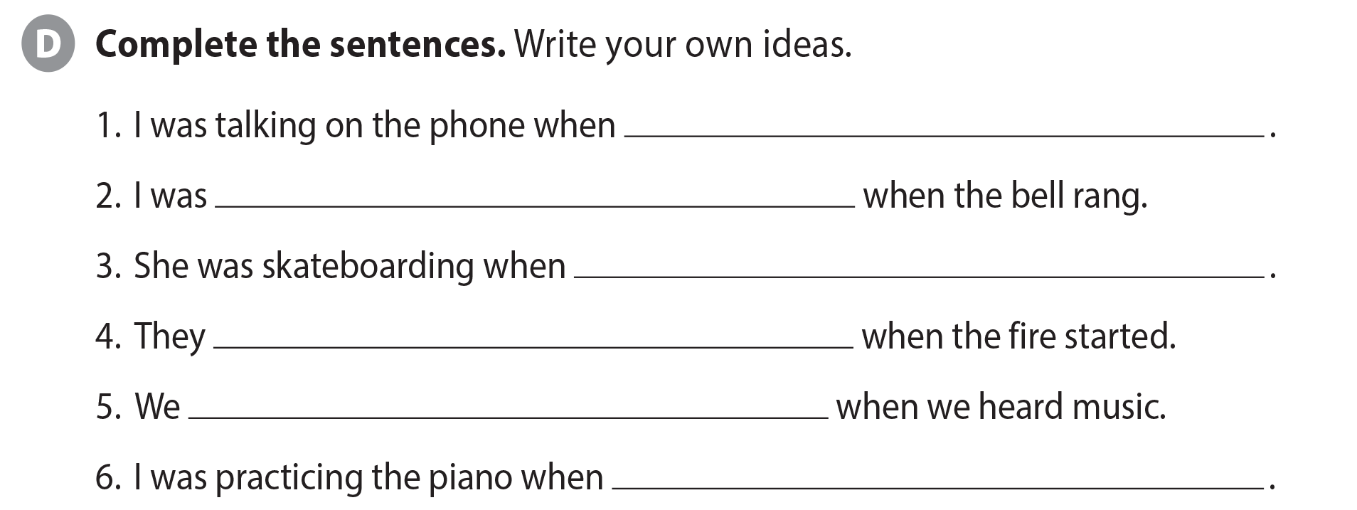
UNIT 11
WHAT WERE YOU DOING?
LANGUAGE FOCUS

Slide 11
UNIT 11
WHAT WERE YOU DOING?
LANGUAGE FOCUS

Slide 12
UNIT 11
WHAT WERE YOU DOING?
THE REAL WORLD

Slide 13
UNIT 11
WHAT WERE YOU DOING?
THE REAL WORLD

Slide 14
UNIT 11
WHAT WERE YOU DOING?
THE REAL WORLD
dark
swimming
had to look
touch
National Geographic Learning, a Cengage Company © 2022 Cengage Learning, Inc. ALL RIGHTS RESERVED. This presentation tool is intended for teaching purposes only and may not be scanned, copied, duplicated, or posted to a publicly accessible platform in whole or in part.

Slide 15
UNIT 11
WHAT WERE YOU DOING?
PRONUNCIATION

Slide 16
UNIT 11
WHAT WERE YOU DOING?
COMMUNICATION

