Slide 1
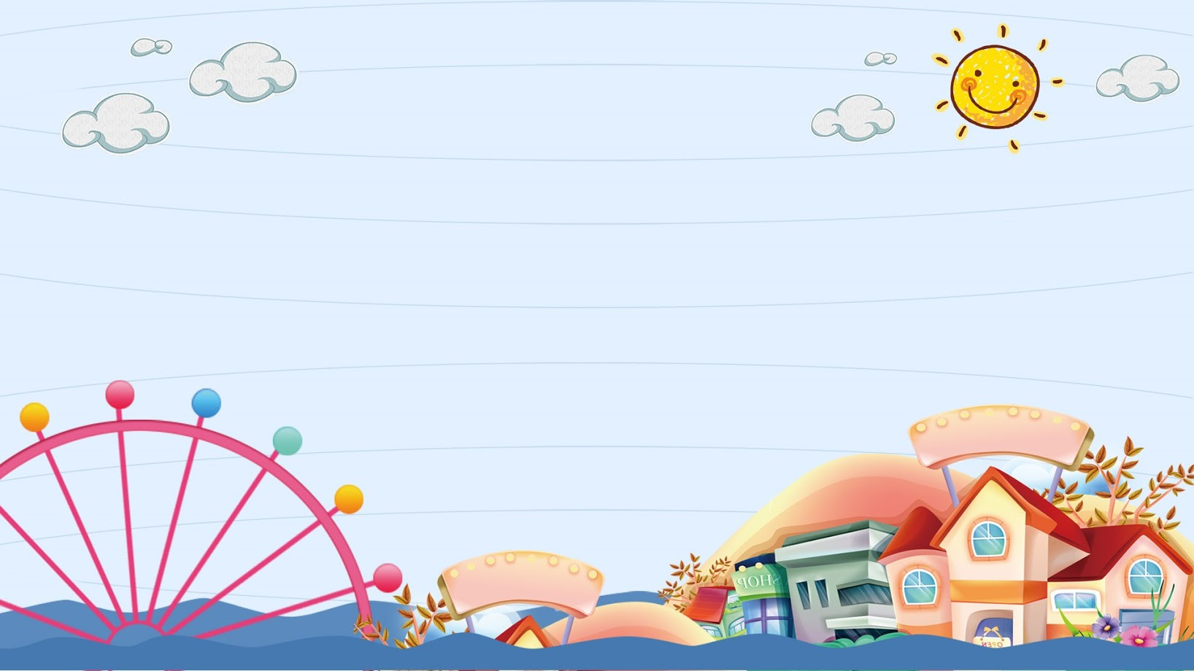
TRƯỜNG THCS KHƯƠNG ĐÌNH
UNIT 11: WHAT ARE YOU DOING?
LESSON 2
Tác giả: Nguyễn Thảo trà

Slide 2
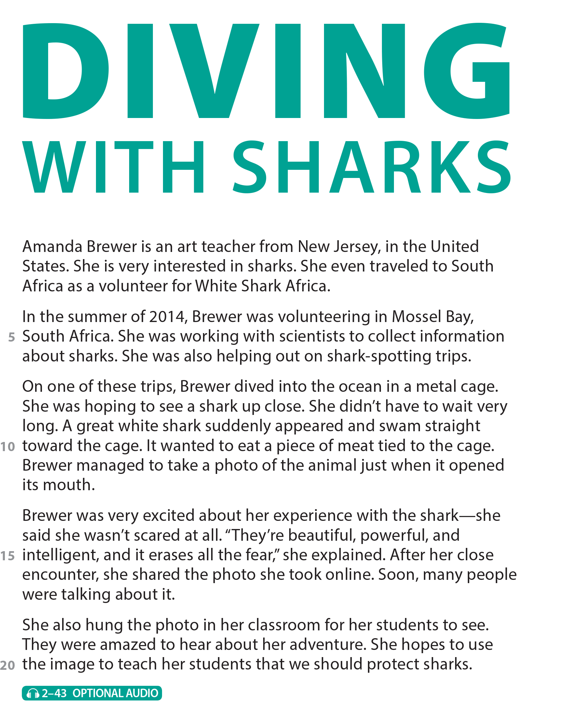
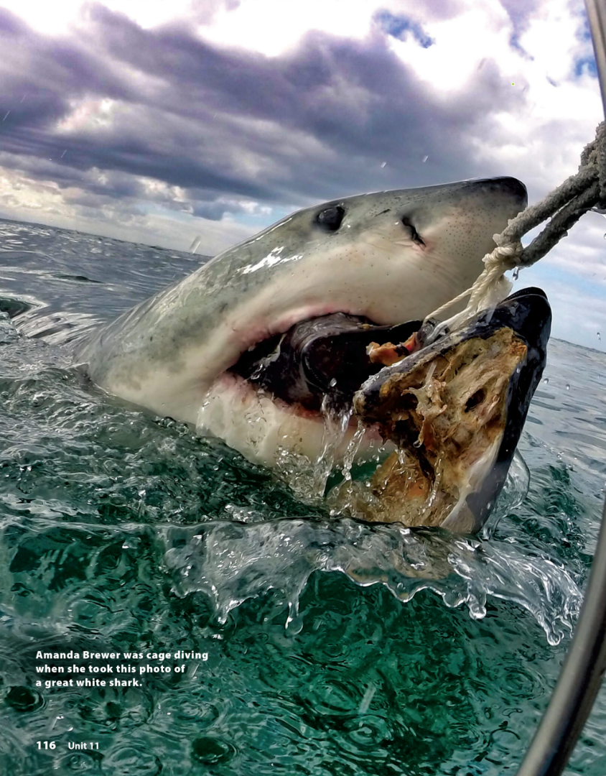
UNIT 11
WHAT WERE YOU DOING?
READING
National Geographic Learning, a Cengage Company © 2022 Cengage Learning, Inc. ALL RIGHTS RESERVED. This presentation tool is intended for teaching purposes only and may not be scanned, copied, duplicated, or posted to a publicly accessible platform in whole or in part.

Slide 3
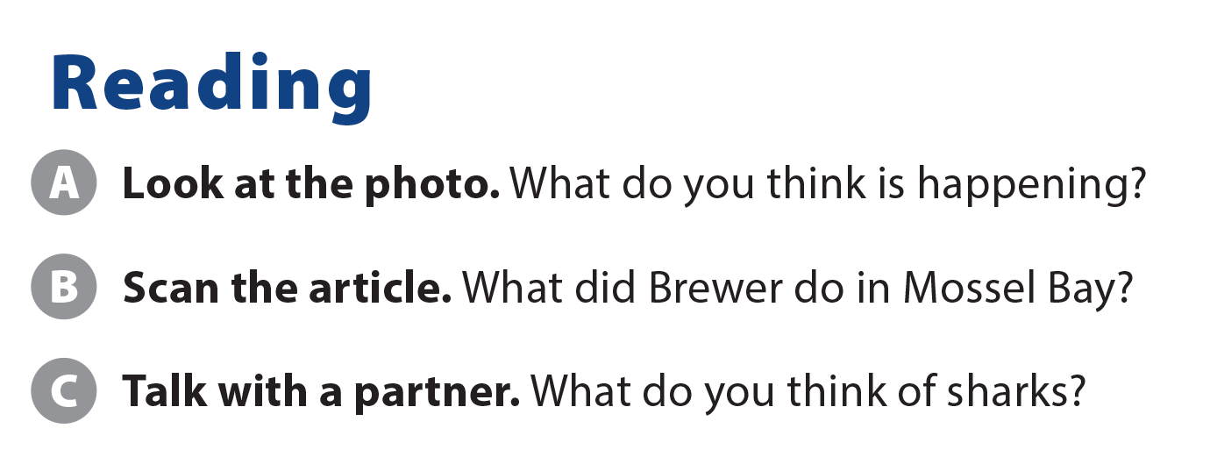
UNIT 11
WHAT WERE YOU DOING?
READING
She did volunteer work.

Slide 4
UNIT 11
WHAT WERE YOU DOING?
COMPREHENSION

Slide 5
UNIT 11
WHAT WERE YOU DOING?
COMPREHENSION
She saw a great white shark when she was diving.
In the summer of 2014
In Mossel Bay, South Africa
She was volunteering for White Shark Africa.

Slide 6
UNIT 11
WHAT WERE YOU DOING?
PROJECT

Slide 7
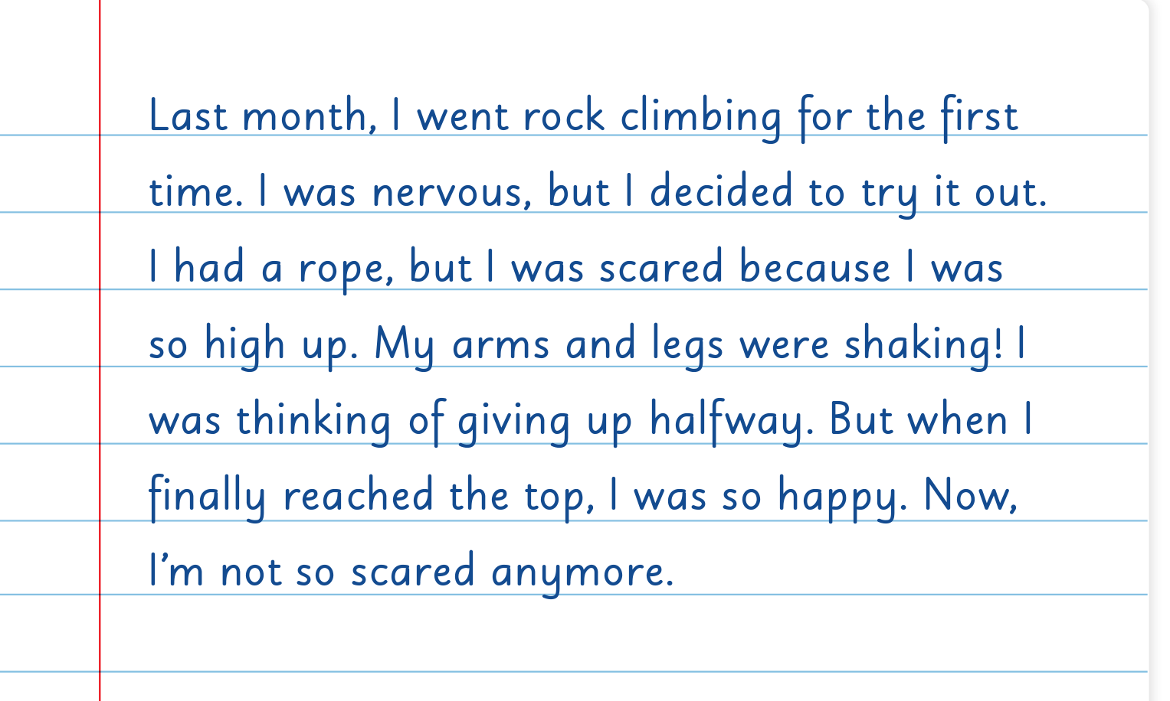
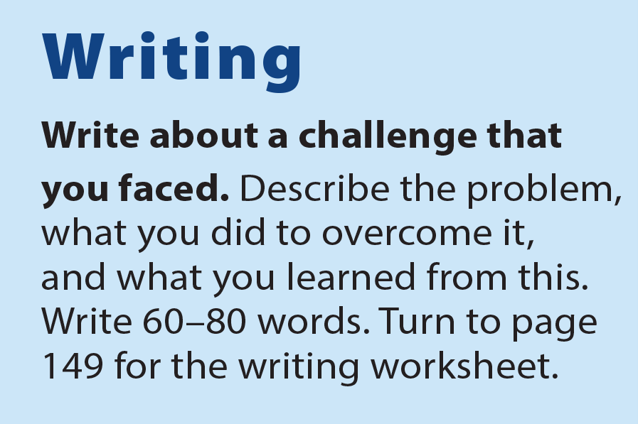
UNIT 11
WHAT WERE YOU DOING?
WRITING

Slide 8
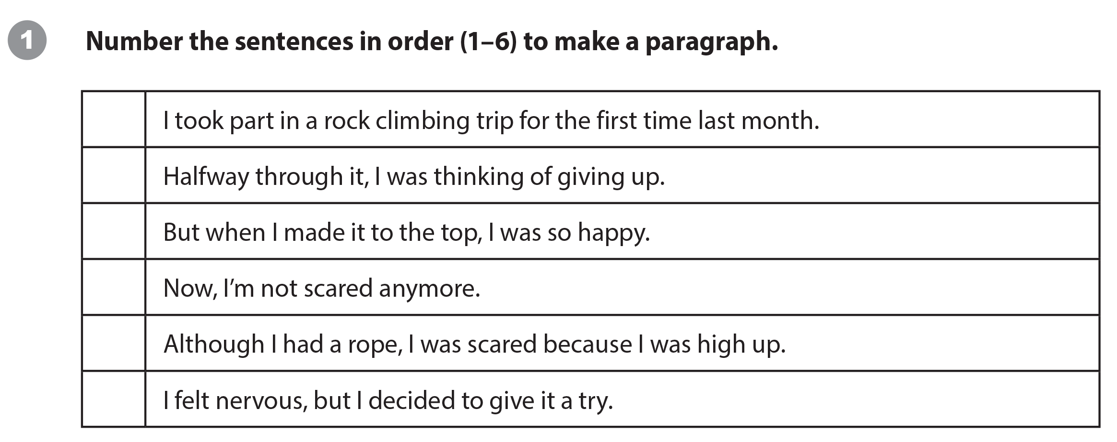
UNIT 11
WHAT WERE YOU DOING?
WRITING WORKSHEET
1
4
5
6
3
2

Slide 9
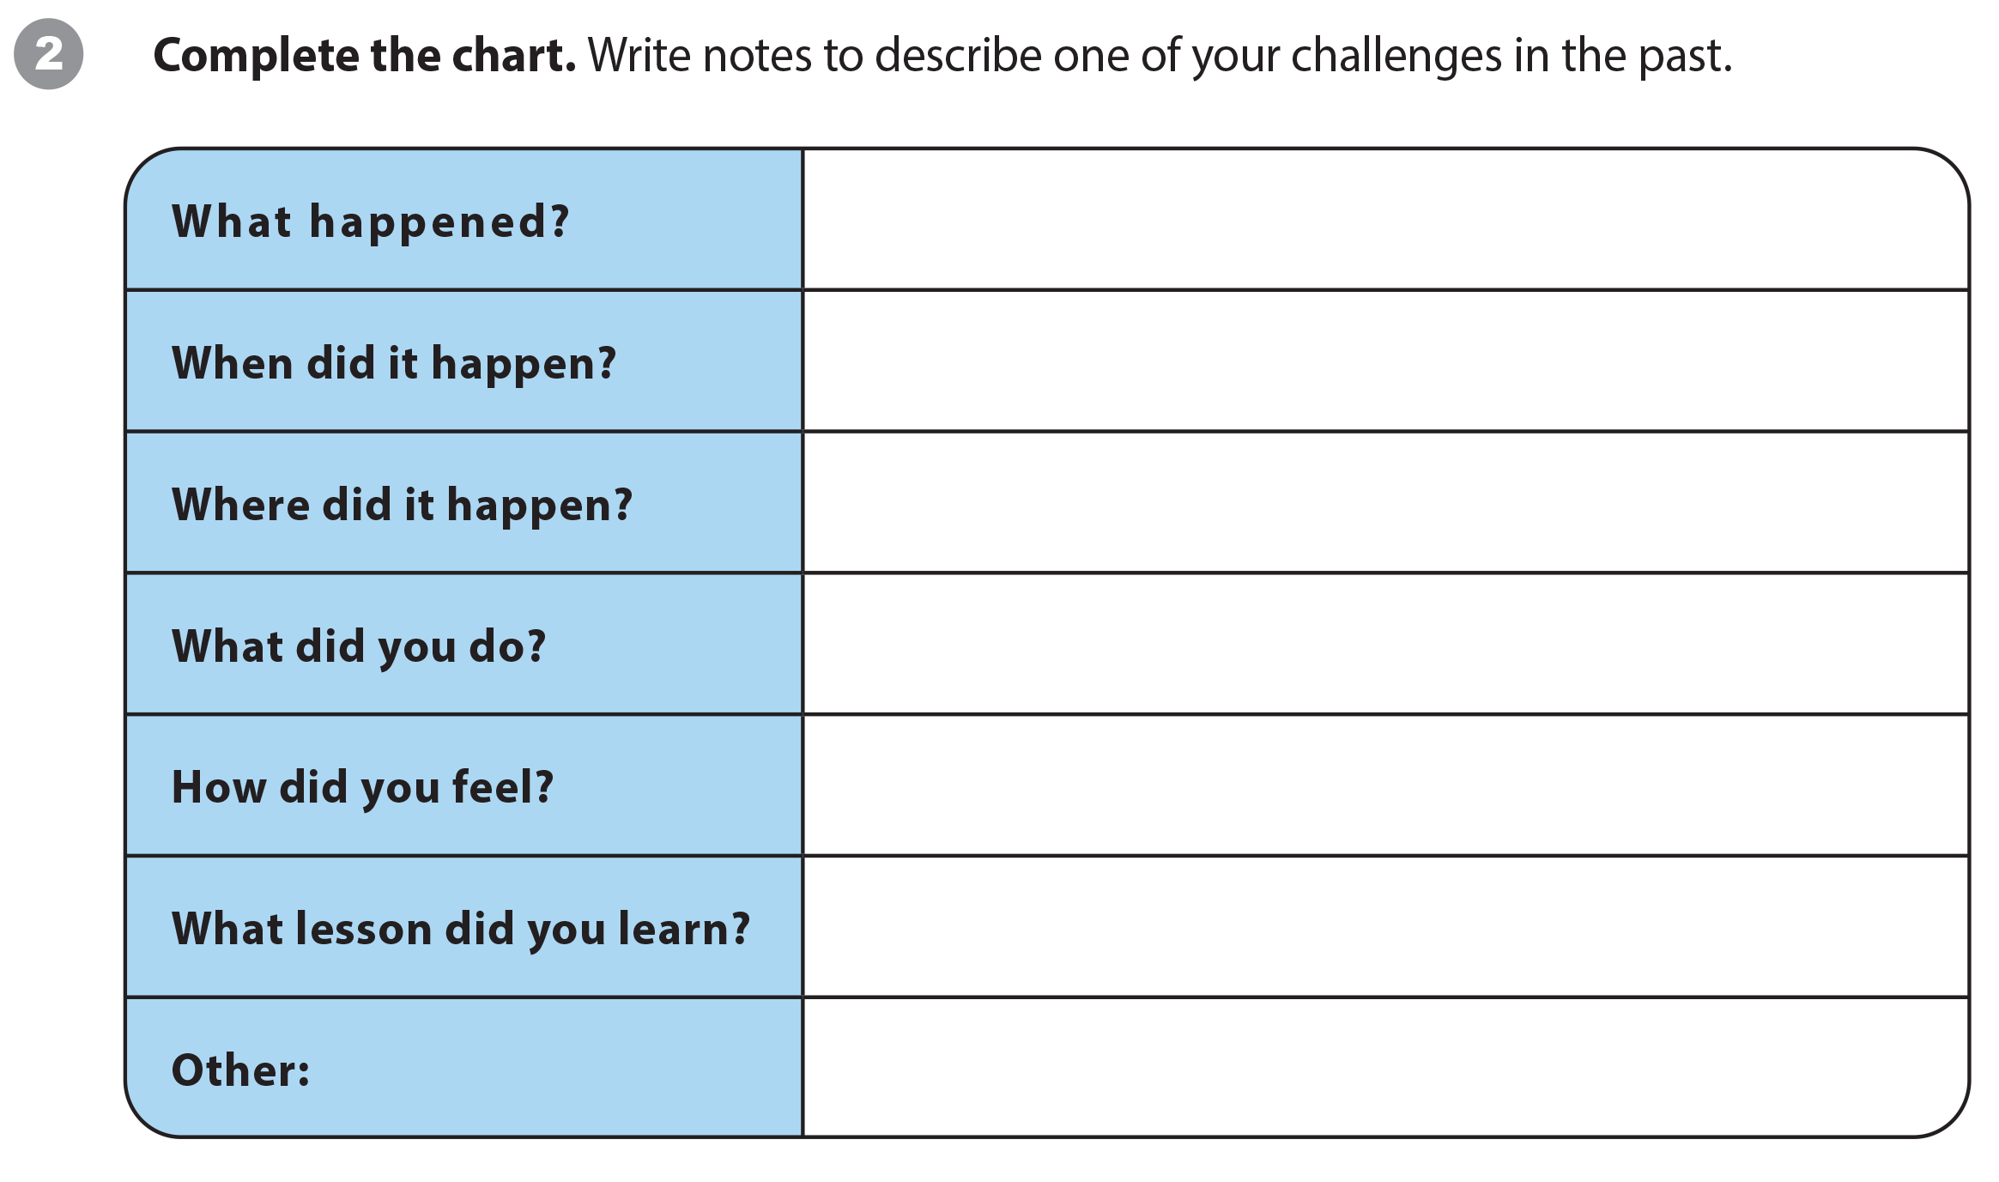
UNIT 11
WHAT WERE YOU DOING?
WRITING WORKSHEET

Slide 10
UNIT 11
WHAT WERE YOU DOING?
WRITING WORKSHEET

Slide 11
UNIT 11
WHAT WERE YOU DOING?
VIDEO

Slide 12
UNIT 11
WHAT WERE YOU DOING?
VIDEO

Slide 13
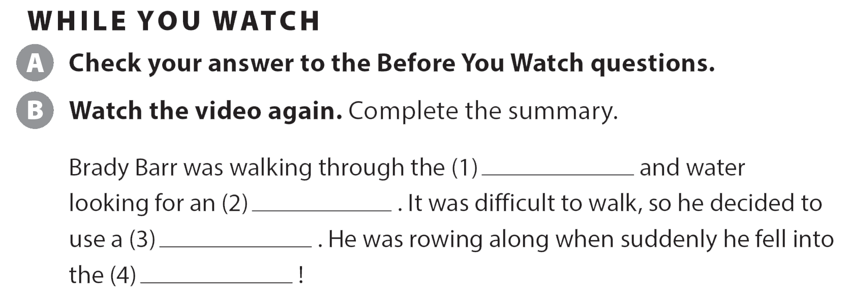
UNIT 11
WHAT WERE YOU DOING?
VIDEO
grass
aligator
boat
water

Slide 14
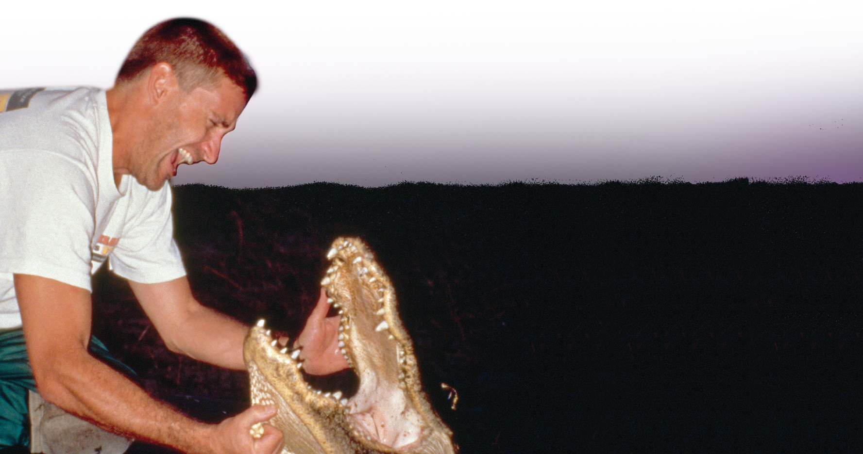
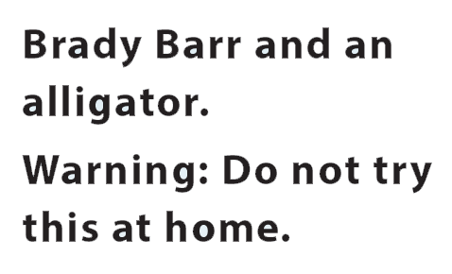
UNIT 11
WHAT WERE YOU DOING?
VIDEO
National Geographic Learning, a Cengage Company © 2022 Cengage Learning, Inc. ALL RIGHTS RESERVED. This presentation tool is intended for teaching purposes only and may not be scanned, copied, duplicated, or posted to a publicly accessible platform in whole or in part.

Slide 15
UNIT 11
WHAT WERE YOU DOING?
Thank you!

