Slide 1
TRƯỜNG THCS KHƯƠNG ĐÌNH
UNIT 12: WE’RE GOING TO VOLUNTEER!
LESSON 1
Tác giả: Nguyễn Thảo trà

Slide 2
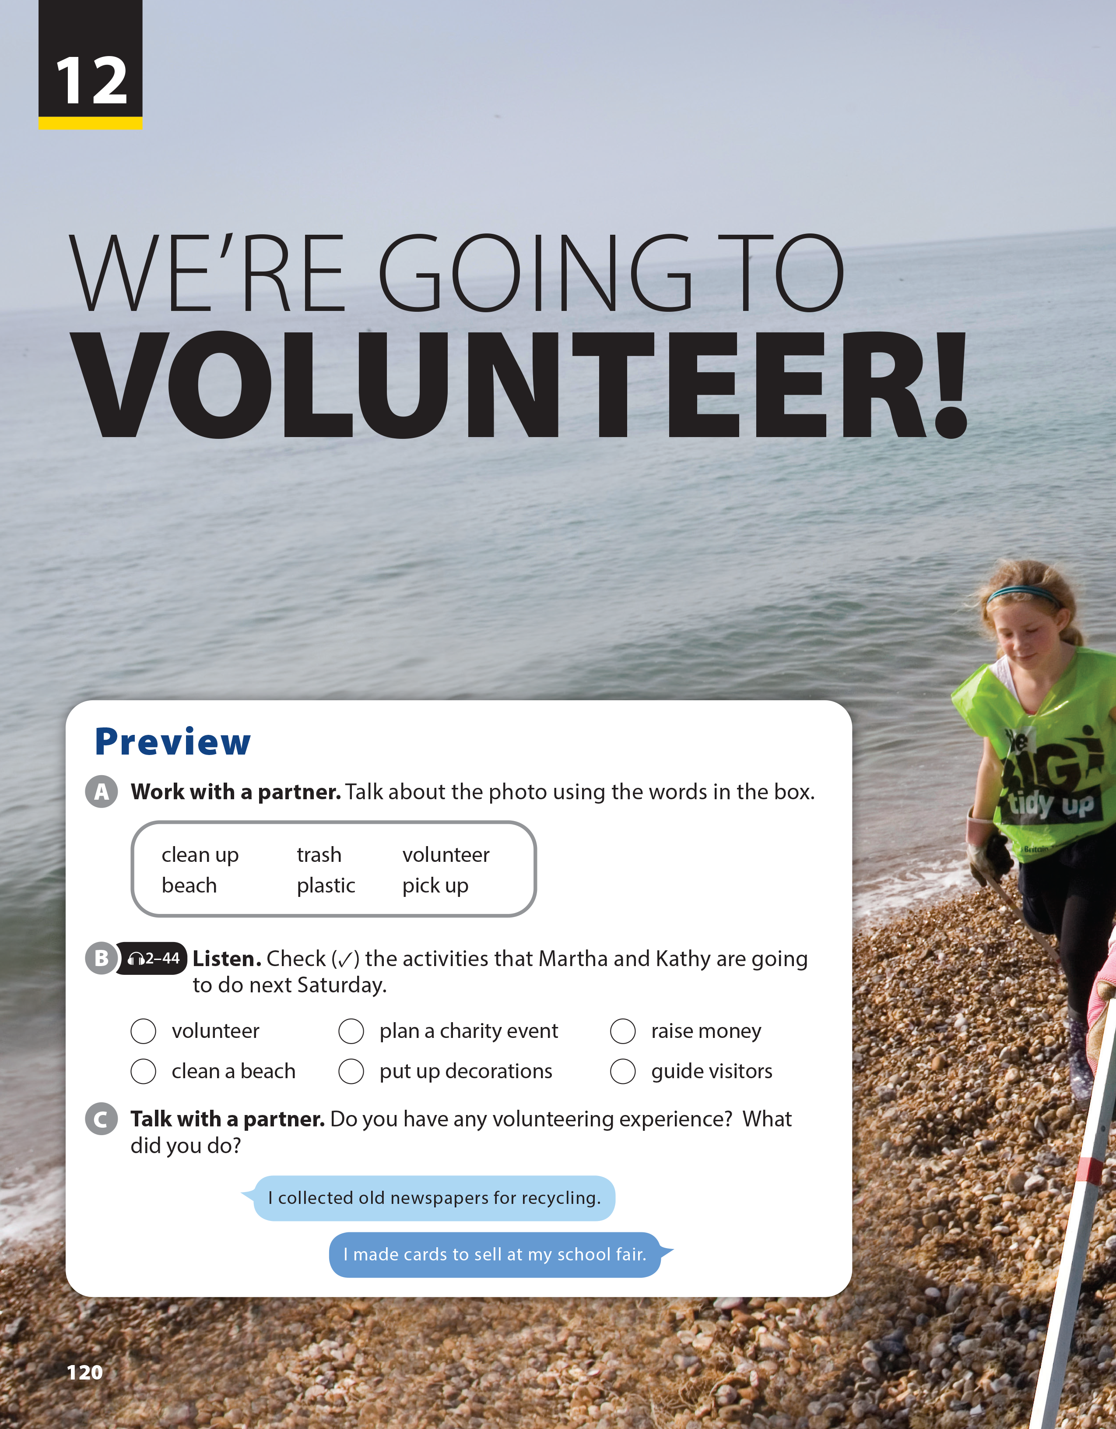
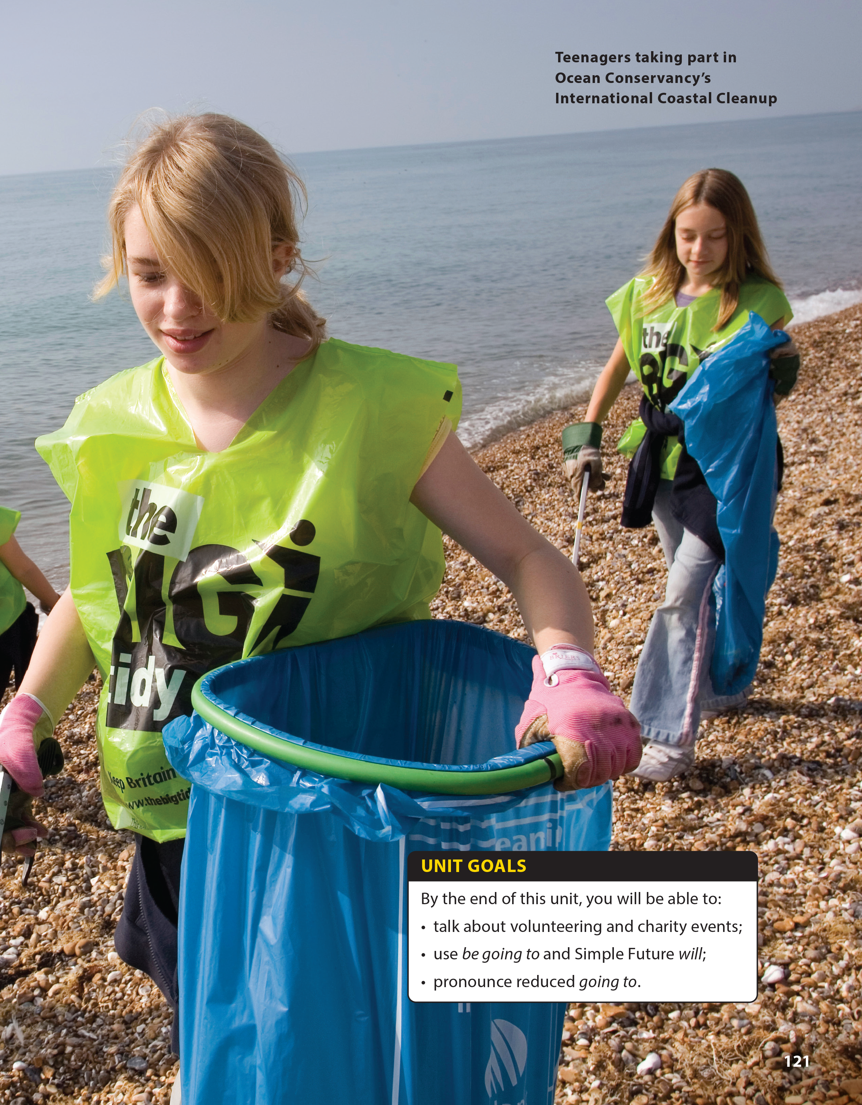
National Geographic Learning, a Cengage Company © 2022 Cengage Learning, Inc. ALL RIGHTS RESERVED. This presentation tool is intended for teaching purposes only and may not be scanned, copied, duplicated, or posted to a publicly accessible platform in whole or in part.

Slide 3
UNIT 12
WE’RE GOING TO VOLUNTEER!
PREVIEW

Slide 4
UNIT 12
WE’RE GOING TO VOLUNTEER!
PREVIEW
✓
✓
✓
✓

Slide 5
UNIT 12
WE’RE GOING TO VOLUNTEER!
PREVIEW

Slide 6
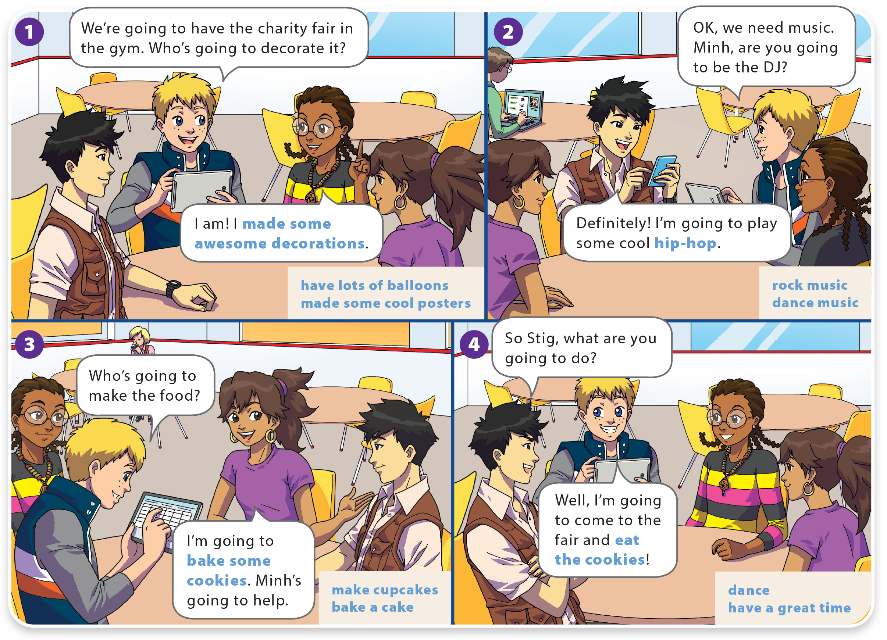
UNIT 12
WE’RE GOING TO VOLUNTEER!
LANGUAGE FOCUS

Slide 7
UNIT 12
WE’RE GOING TO VOLUNTEER!
LANGUAGE FOCUS

Slide 8
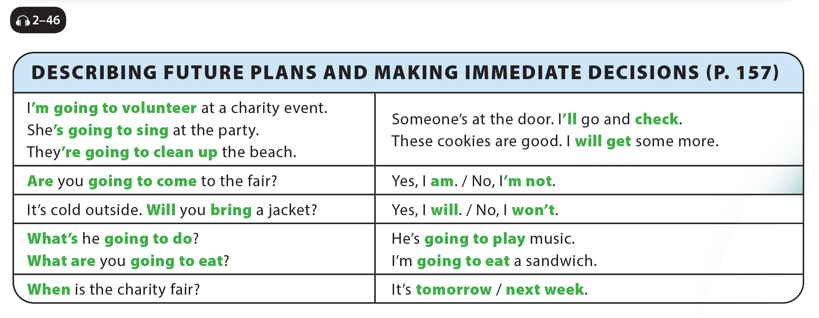
UNIT 12
WE’RE GOING TO VOLUNTEER!
LANGUAGE FOCUS

Slide 9
UNIT 12
WE’RE GOING TO VOLUNTEER!
GRAMMAR REFERENCE

Slide 10
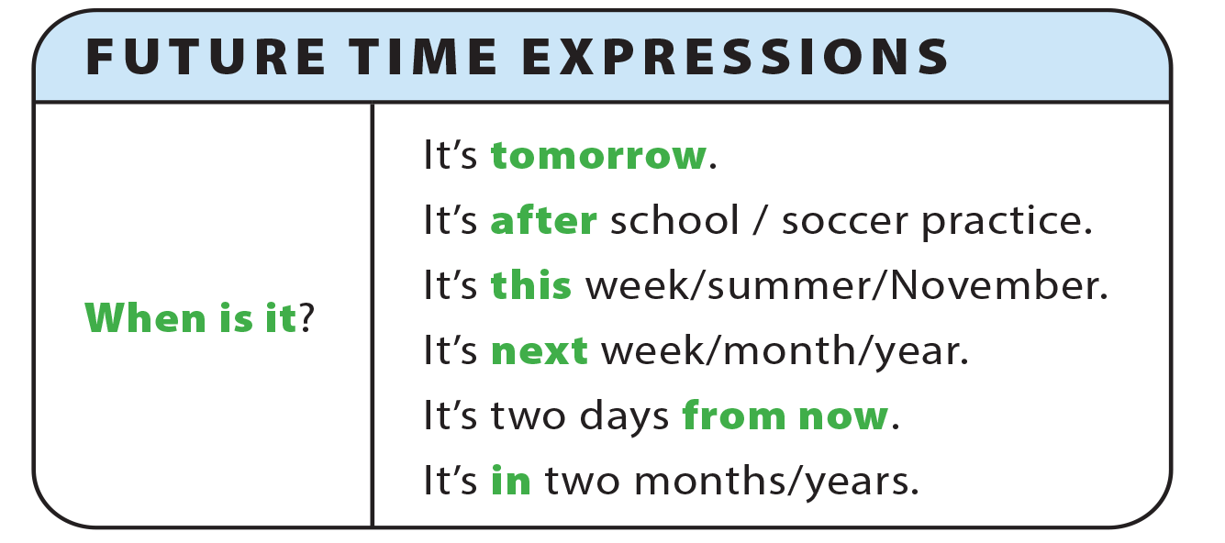
UNIT 12
WE’RE GOING TO VOLUNTEER!
GRAMMAR REFERENCE

Slide 11
UNIT 12
WE’RE GOING TO VOLUNTEER!
LANGUAGE FOCUS
is/’s going to bake
will/’ll open
is‘/’s going to study
is not/isn’t going to put up
is/’s going to have
will/’ll get

Slide 12
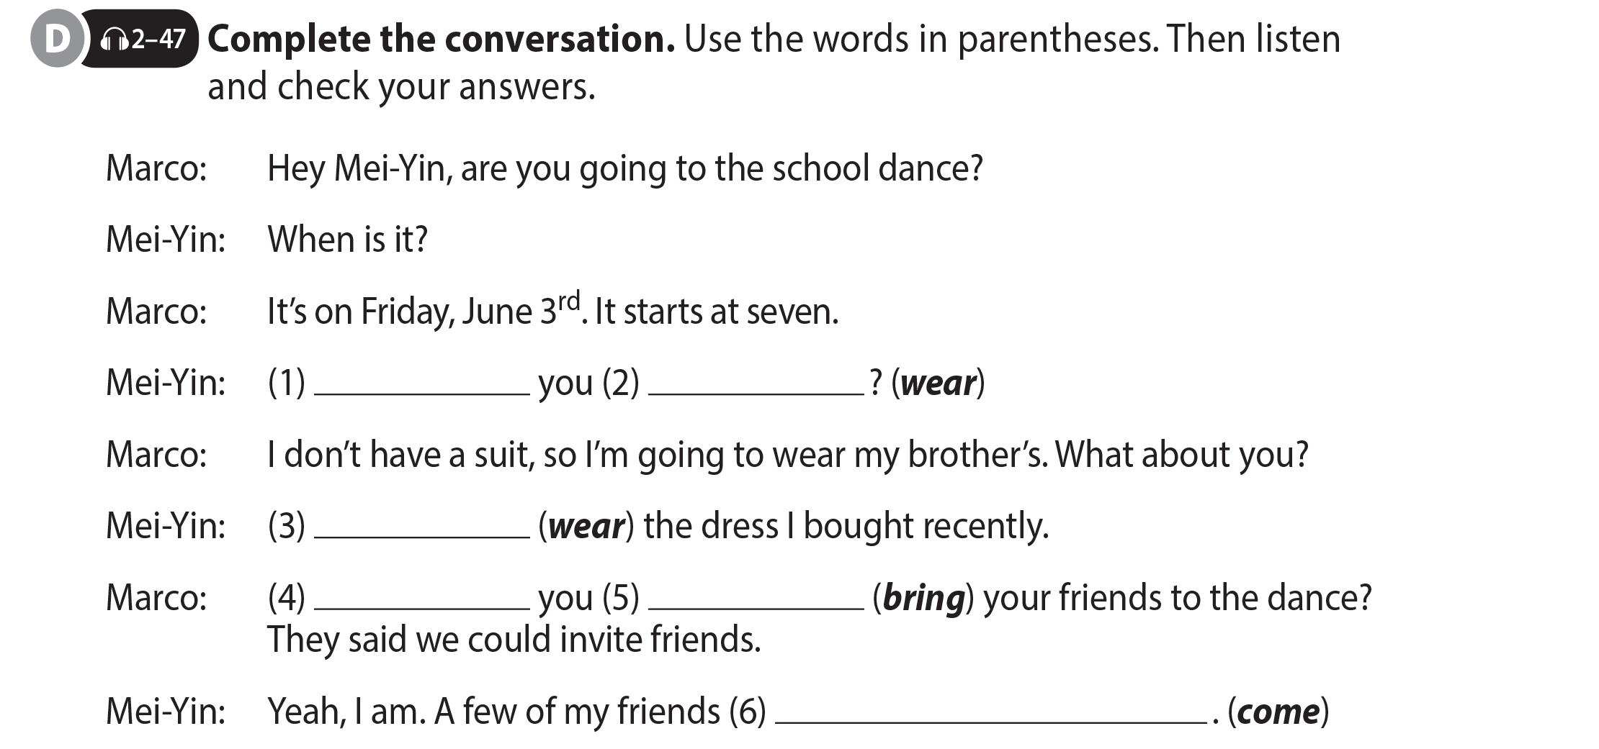
UNIT 12
WE’RE GOING TO VOLUNTEER!
LANGUAGE FOCUS
What are
going to wear
I’m going to wear
Are
going to bring
are going to come

Slide 13
UNIT 12
WE’RE GOING TO VOLUNTEER!
LANGUAGE FOCUS

Slide 14
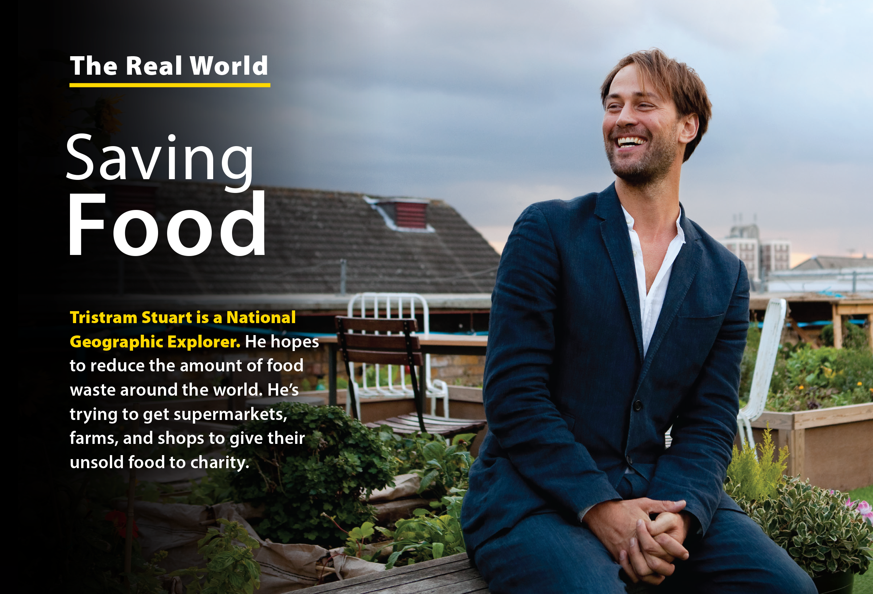
UNIT 12
WE’RE GOING TO VOLUNTEER!
THE REAL WORLD

Slide 15
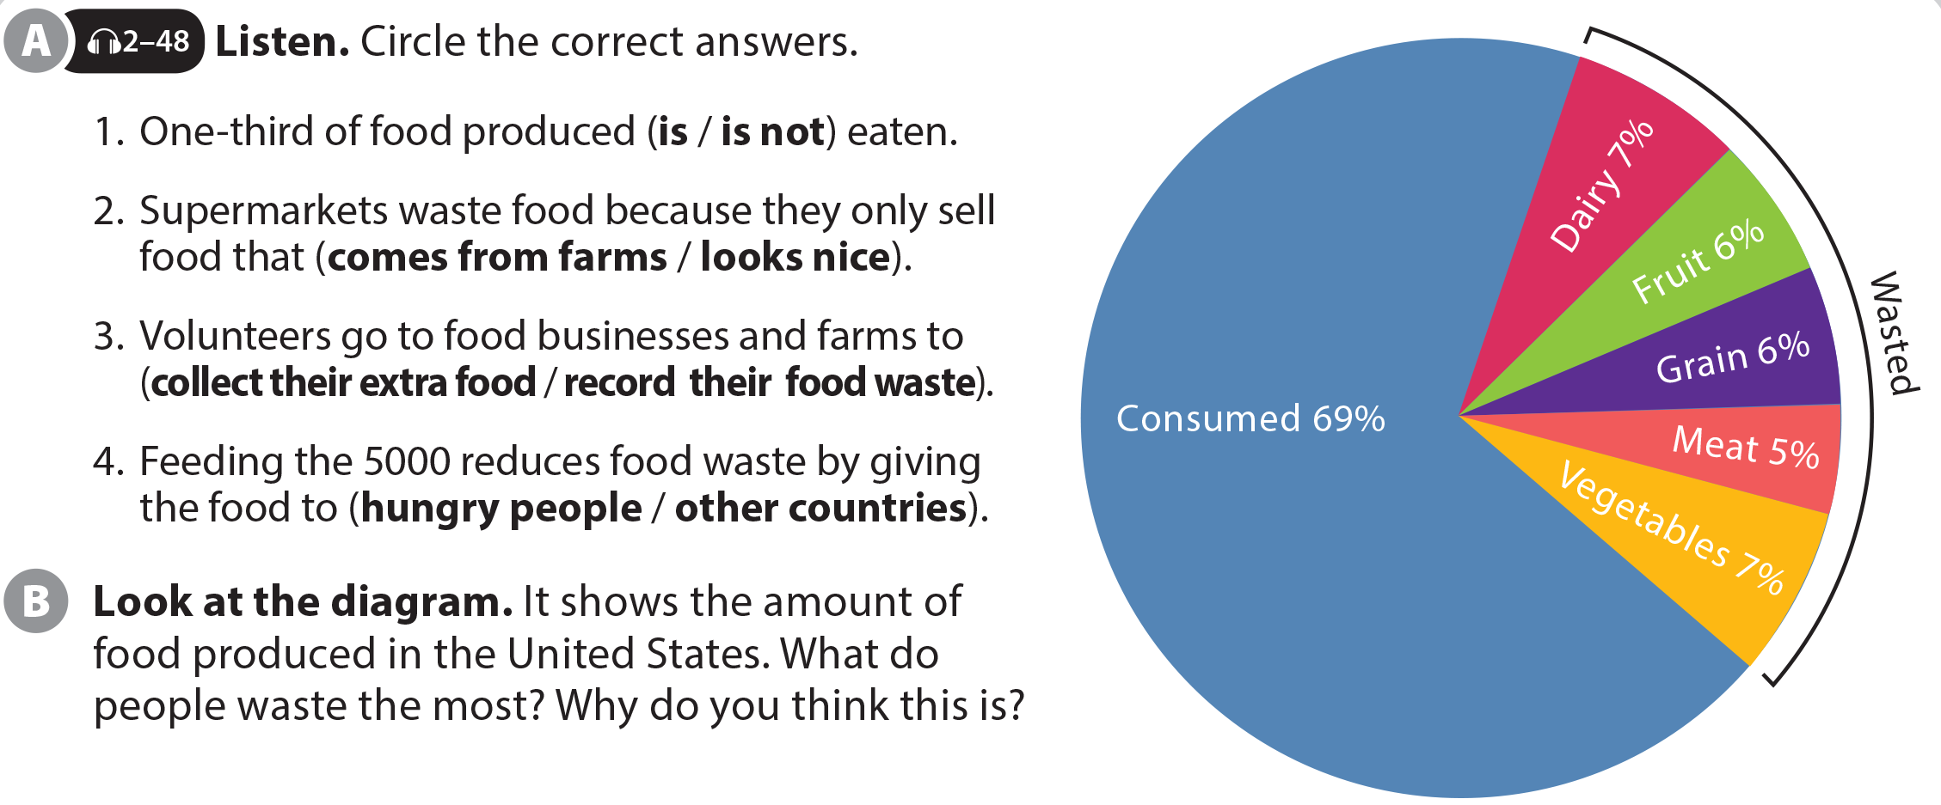
UNIT 12
WE’RE GOING TO VOLUNTEER!
THE REAL WORLD
Dairy and Vegetables (Answers will vary)
National Geographic Learning, a Cengage Company © 2022 Cengage Learning, Inc. ALL RIGHTS RESERVED. This presentation tool is intended for teaching purposes only and may not be scanned, copied, duplicated, or posted to a publicly accessible platform in whole or in part.

Slide 16
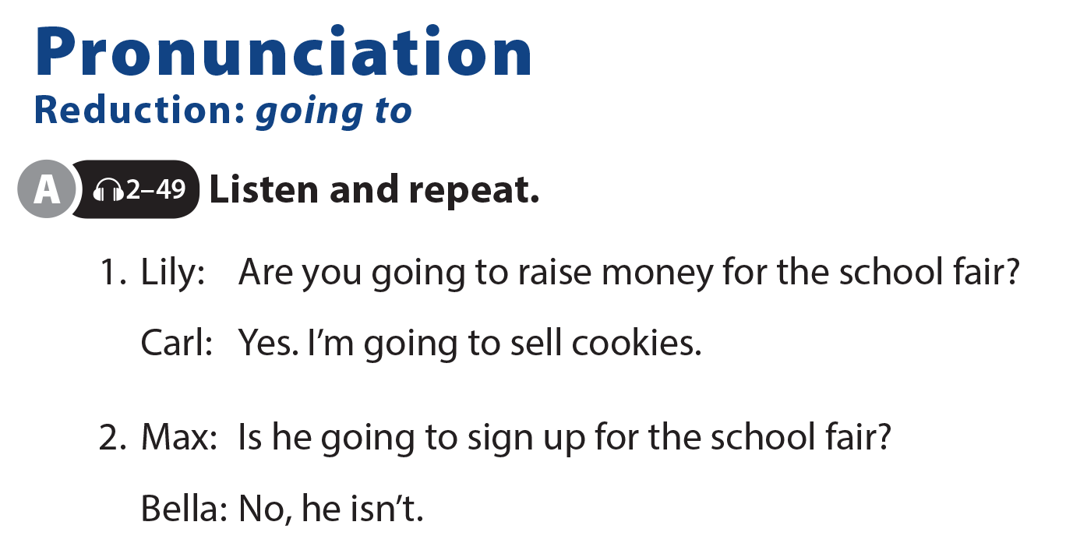
UNIT 12
WE’RE GOING TO VOLUNTEER!
PRONUNCIATION

Slide 17
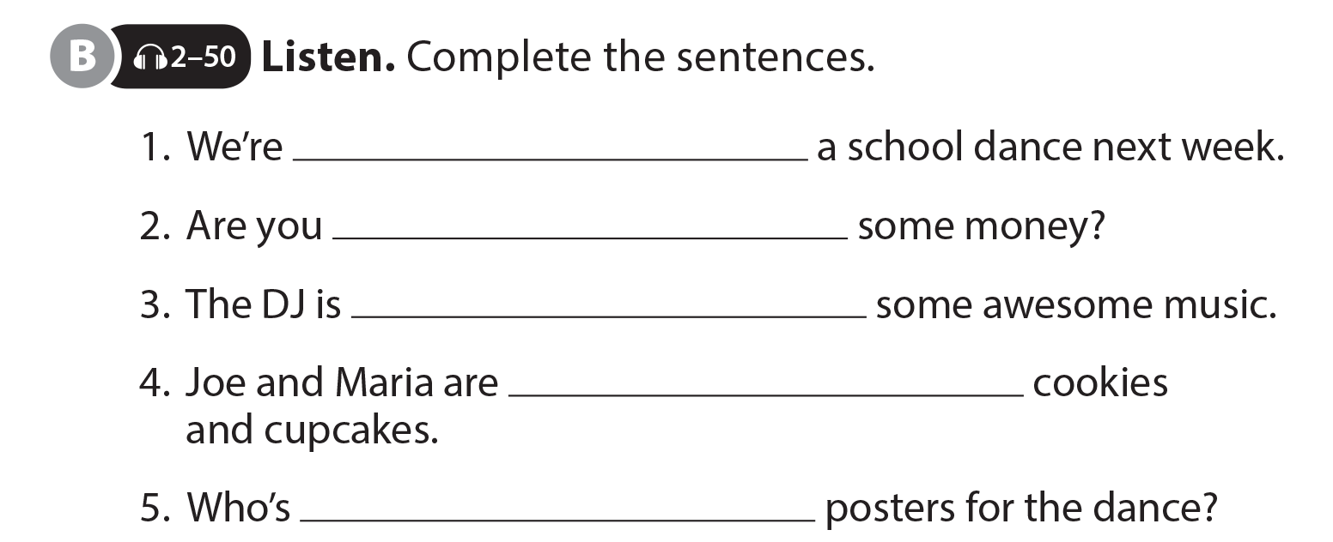
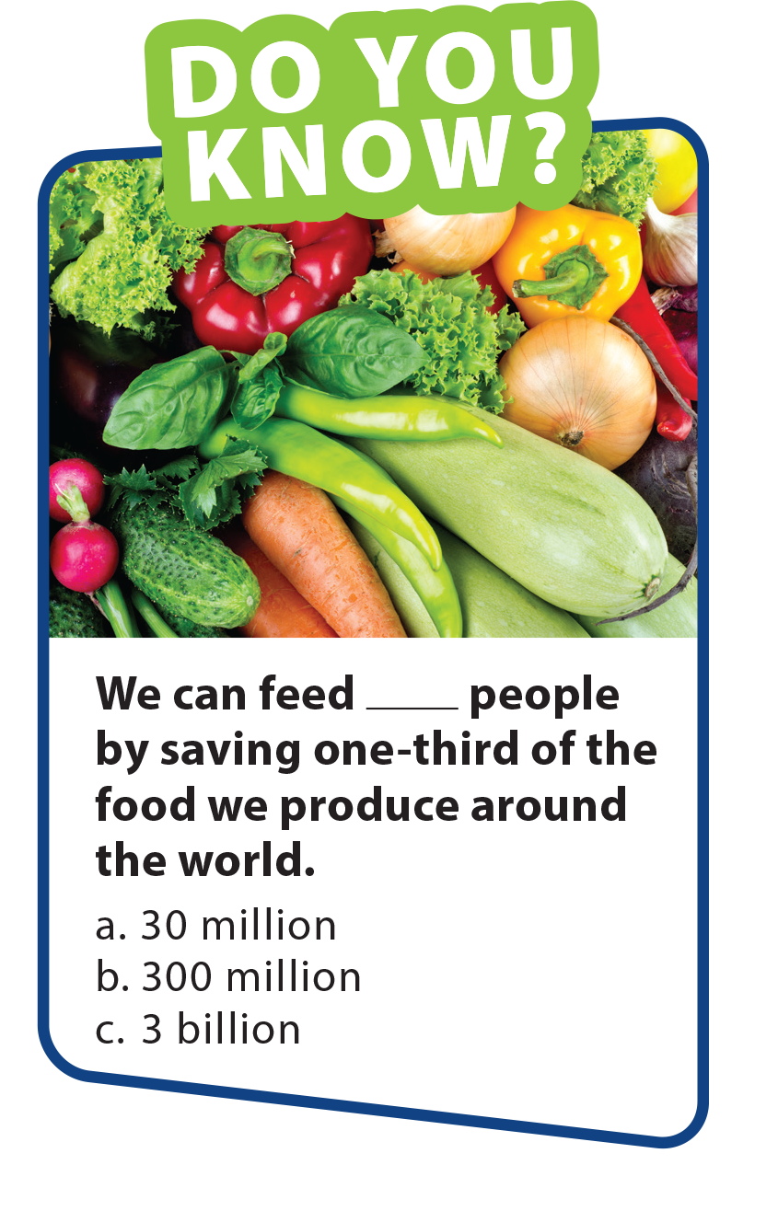
UNIT 12
WE’RE GOING TO VOLUNTEER!
PRONUNCIATION
going to have
going to donate
going to play
going to bake
going to make

Slide 18
UNIT 12
WE’RE GOING TO VOLUNTEER!
COMMUNICATION
plan the entertainment
plan the poster design
buy balloons
make posters
put up decorations
choose the music
make sandwiches
sell sandwiches

Slide 19
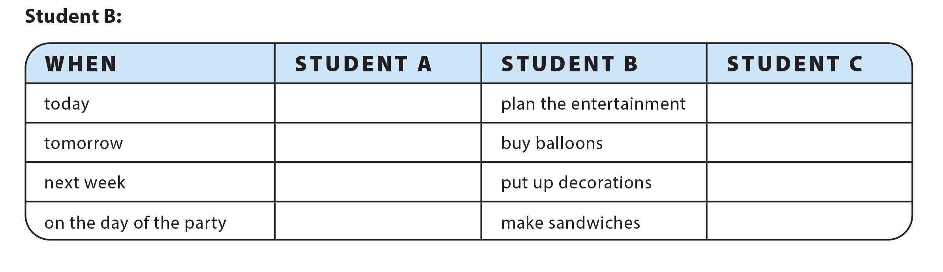
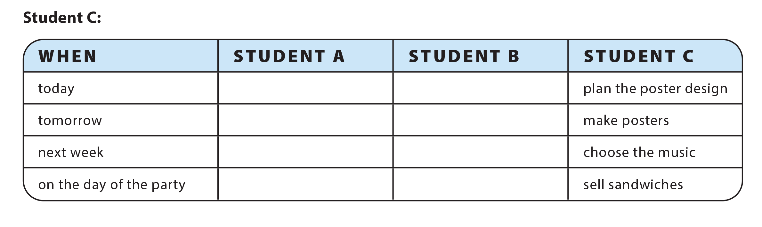
UNIT 12
WE’RE GOING TO VOLUNTEER!
COMMUNICATION
design a T-shirt
plan the poster design
make decorations
make posters
buy plates and cups
choose the music
sell the drinks
sell sandwiches
design a T-shirt
plan the entertainment
make decorations
buy balloons
buy plates and cups
put up decorations
sell the drinks
make sandwiches

