Slide 1
TRƯỜNG THCS KHƯƠNG ĐÌNH
UNIT 12: WE’RE GOING TO VOLUNTEER!
LESSON 2
Tác giả: Nguyễn Thảo trà

Slide 2
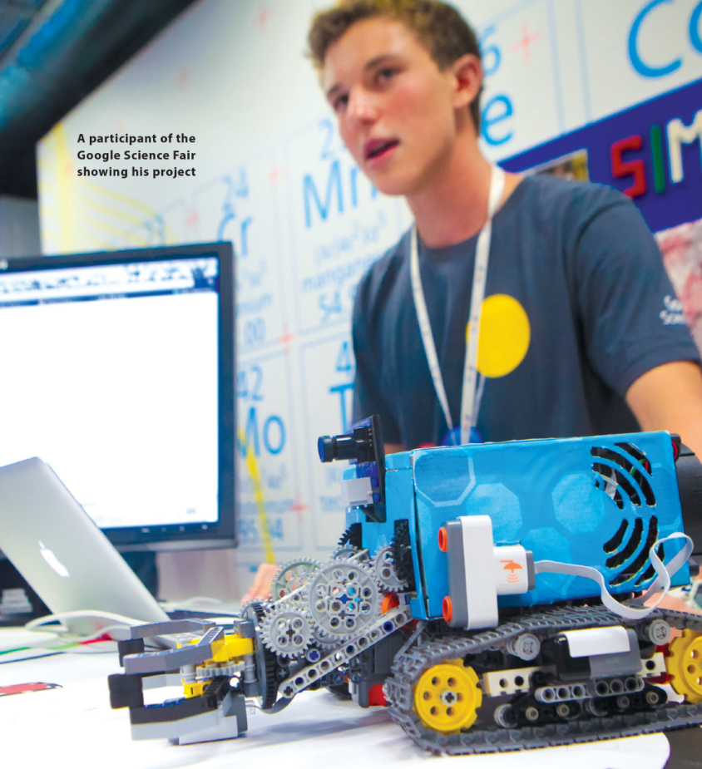
WE’RE GOING TO VOLUNTEER!
READING
UNIT 12
READING
UNIT 12
WE’RE GOING TO VOLUNTEER!
National Geographic Learning, a Cengage Company © 2022 Cengage Learning, Inc. ALL RIGHTS RESERVED. This presentation tool is intended for teaching purposes only and may not be scanned, copied, duplicated, or posted to a publicly accessible platform in whole or in part.

Slide 3
UNIT 12
WE’RE GOING TO VOLUNTEER!
READING
teenagers aged 13 to 18
Brittany: a cancer-testing program
Elif: a new kind of plastic made from banana peels

Slide 4
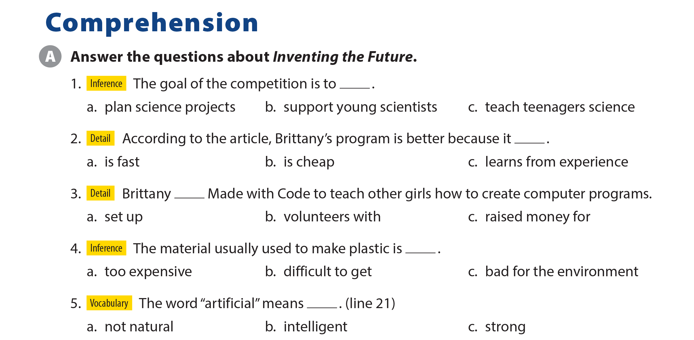
UNIT 12
WE’RE GOING TO VOLUNTEER!
COMPREHENSION

Slide 5
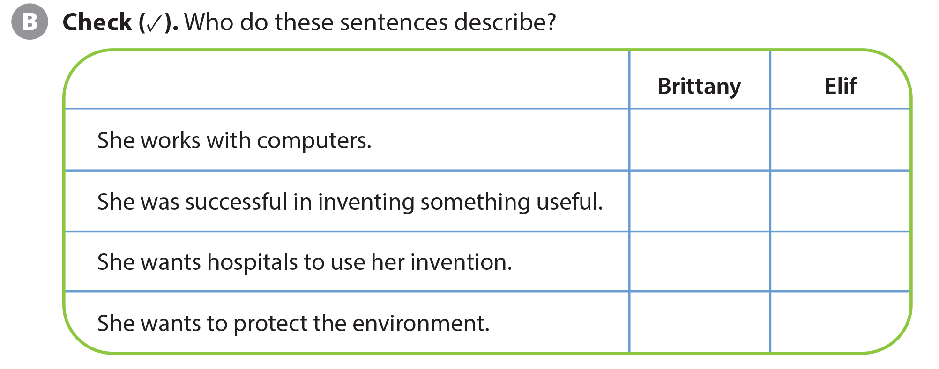
UNIT 12
WE’RE GOING TO VOLUNTEER!
COMPREHENSION
✓
✓
✓
✓
✓
✓

Slide 6
UNIT 12
WE’RE GOING TO VOLUNTEER!
PROJECT

Slide 7
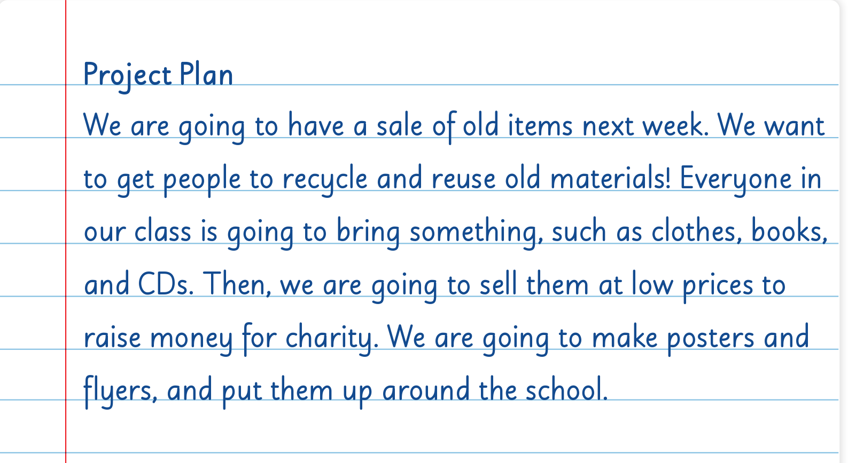
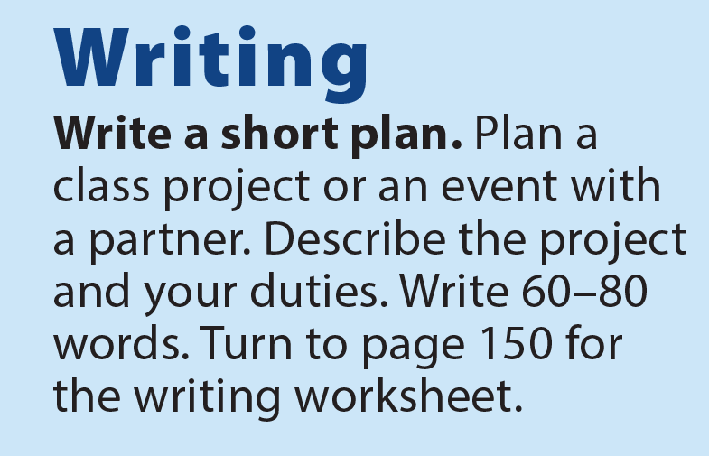
UNIT 12
WE’RE GOING TO VOLUNTEER!
WRITING

Slide 8
UNIT 12
WE’RE GOING TO VOLUNTEER!
WRITING WORKSHEET
are going to have
are going to get
are going to make

Slide 9
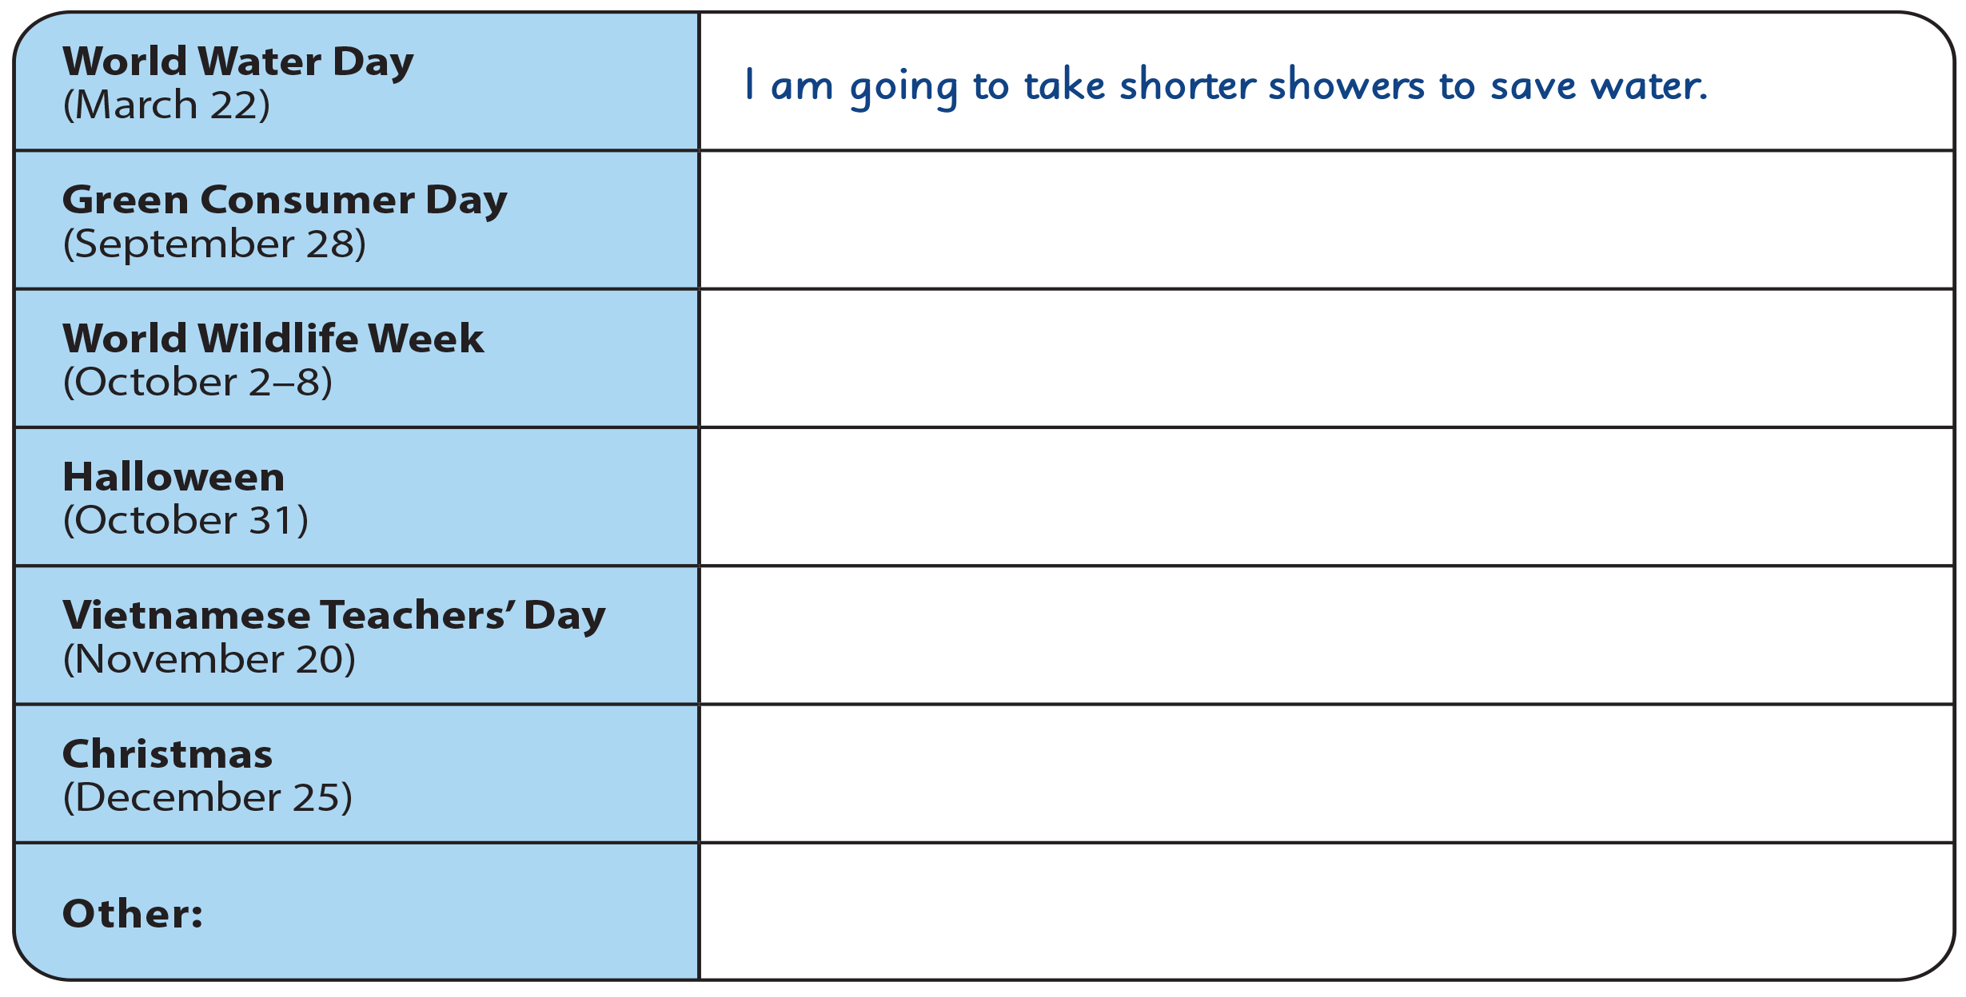
UNIT 12
WE’RE GOING TO VOLUNTEER!
WRITING WORKSHEET

Slide 10
UNIT 12
WE’RE GOING TO VOLUNTEER!
WRITING WORKSHEET
Happy Teachers’ Day
Halloween
Women’s Day
Christmas
Lunar New Year

Slide 11
UNIT 12
WE’RE GOING TO VOLUNTEER!
VIDEO

Slide 12
UNIT 12
WE’RE GOING TO VOLUNTEER!
VIDEO

Slide 13
UNIT 12
WE’RE GOING TO VOLUNTEER!
VIDEO

Slide 14
UNIT 12
WE’RE GOING TO VOLUNTEER!
VIDEO

Slide 15
UNIT 12
WE’RE GOING TO VOLUNTEER!
VIDEO
National Geographic Learning, a Cengage Company © 2022 Cengage Learning, Inc. ALL RIGHTS RESERVED. This presentation tool is intended for teaching purposes only and may not be scanned, copied, duplicated, or posted to a publicly accessible platform in whole or in part.

Slide 16
UNIT 12
WE’RE GOING TO VOLUNTEER!
Thank you!

