Slide 1
TRƯỜNG THCS KHƯƠNG ĐÌNH
UNIT 7: WHAT’S FOR DINNER?
LESSON 2: LANGUAGE FOCUS (2)
Tác giả: Nguyễn Thảo trà

Slide 2
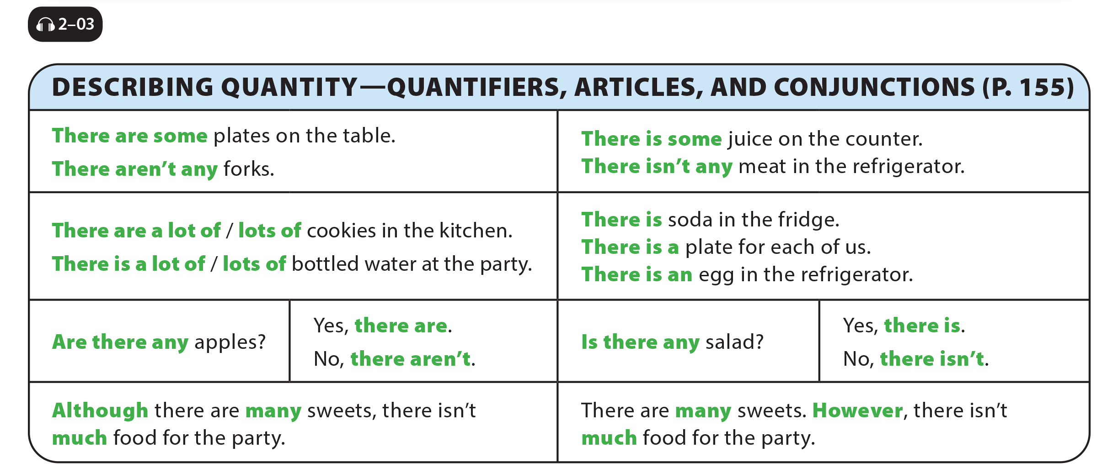
UNIT 7
WHAT’S FOR DINNER?
LANGUAGE FOCUS

Slide 3
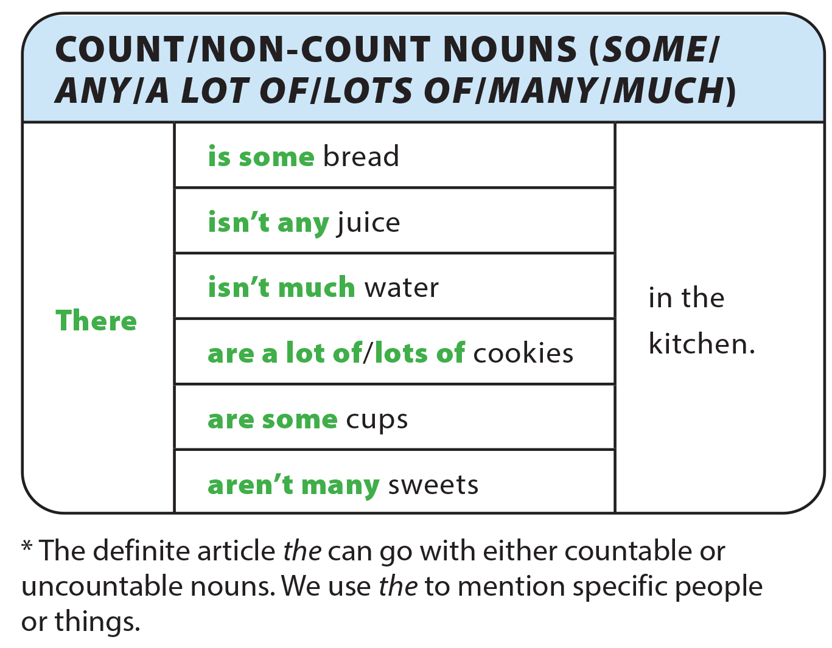
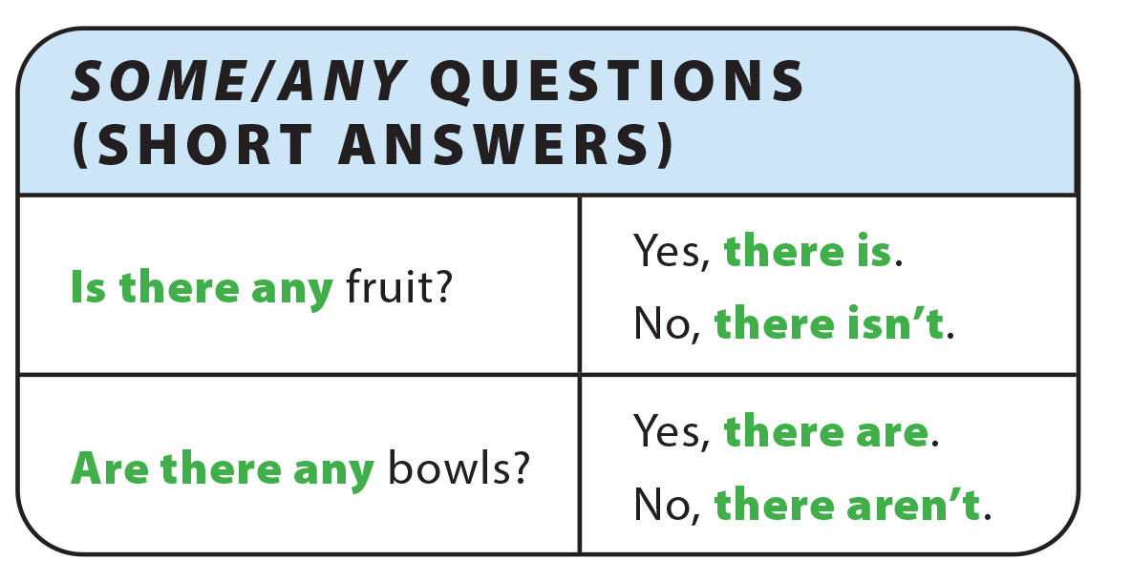
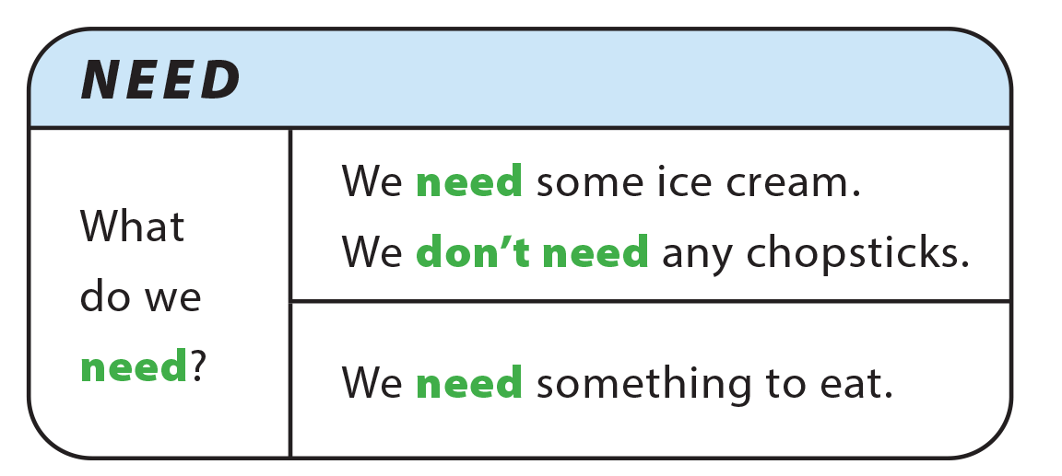
UNIT 7
WHAT’S FOR DINNER?
GRAMMAR REFERENCE

Slide 4
UNIT 7
WHAT’S FOR DINNER?
LANGUAGE FOCUS
There aren’t any
There are a lot of /
lots of / many
There are some
There isn’t any
There is some

Slide 5
UNIT 7
WHAT’S FOR DINNER?
LANGUAGE FOCUS
Is there any
Are there any

Slide 6
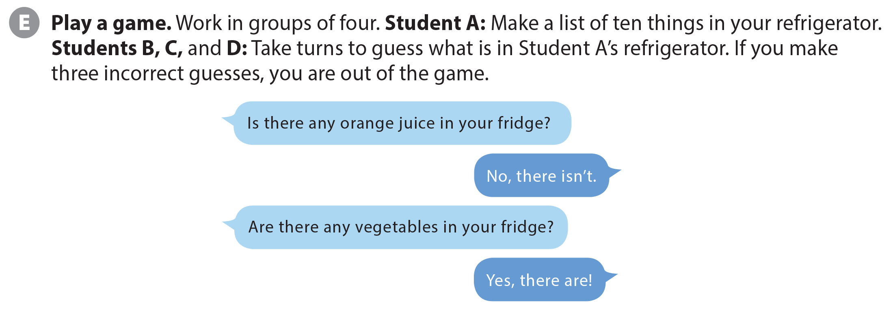
UNIT 7
WHAT’S FOR DINNER?
LANGUAGE FOCUS

