Slide 1
TRƯỜNG THCS KHƯƠNG ĐÌNH
UNIT 7: WHAT’S FOR DINNER?
LESSON 3: THE REAL WORLD
Tác giả: Nguyễn Thảo trà

Slide 2
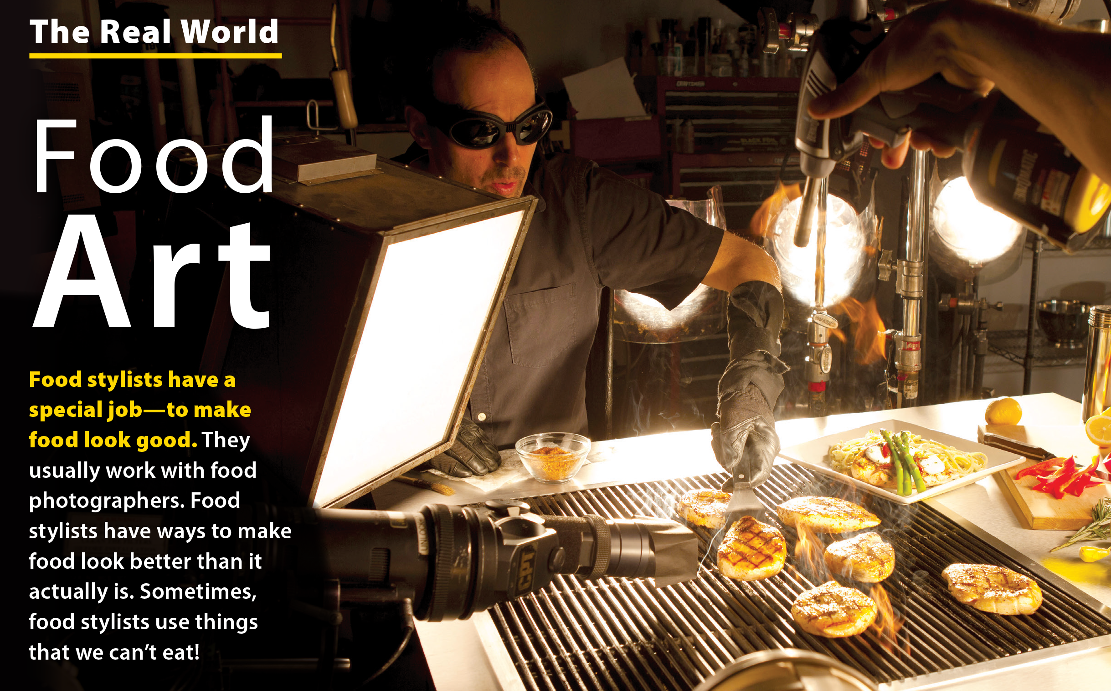
UNIT 7
WHAT’S FOR DINNER?
THE REAL WORLD

Slide 3
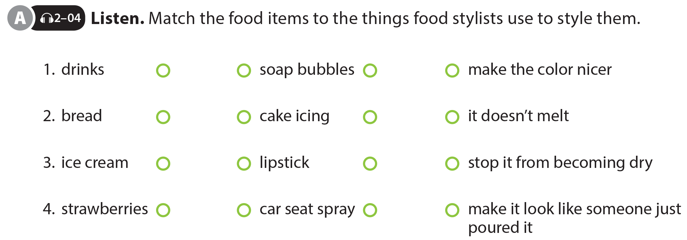
UNIT 7
WHAT’S FOR DINNER?
THE REAL WORLD

Slide 4
UNIT 7
WHAT’S FOR DINNER?
THE REAL WORLD
National Geographic Learning, a Cengage Company © 2022 Cengage Learning, Inc. ALL RIGHTS RESERVED. This presentation tool is intended for teaching purposes only and may not be scanned, copied, duplicated, or posted to a publicly accessible platform in whole or in part.

Slide 5
UNIT 7
WHAT’S FOR DINNER?
PRONUNCIATION

Slide 6
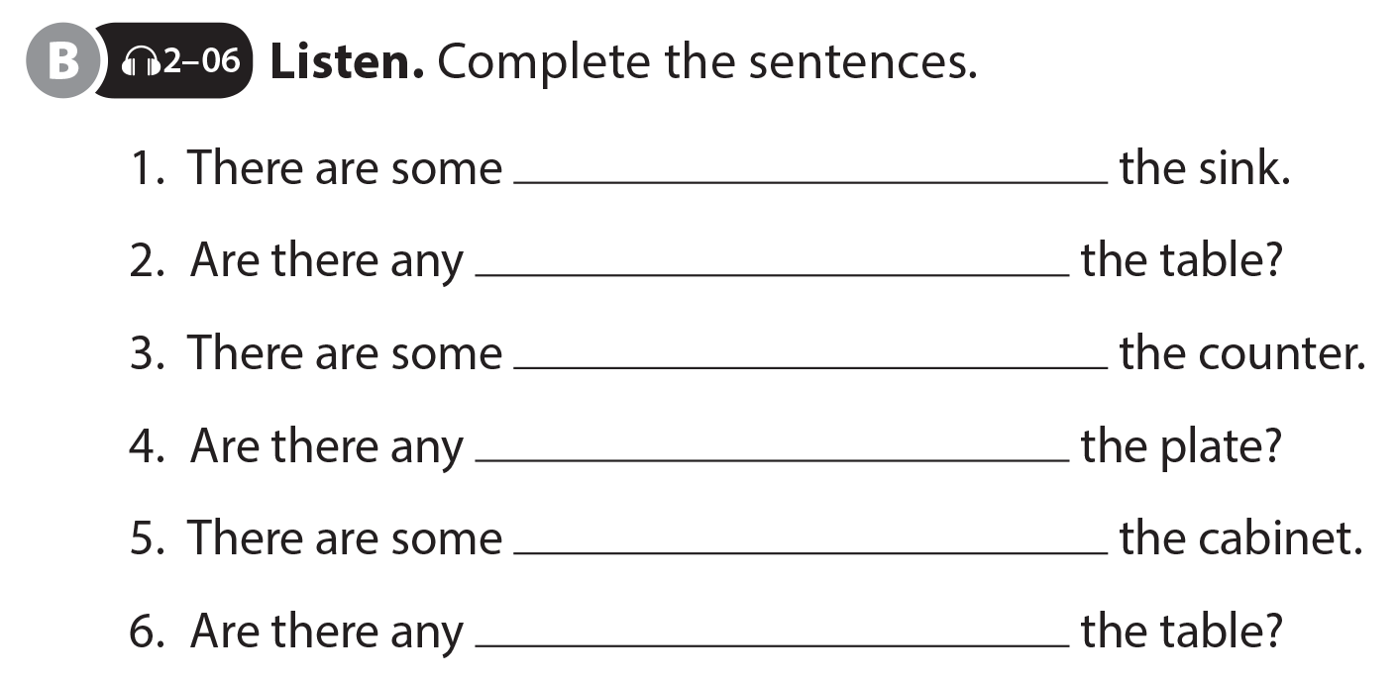
UNIT 7
WHAT’S FOR DINNER?
PRONUNCIATION
knives in
bowls on
cups on
hamburgers on
plates in
spoons on

Slide 7
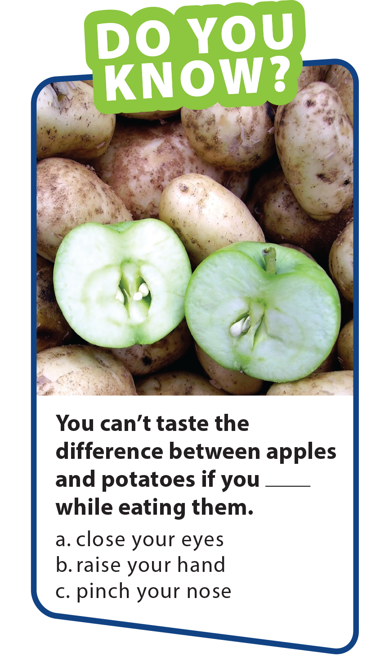
UNIT 7
WHAT’S FOR DINNER?
PRONUNCIATION
knives in
bowls on
cups on
hamburgers on
plates in
spoons on

Slide 8
UNIT 7
WHAT’S FOR DINNER?
COMMUNICATION
National Geographic Learning, a Cengage Company © 2022 Cengage Learning, Inc. ALL RIGHTS RESERVED. This presentation tool is intended for teaching purposes only and may not be scanned, copied, duplicated, or posted to a publicly accessible platform in whole or in part.

Slide 9
UNIT 7
WHAT’S FOR DINNER?
COMMUNICATION
National Geographic Learning, a Cengage Company © 2022 Cengage Learning, Inc. ALL RIGHTS RESERVED. This presentation tool is intended for teaching purposes only and may not be scanned, copied, duplicated, or posted to a publicly accessible platform in whole or in part.

