Slide 1
TRƯỜNG THCS KHƯƠNG ĐÌNH
UNIT 7: WHAT’S FOR DINNER?
LESSON 4: READING
Tác giả: Nguyễn Thảo trà

Slide 2
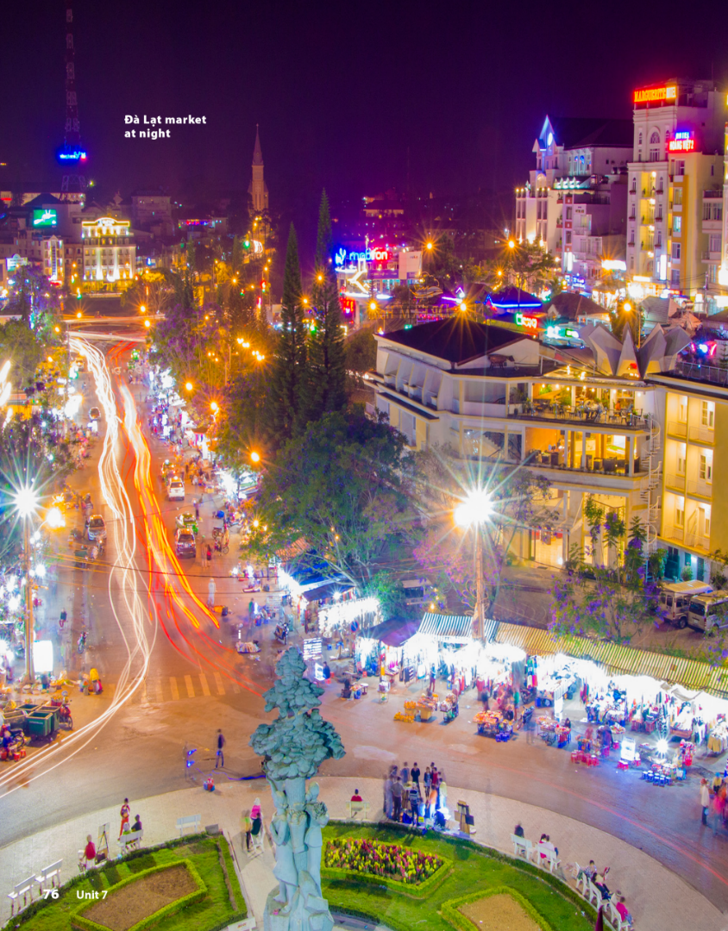
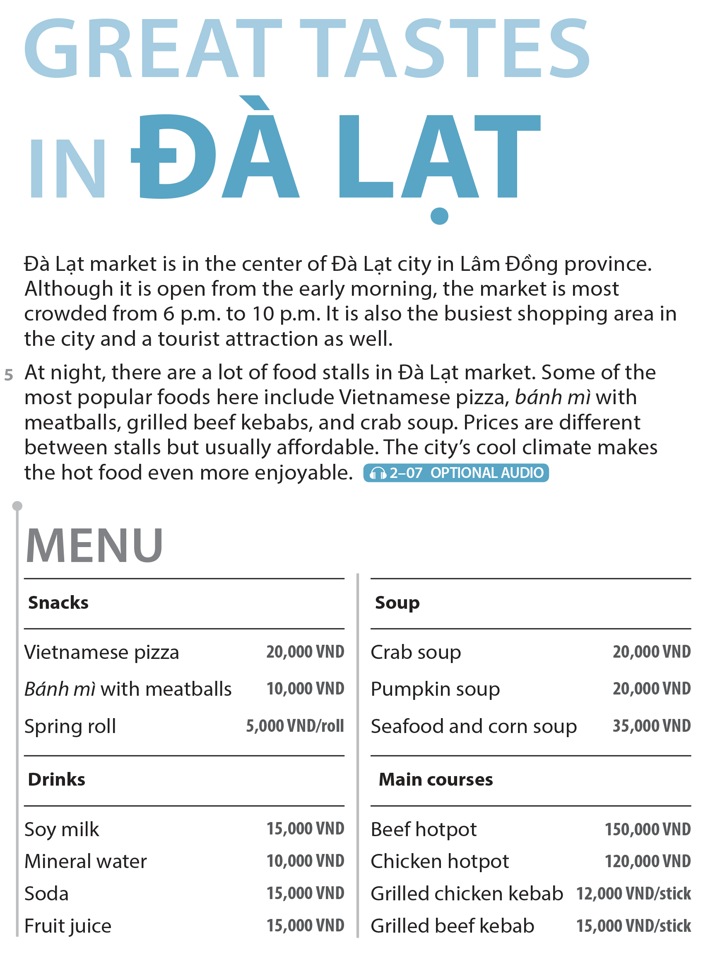
UNIT 7
WHAT’S FOR DINNER?
READING
National Geographic Learning, a Cengage Company © 2022 Cengage Learning, Inc. ALL RIGHTS RESERVED. This presentation tool is intended for teaching purposes only and may not be scanned, copied, duplicated, or posted to a publicly accessible platform in whole or in part.

Slide 3
UNIT 7
WHAT’S FOR DINNER?
READING
Spring roll

Slide 4
UNIT 7
WHAT’S FOR DINNER?
COMPREHENSION

Slide 5
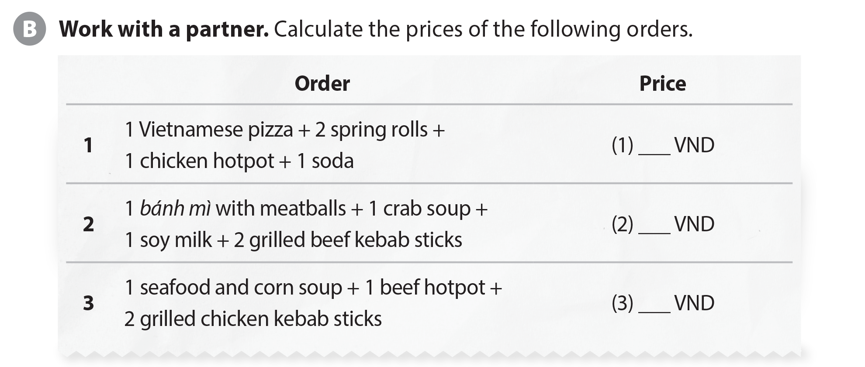
UNIT 7
WHAT’S FOR DINNER?
COMPREHENSION
165,000
75,000
209,000

Slide 6
UNIT 7
WHAT’S FOR DINNER?
COMPREHENSION
The market’s name | Reasons why it is famous

Slide 7
UNIT 7
WHAT’S FOR DINNER?
PROJECT

Slide 8
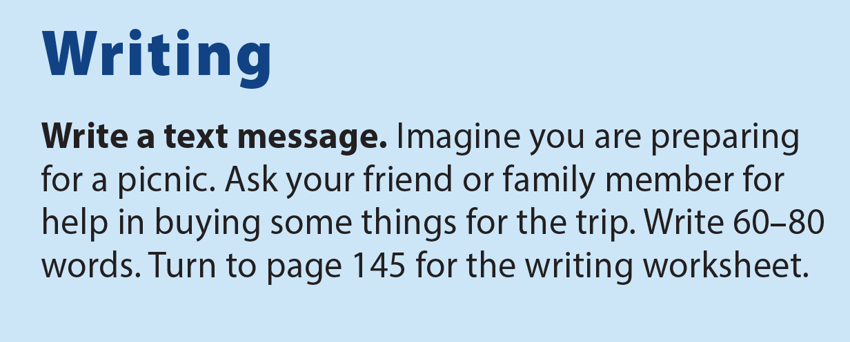
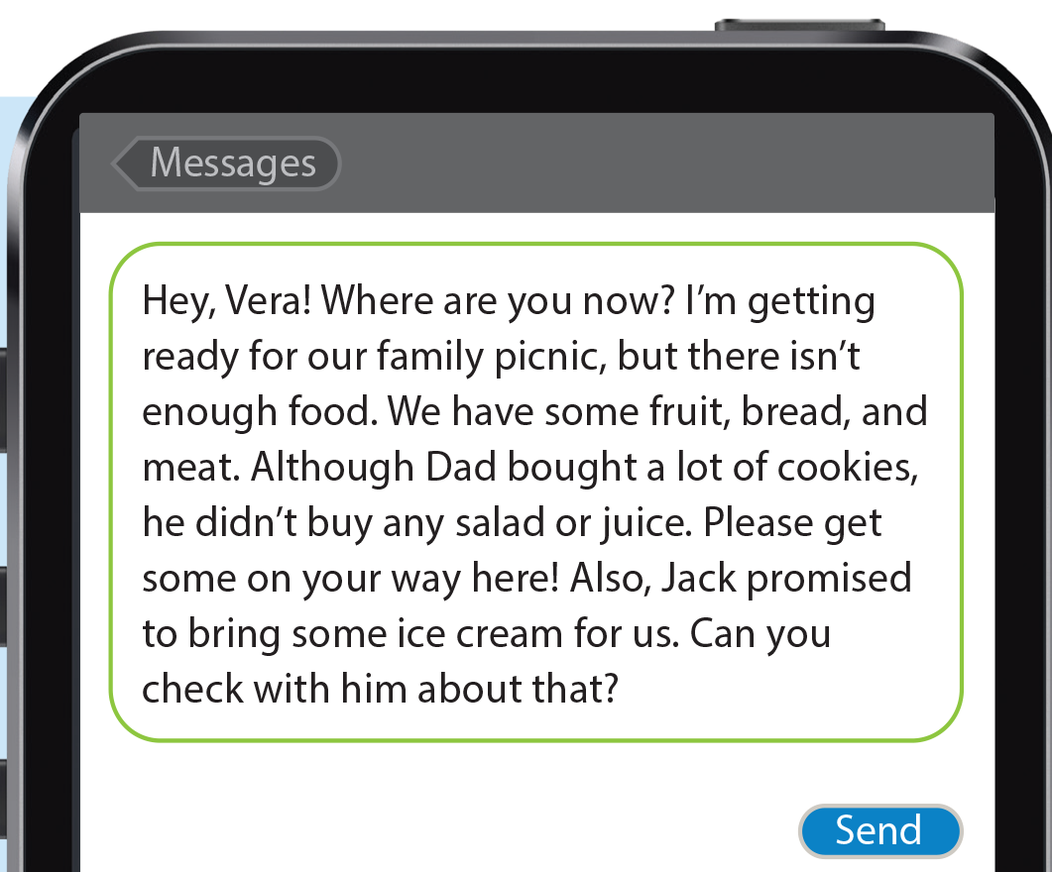
UNIT 7
WHAT’S FOR DINNER?
WRITING

Slide 9
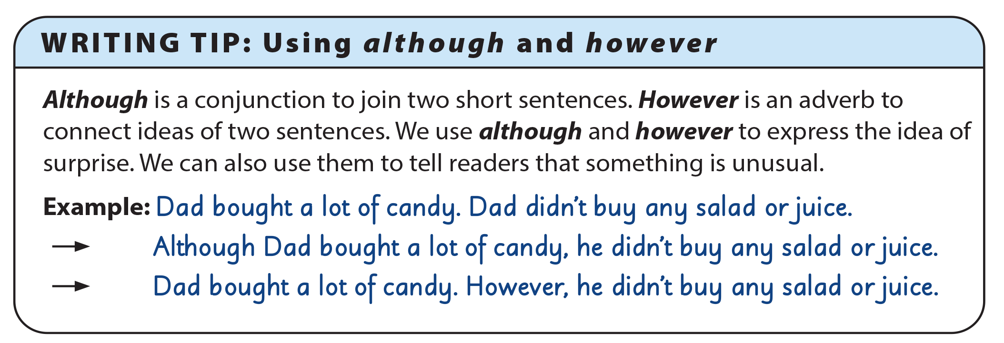
UNIT 7
WHAT’S FOR DINNER?
WRITING

Slide 10
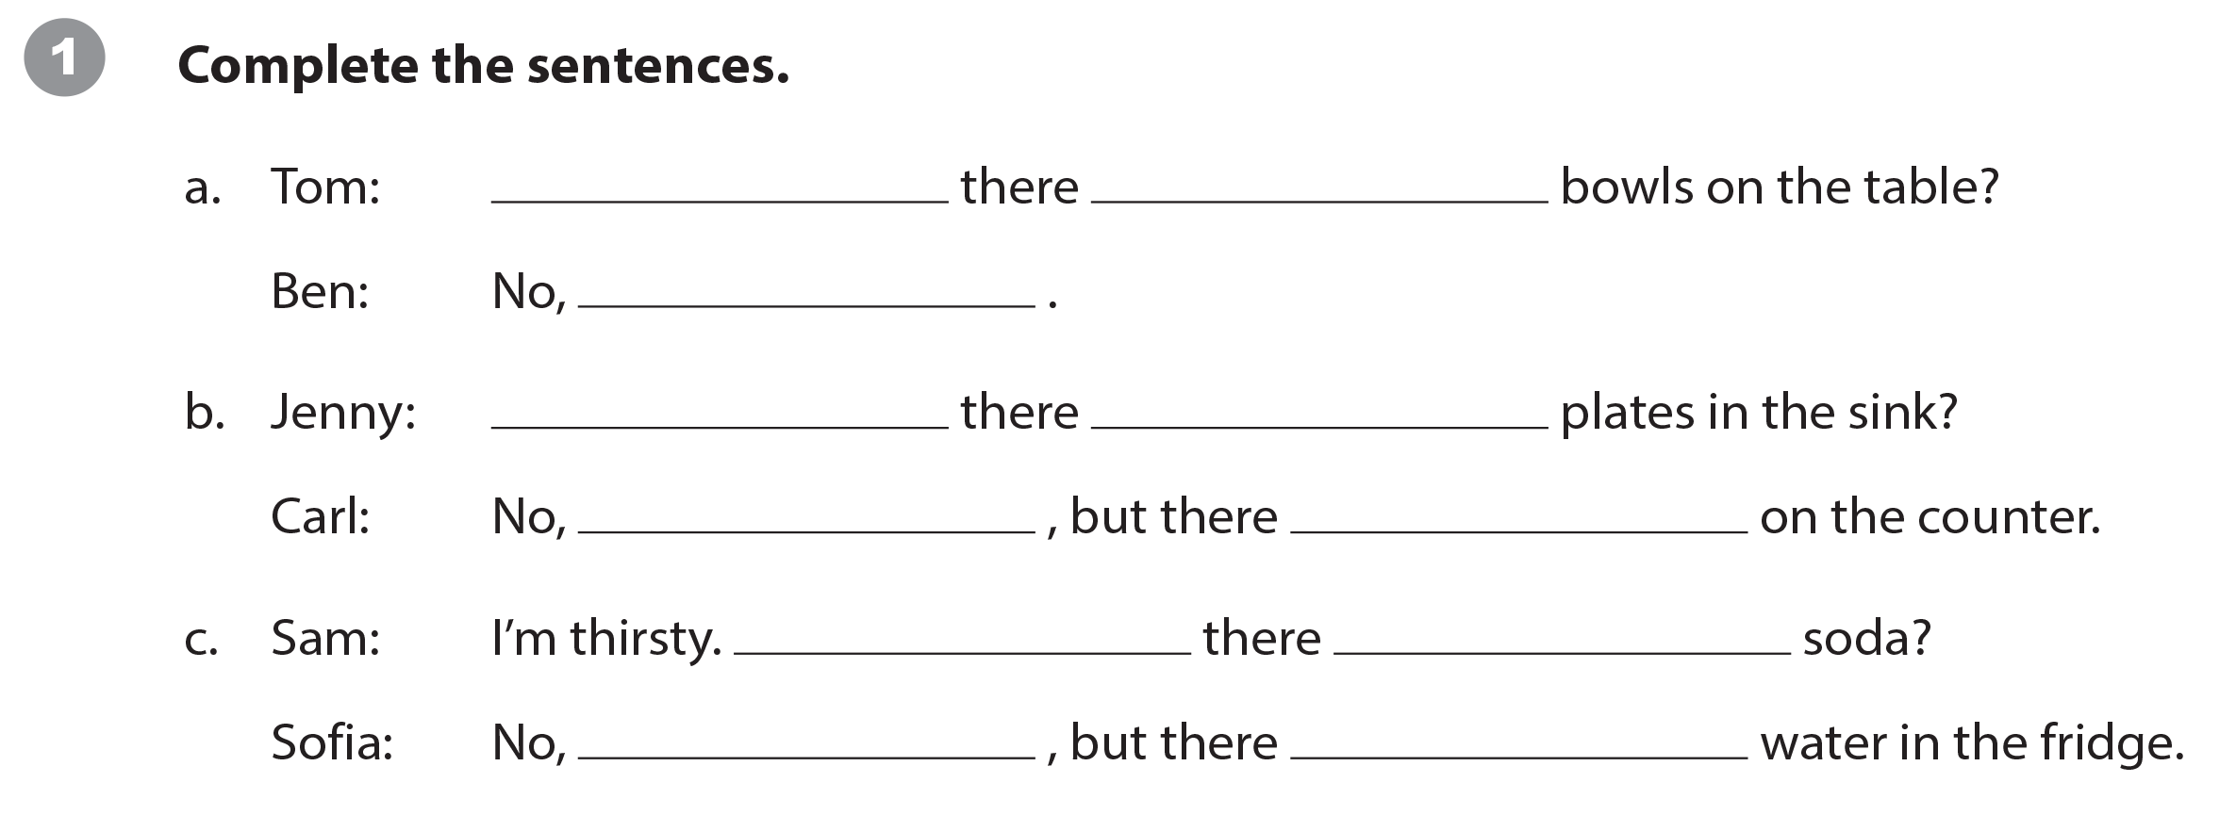
UNIT 7
WHAT’S FOR DINNER?
WRITING WORKSHEET
Are
any
there aren’t
Are
any
there aren’t
are some (plates)
Is
any
there isn’t
is

Slide 11
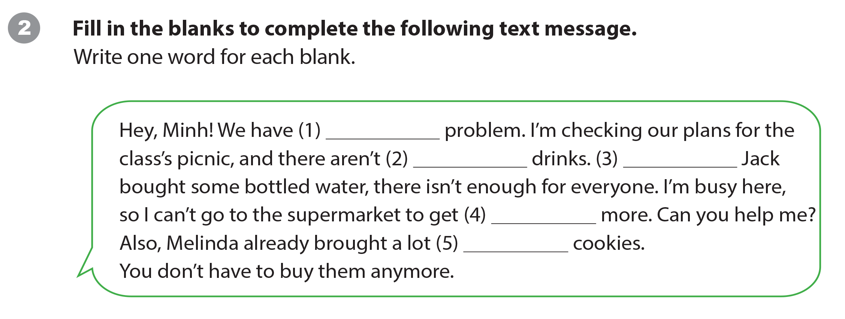
UNIT 7
WHAT’S FOR DINNER?
WRITING WORKSHEET
a
any
Although
some
of

Slide 12
UNIT 7
WHAT’S FOR DINNER?
WRITING WORKSHEET

