Slide 1
TRƯỜNG THCS KHƯƠNG ĐÌNH
UNIT 8: YOU SHOULD SEE A DOCTOR!
LESSON 2
Tác giả: Nguyễn Thảo trà

Slide 2
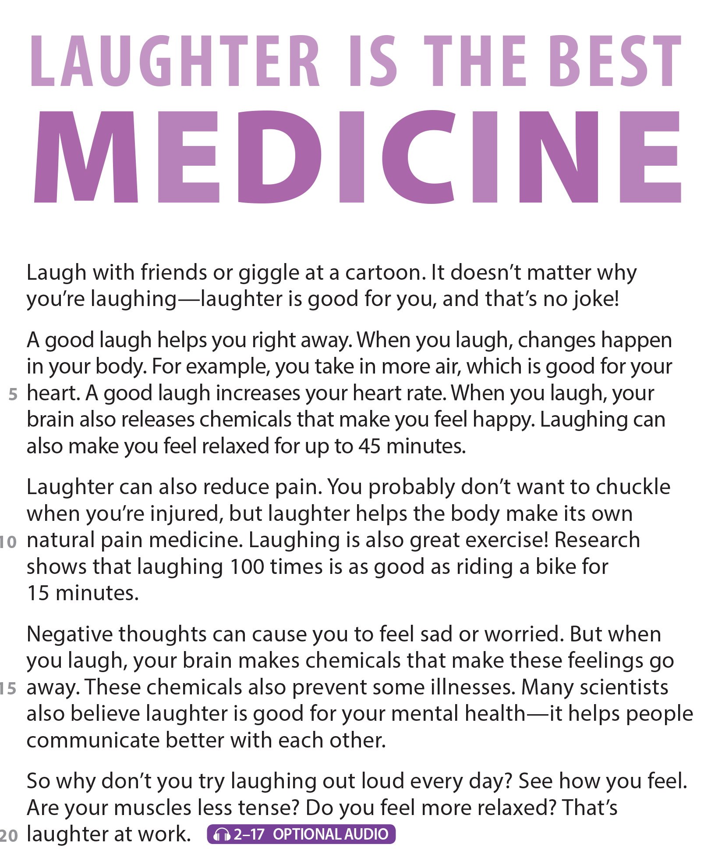
UNIT 8
YOU SHOULD SEE A DOCTOR!
READING
National Geographic Learning, a Cengage Company © 2022 Cengage Learning, Inc. ALL RIGHTS RESERVED. This presentation tool is intended for teaching purposes only and may not be scanned, copied, duplicated, or posted to a publicly accessible platform in whole or in part.

Slide 3
UNIT 8
YOU SHOULD SEE A DOCTOR!
READING
giggle
chuckle

Slide 4
UNIT 8
YOU SHOULD SEE A DOCTOR!
COMPREHENSION

Slide 5
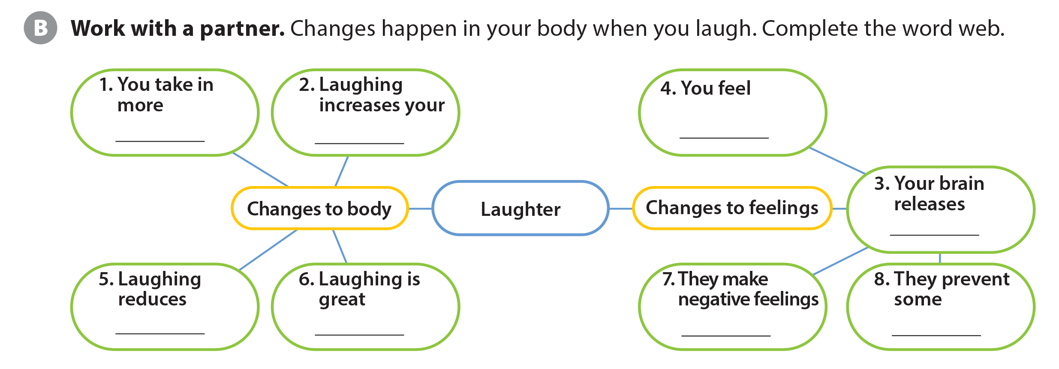
UNIT 8
YOU SHOULD SEE A DOCTOR!
COMPREHENSION
air
heart race
happy
chemicals
pain
exercise
go away
illnesses

Slide 6
UNIT 8
YOU SHOULD SEE A DOCTOR!
PROJECT

Slide 7
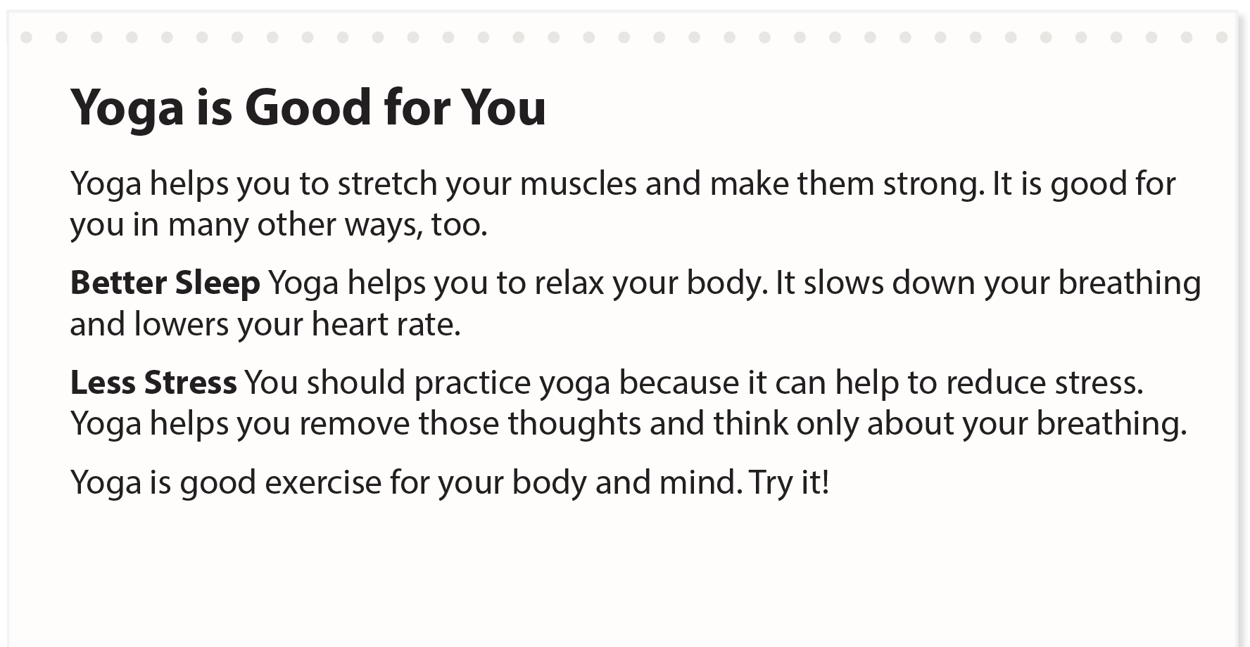
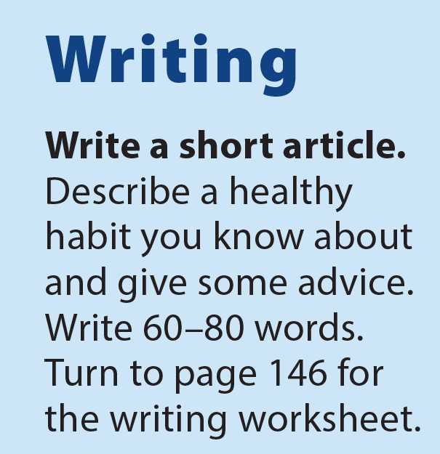
UNIT 8
YOU SHOULD SEE A DOCTOR!
WRITING

Slide 8
UNIT 8
YOU SHOULD SEE A DOCTOR!
WRITING WORKSHEET
should see a doctor
shouldn’t make noise
should take a rest
should rest for a week
shouldn’t go out

Slide 9
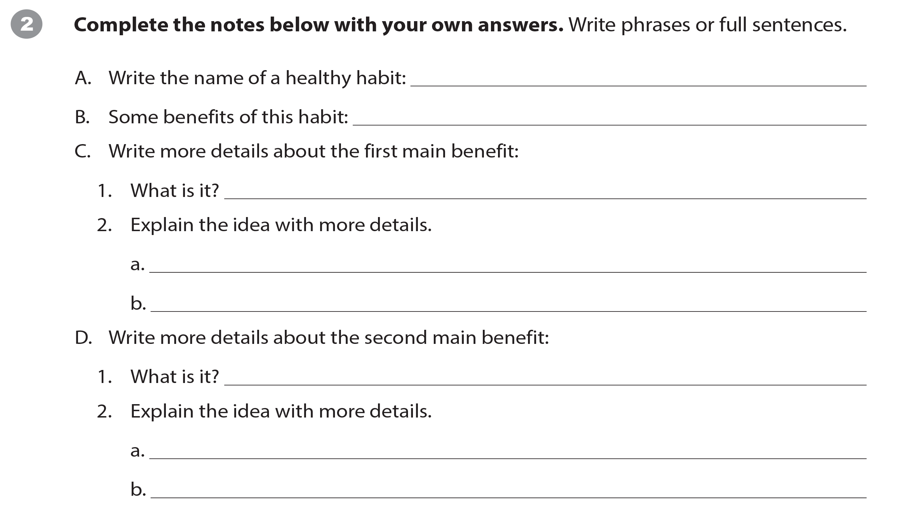
UNIT 8
YOU SHOULD SEE A DOCTOR!
WRITING WORKSHEET

Slide 10
UNIT 8
YOU SHOULD SEE A DOCTOR!
WRITING WORKSHEET

Slide 11
UNIT 8
YOU SHOULD SEE A DOCTOR!
VIDEO
✓
✓
✓

Slide 12
UNIT 8
YOU SHOULD SEE A DOCTOR!
VIDEO

Slide 13
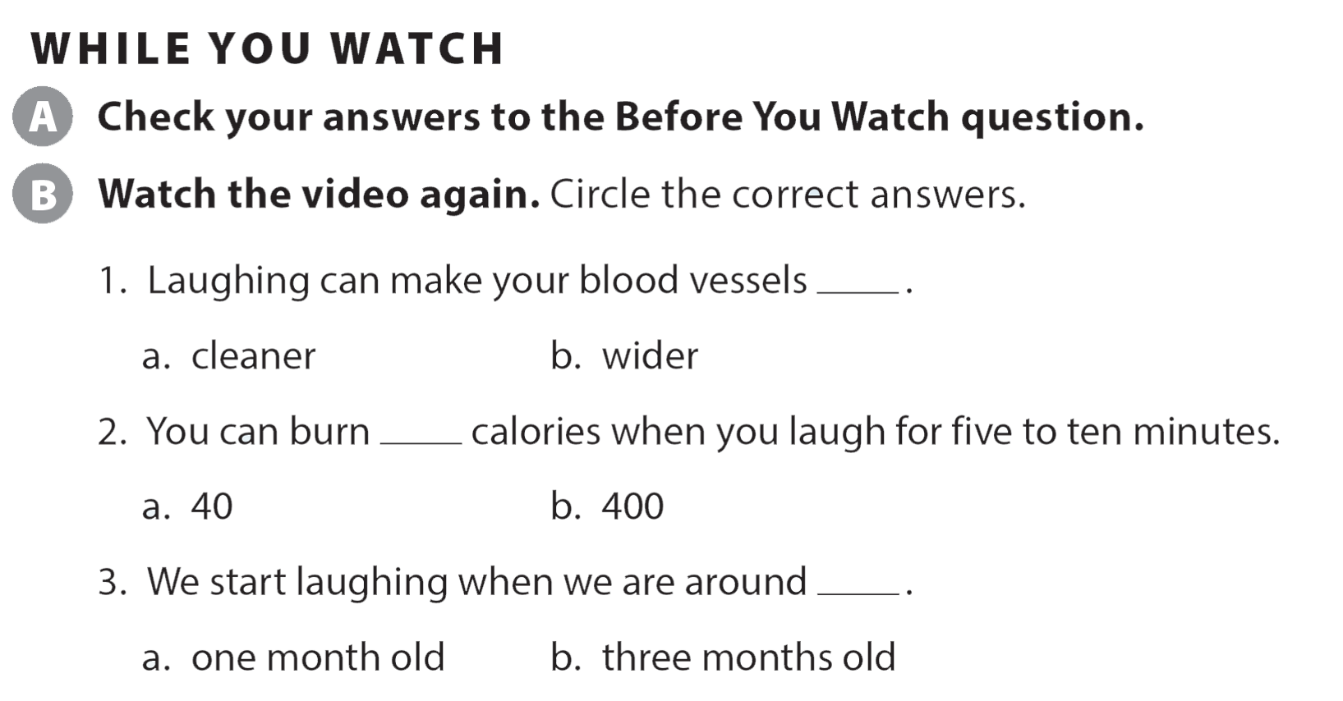
UNIT 8
YOU SHOULD SEE A DOCTOR!
VIDEO

Slide 14
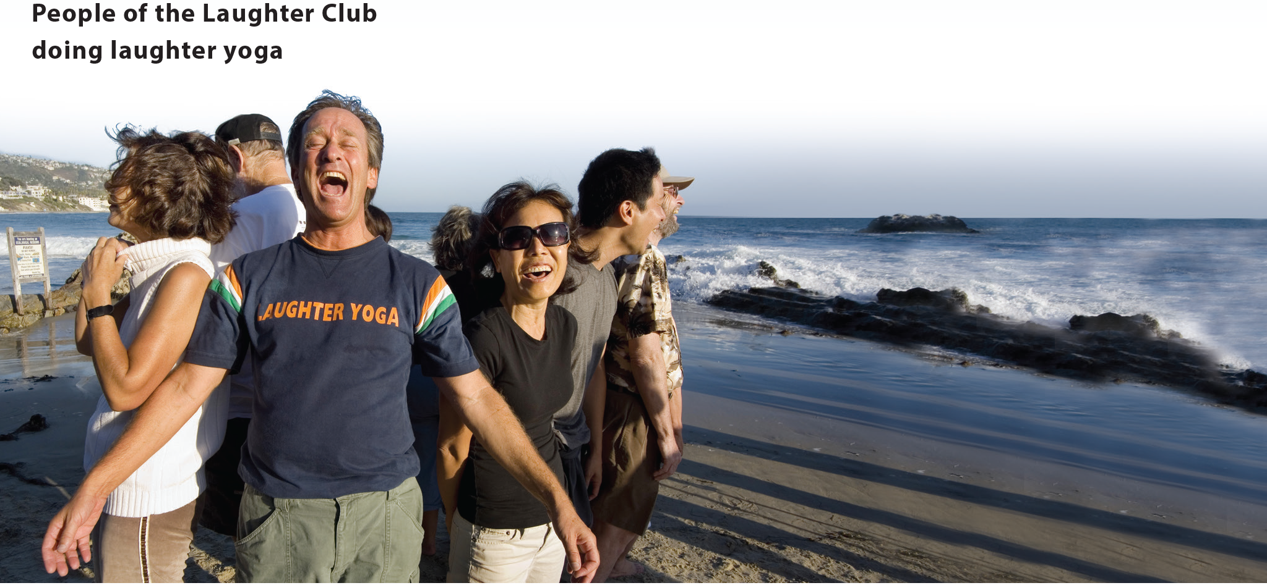
UNIT 8
YOU SHOULD SEE A DOCTOR!
VIDEO
National Geographic Learning, a Cengage Company © 2022 Cengage Learning, Inc. ALL RIGHTS RESERVED. This presentation tool is intended for teaching purposes only and may not be scanned, copied, duplicated, or posted to a publicly accessible platform in whole or in part.

Slide 15
UNIT 8
YOU SHOULD SEE A DOCTOR!
Thank you!

