Slide 1
TRƯỜNG THCS KHƯƠNG ĐÌNH
UNIT 9: I OFTEN PLAY GAMES
LESSON 1
Tác giả: Nguyễn Thảo trà

Slide 2
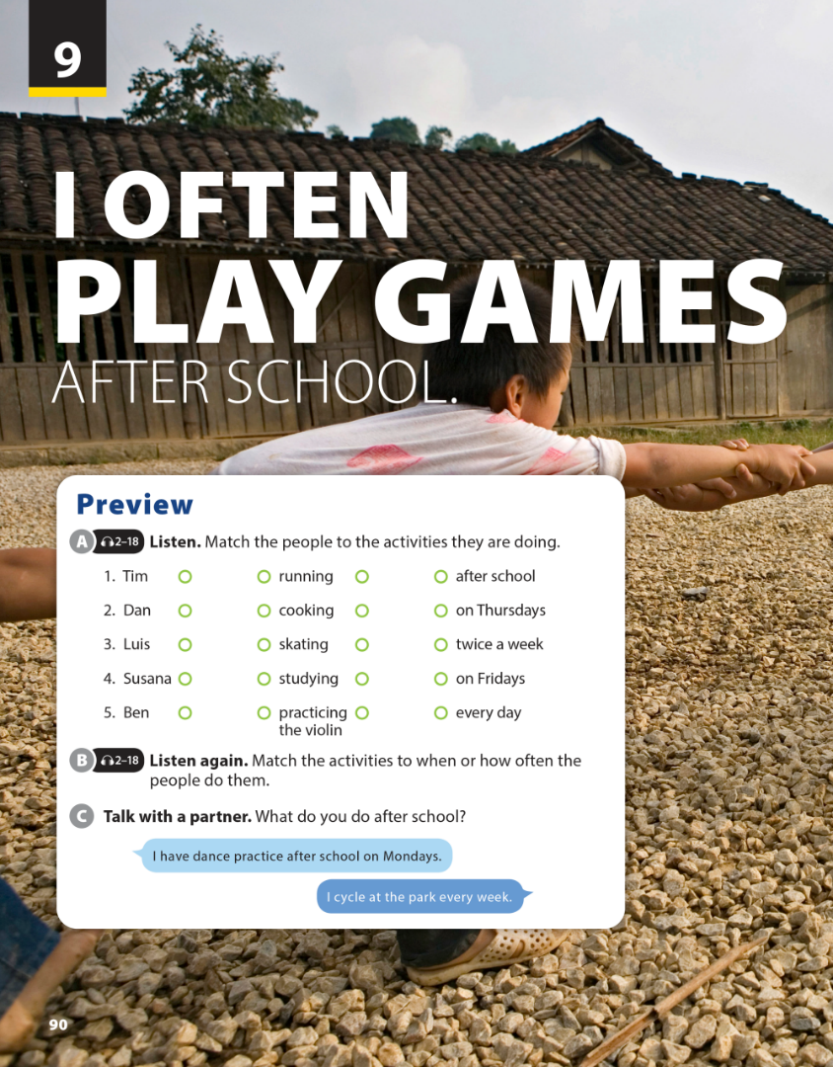
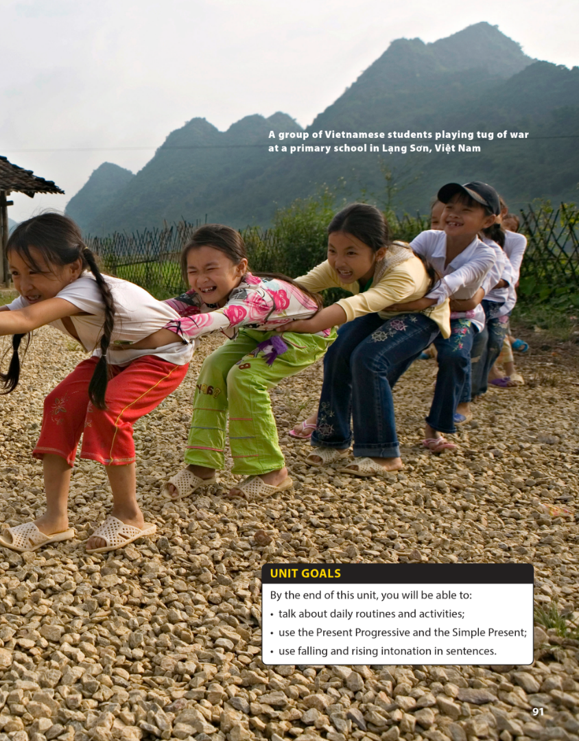
National Geographic Learning, a Cengage Company © 2022 Cengage Learning, Inc. ALL RIGHTS RESERVED. This presentation tool is intended for teaching purposes only and may not be scanned, copied, duplicated, or posted to a publicly accessible platform in whole or in part.

Slide 3
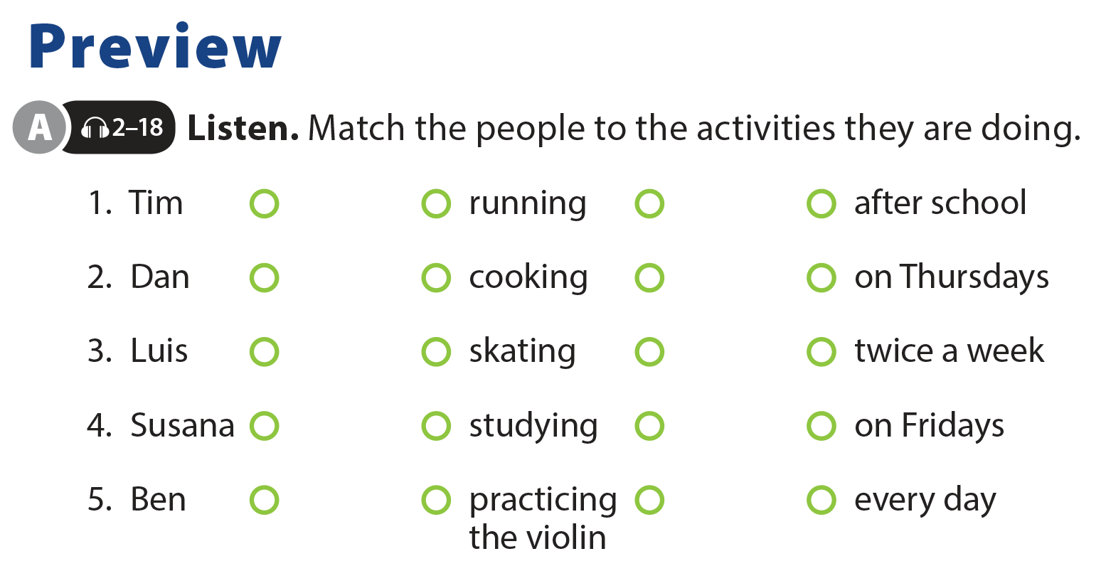
UNIT 9
I OFTEN PLAY GAMES AFTER SCHOOL.
PREVIEW

Slide 4
UNIT 9
I OFTEN PLAY GAMES AFTER SCHOOL.
PREVIEW

Slide 5
UNIT 9
I OFTEN PLAY GAMES AFTER SCHOOL.
PREVIEW

Slide 6
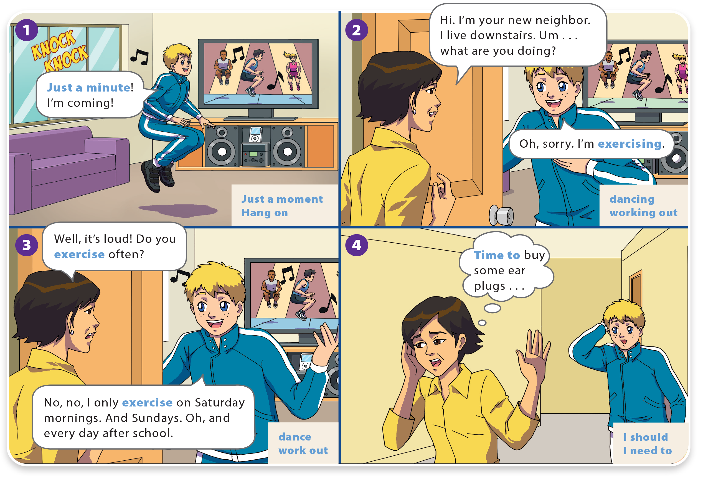
I OFTEN PLAY GAMES AFTER SCHOOL.
UNIT 9
WHAT DO YOU LIKE TO DO?
LANGUAGE FOCUS

Slide 7
WHAT DO YOU LIKE TO DO?
UNIT 9
I OFTEN PLAY GAMES AFTER SCHOOL.
LANGUAGE FOCUS

Slide 8
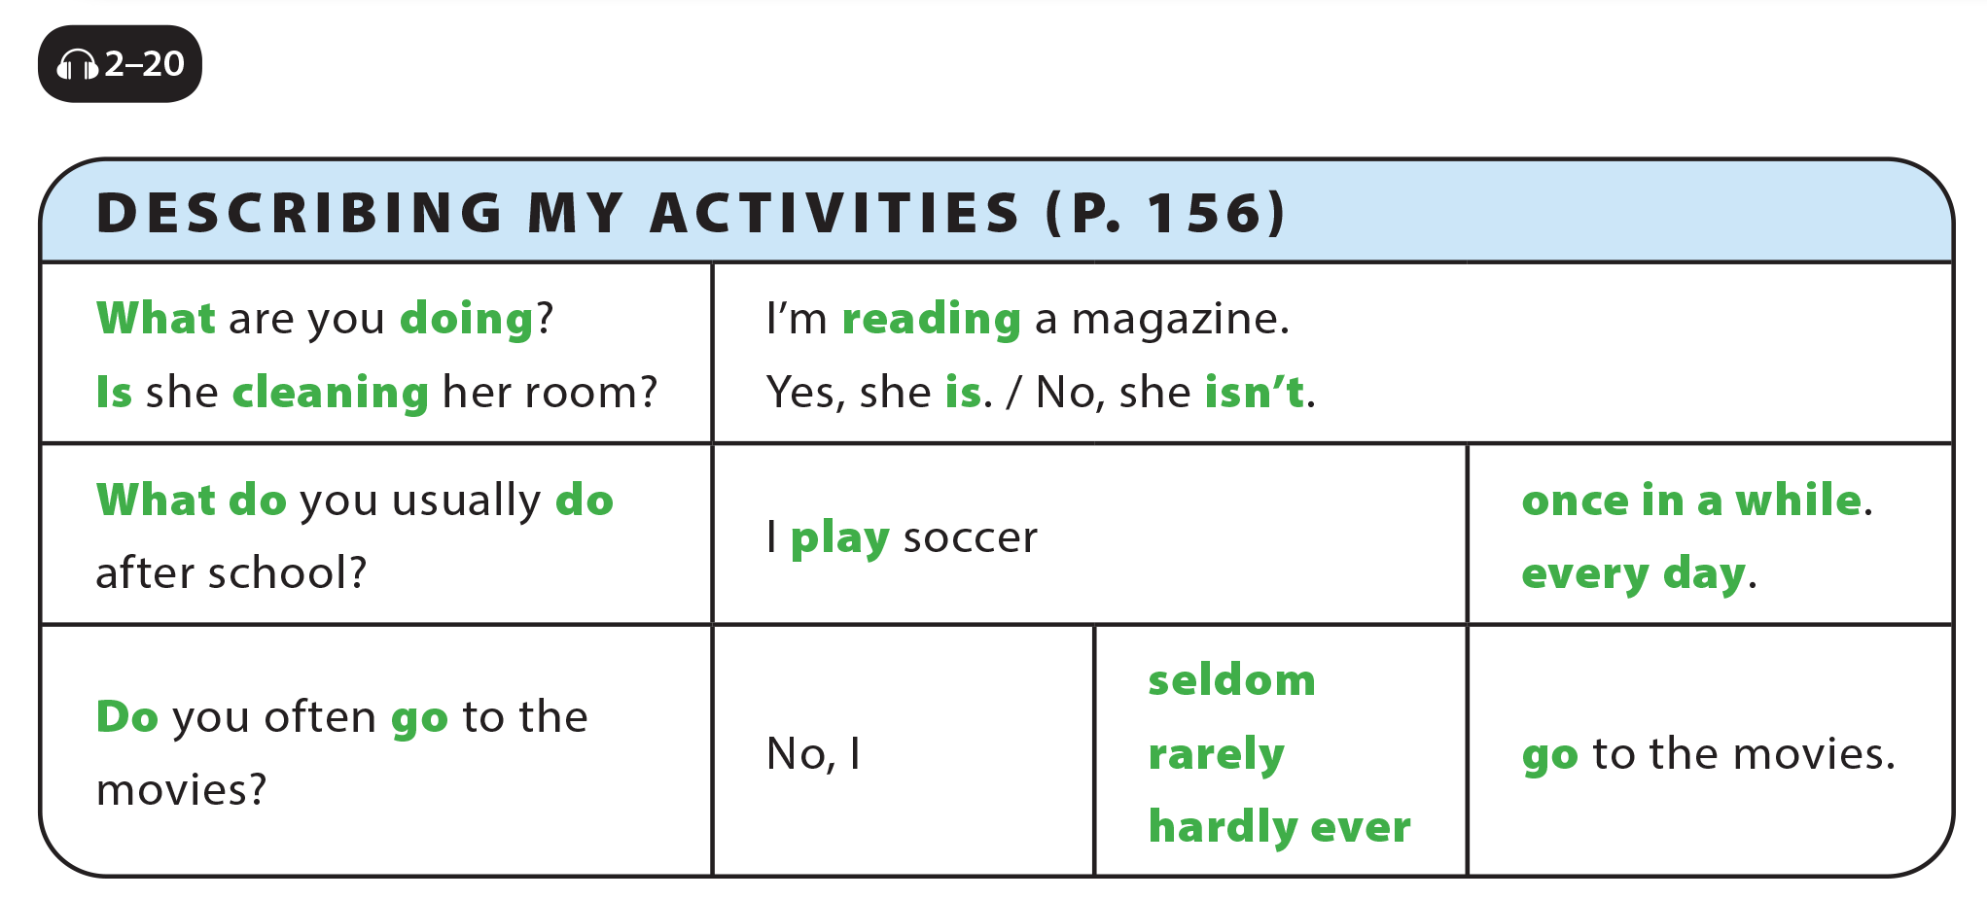
UNIT 9
I OFTEN PLAY GAMES AFTER SCHOOL.
LANGUAGE FOCUS

Slide 9
UNIT 9
I OFTEN PLAY GAMES AFTER SCHOOL.
GRAMMAR REFERENCE

Slide 10
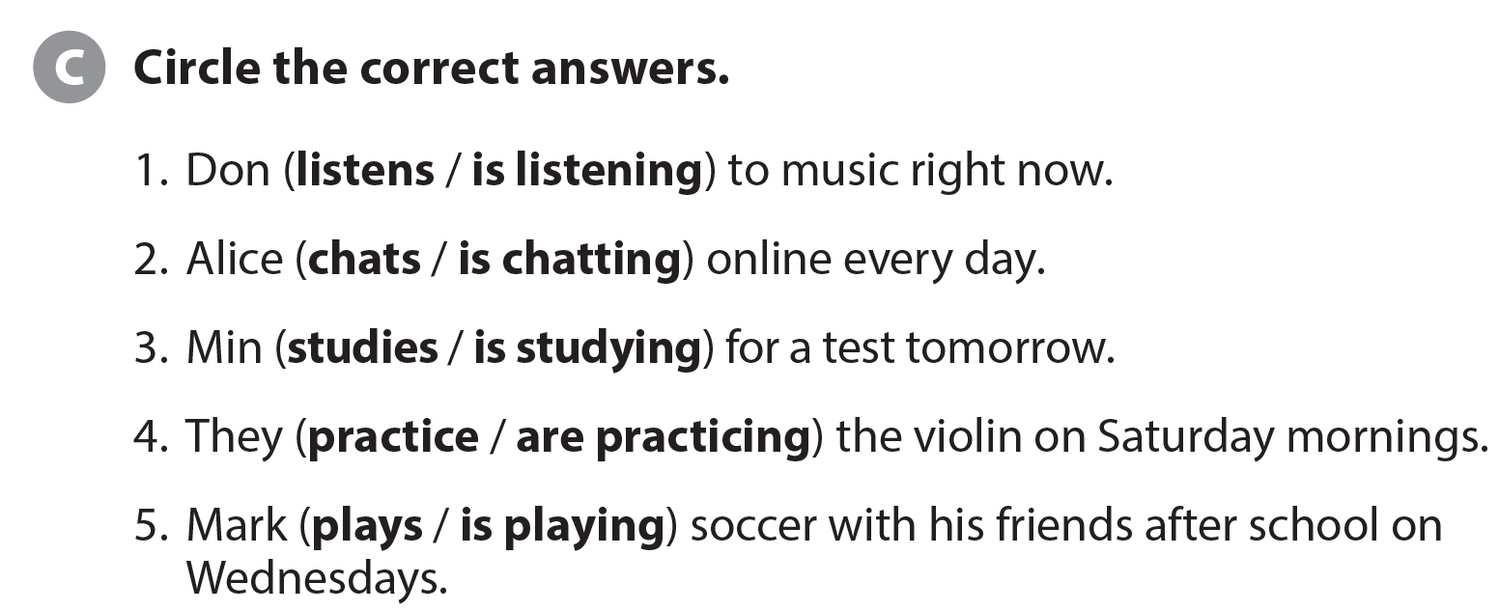
UNIT 9
I OFTEN PLAY GAMES AFTER SCHOOL.
LANGUAGE FOCUS

Slide 11
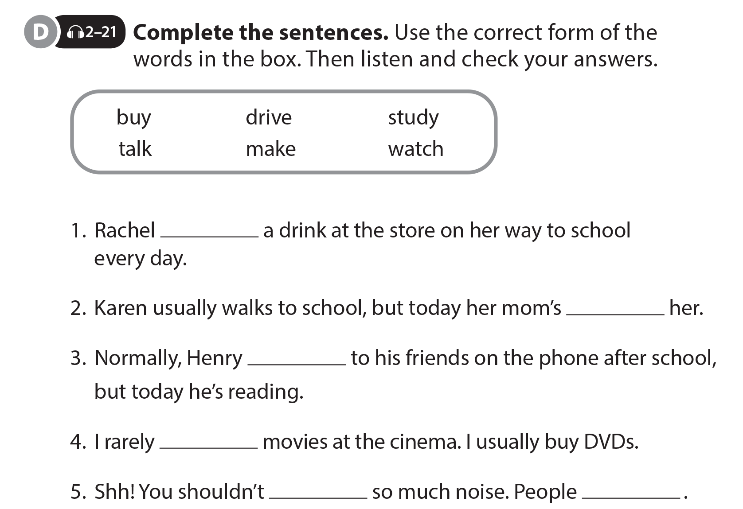
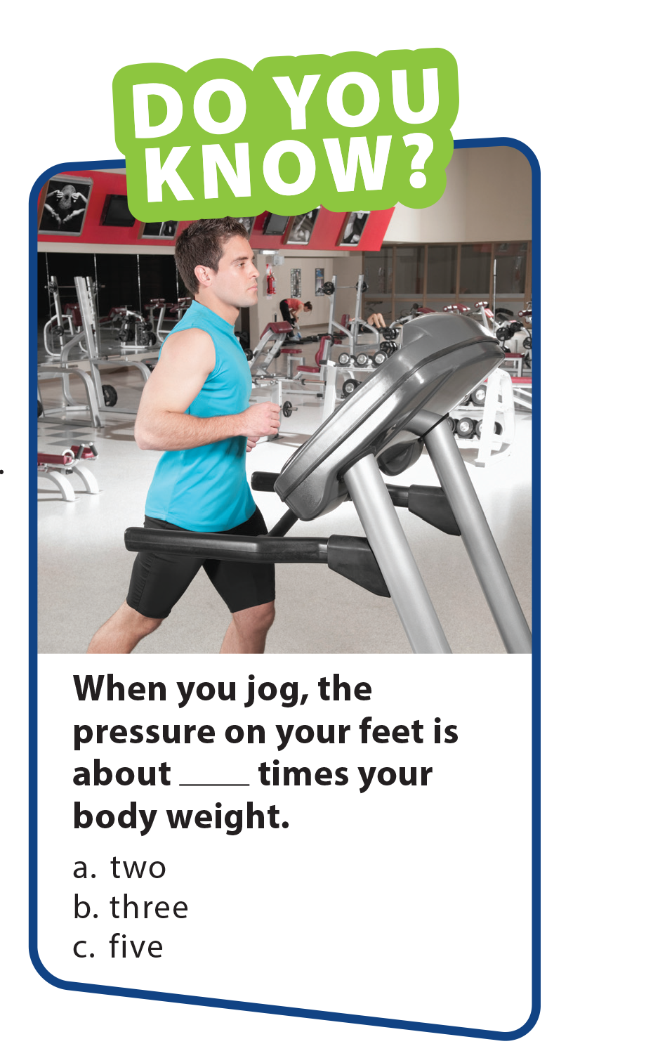
UNIT 9
I OFTEN PLAY GAMES AFTER SCHOOL.
LANGUAGE FOCUS
buys
driving
talks
watch
make
are studying

Slide 12
UNIT 9
I OFTEN PLAY GAMES AFTER SCHOOL.
LANGUAGE FOCUS

Slide 13
UNIT 9
I OFTEN PLAY GAMES AFTER SCHOOL.
THE REAL WORLD
National Geographic Learning, a Cengage Company © 2022 Cengage Learning, Inc. ALL RIGHTS RESERVED. This presentation tool is intended for teaching purposes only and may not be scanned, copied, duplicated, or posted to a publicly accessible platform in whole or in part.

Slide 14
UNIT 9
I OFTEN PLAY GAMES AFTER SCHOOL.
THE REAL WORLD

Slide 15
UNIT 9
I OFTEN PLAY GAMES AFTER SCHOOL.
THE REAL WORLD
National Geographic Learning, a Cengage Company © 2022 Cengage Learning, Inc. ALL RIGHTS RESERVED. This presentation tool is intended for teaching purposes only and may not be scanned, copied, duplicated, or posted to a publicly accessible platform in whole or in part.

Slide 16
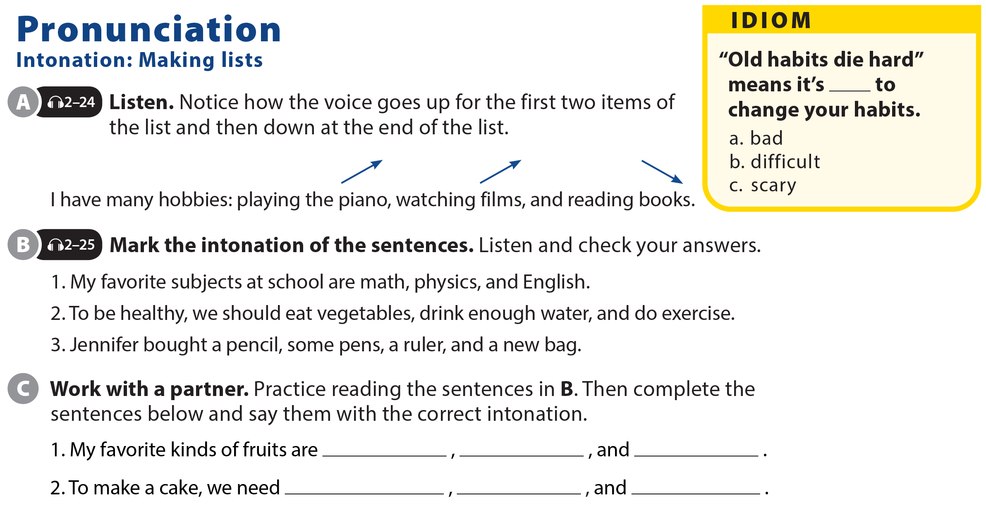
UNIT 9
I OFTEN PLAY GAMES AFTER SCHOOL.
PRONUNCIATION

Slide 17
UNIT 9
I OFTEN PLAY GAMES AFTER SCHOOL.
COMMUNICATION

