Slide 1
TRƯỜNG THCS KHƯƠNG ĐÌNH
UNIT 9: I OFTEN PLAY GAMES
LESSON 2
Tác giả: Nguyễn Thảo trà

Slide 2
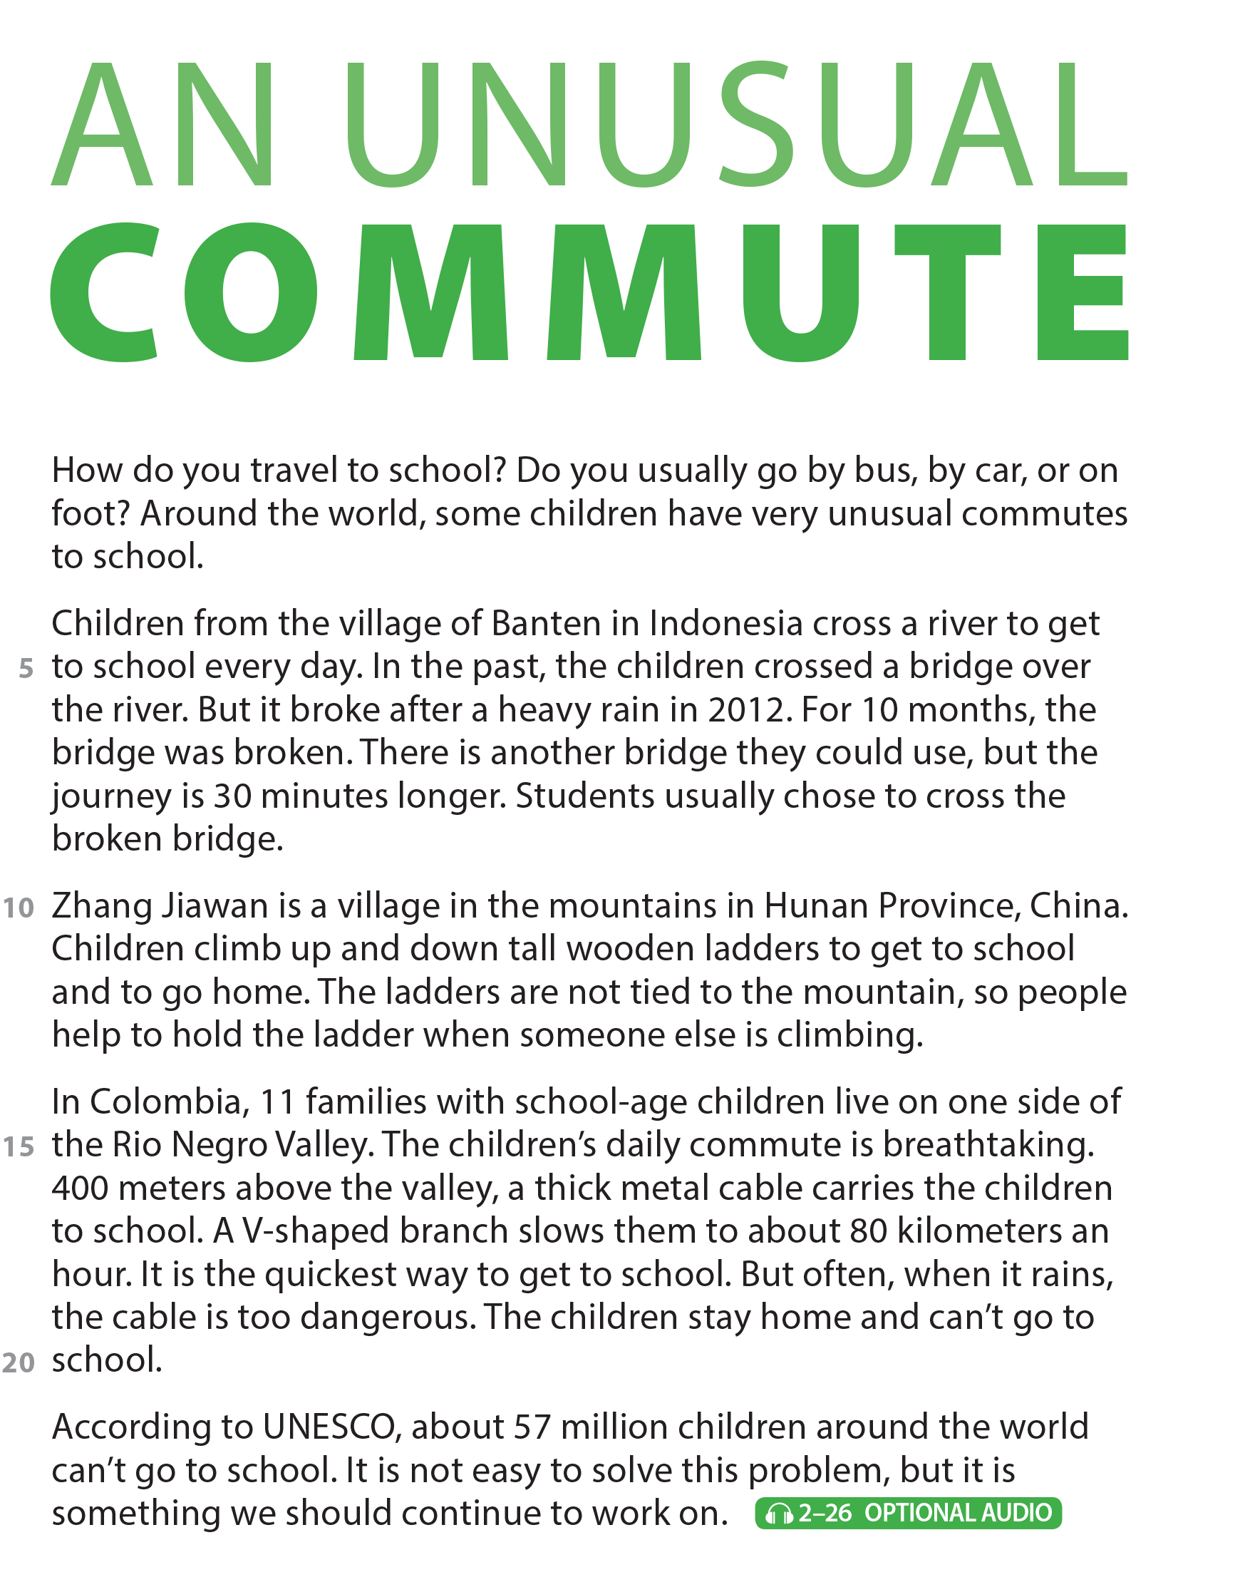
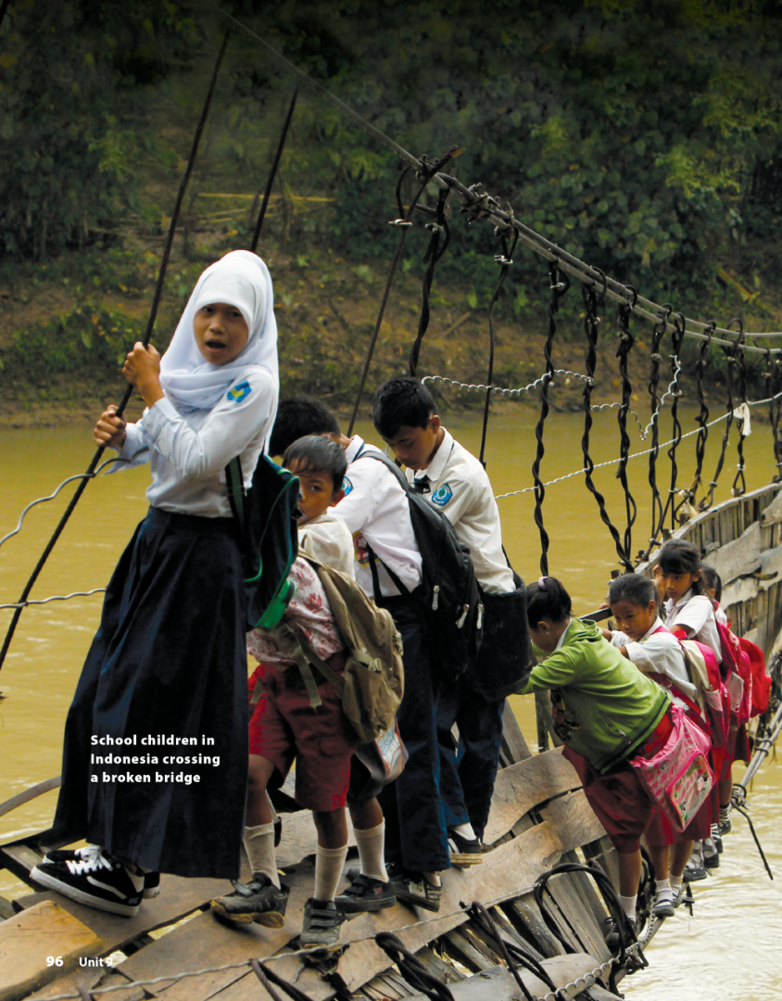
UNIT 9
I OFTEN PLAY GAMES AFTER SCHOOL.
READING
National Geographic Learning, a Cengage Company © 2022 Cengage Learning, Inc. ALL RIGHTS RESERVED. This presentation tool is intended for teaching purposes only and may not be scanned, copied, duplicated, or posted to a publicly accessible platform in whole or in part.

Slide 3
UNIT 9
I OFTEN PLAY GAMES AFTER SCHOOL.
READING
Suggested answer: The journey you make when you travel to and from a place you go to regularly.

Slide 4
UNIT 9
I OFTEN PLAY GAMES AFTER SCHOOL.
COMPREHENSION

Slide 5
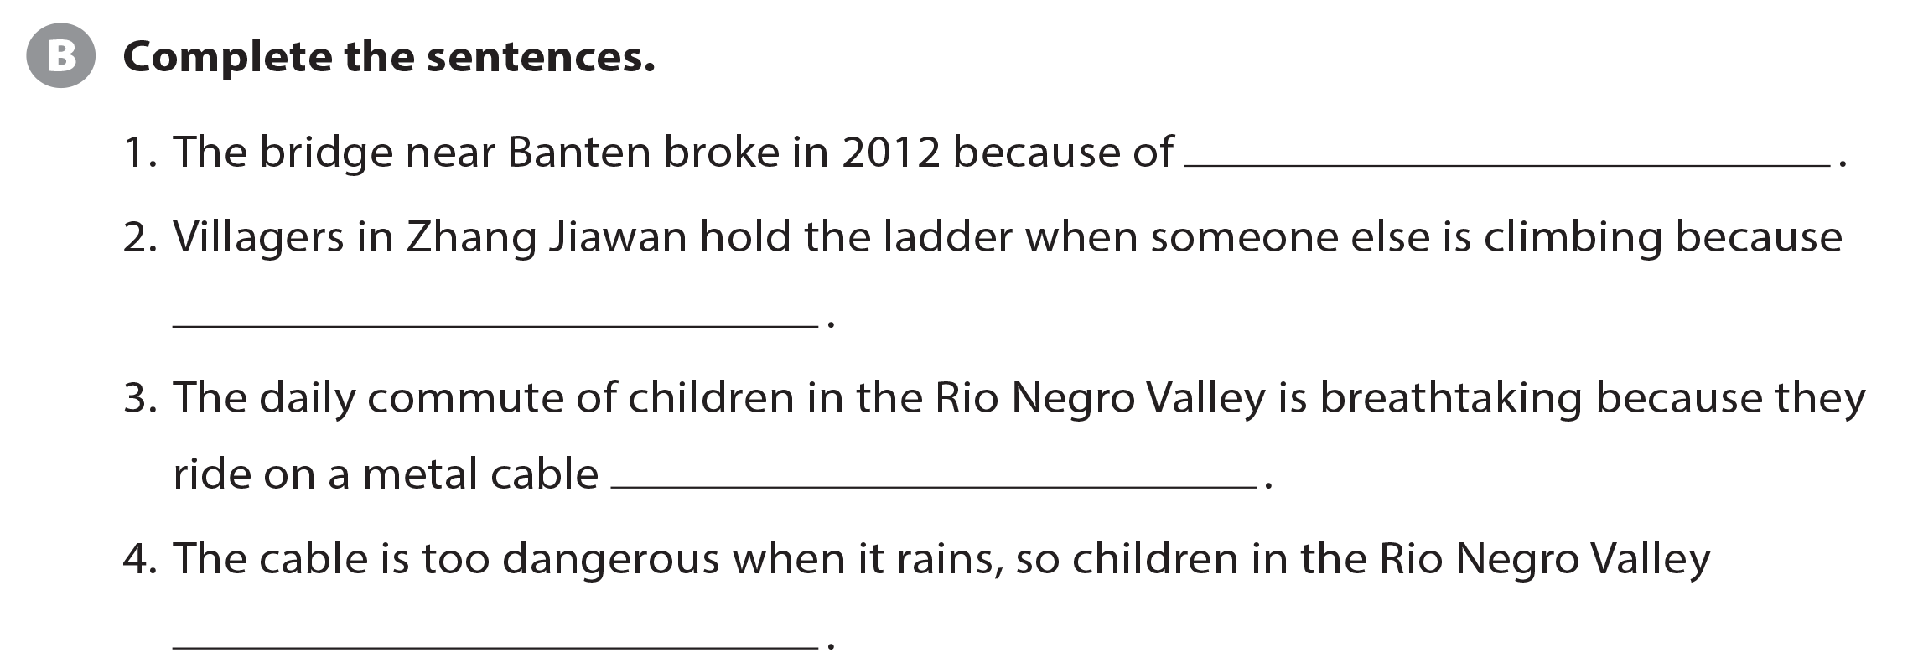
UNIT 9
I OFTEN PLAY GAMES AFTER SCHOOL.
COMPREHENSION
a heavy rain
the ladders are not tied to the mountain
400 meters above the valley
stay home and can’t go to school

Slide 6
UNIT 9
I OFTEN PLAY GAMES AFTER SCHOOL.
PROJECT

Slide 7
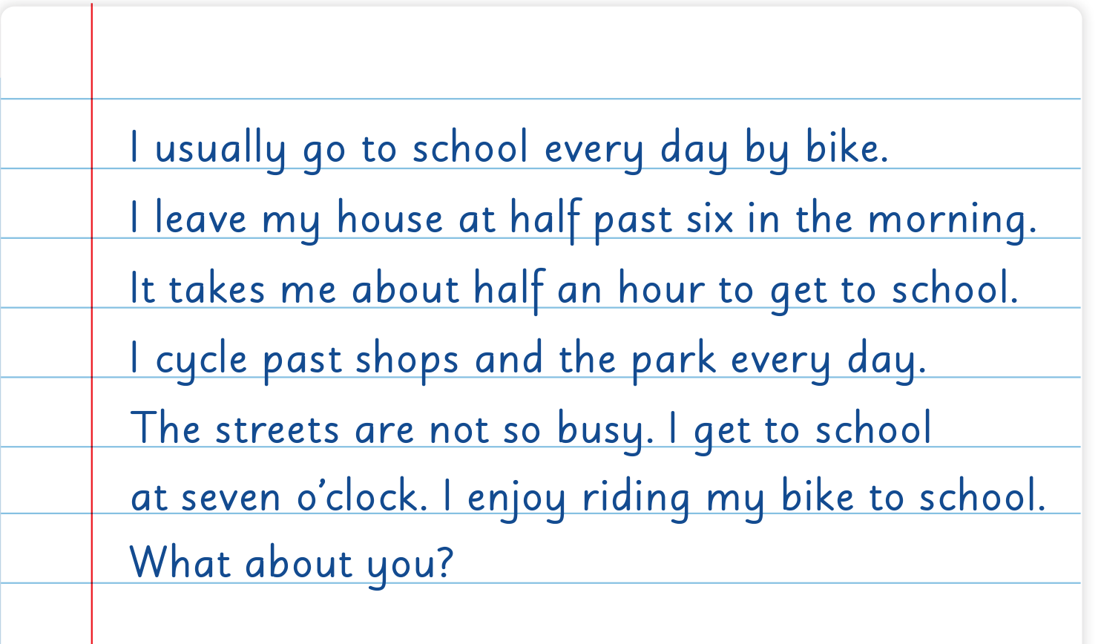
UNIT 9
I OFTEN PLAY GAMES AFTER SCHOOL.
WRITING

Slide 8
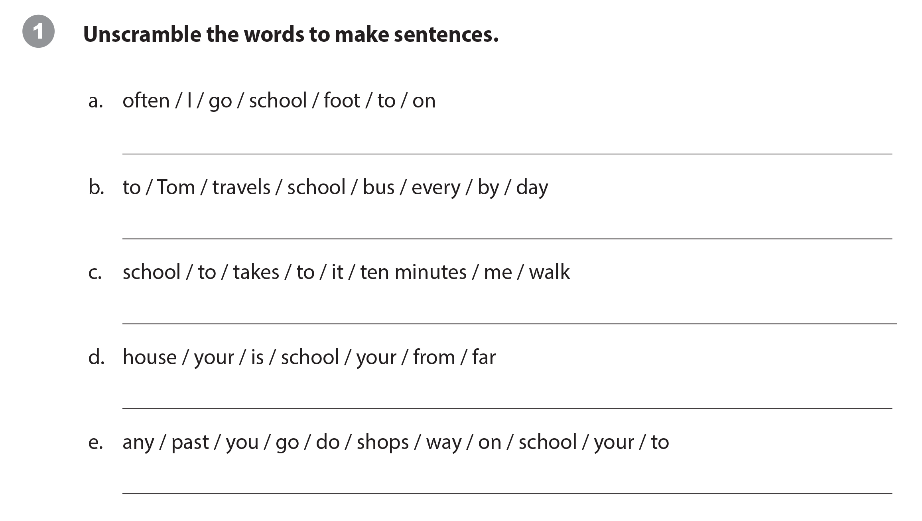
UNIT 9
I OFTEN PLAY GAMES AFTER SCHOOL.
WRITING WORKSHEET
I often go to school on foot. / Often, I go to school on foot.
Tom travels to school by bus every day. / Every day, Tom travels to school by bus. / Tom travels to school every day by bus.
It takes me ten minutes to walk to school.
Is your school far from your house? / Is your house far from your school? / Your school is far from your house. / Your house is far from your school.
Do you go past any shops on your way to school?

Slide 9
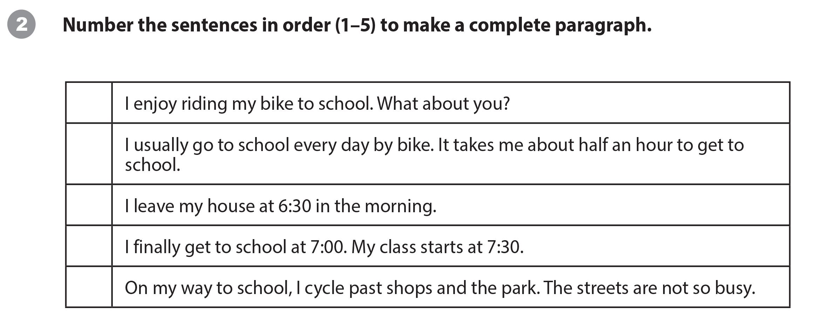
UNIT 9
I OFTEN PLAY GAMES AFTER SCHOOL.
WRITING WORKSHEET
5
1
2
4
3

Slide 10
UNIT 9
I OFTEN PLAY GAMES AFTER SCHOOL.
WRITING WORKSHEET

Slide 11
UNIT 9
I OFTEN PLAY GAMES AFTER SCHOOL.
VIDEO
It’s a skateboarding school in Afghanistan.

Slide 12
UNIT 9
I OFTEN PLAY GAMES AFTER SCHOOL.
VIDEO

Slide 13
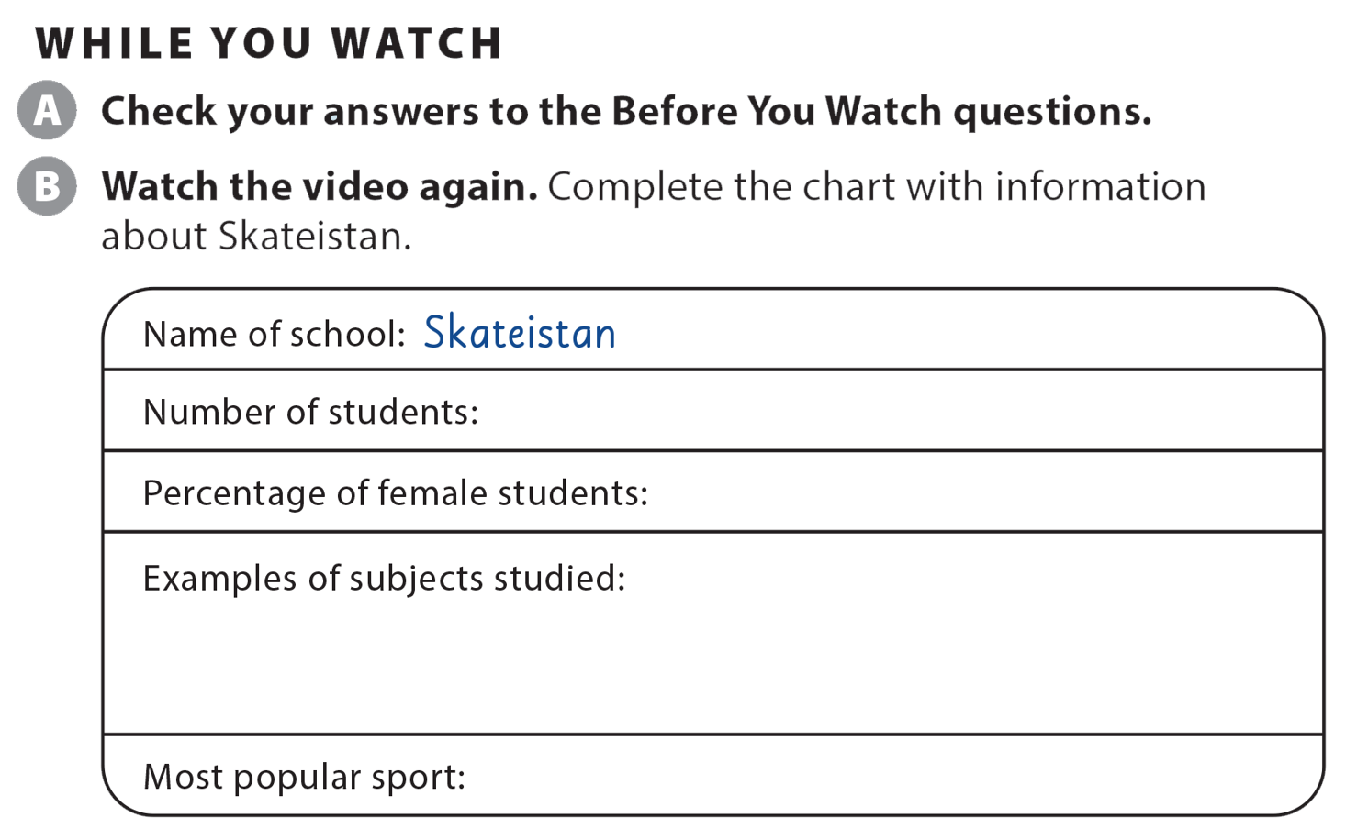
UNIT 9
I OFTEN PLAY GAMES AFTER SCHOOL.
VIDEO
more than 400
40%
science, history, art, math
skateboarding

Slide 14
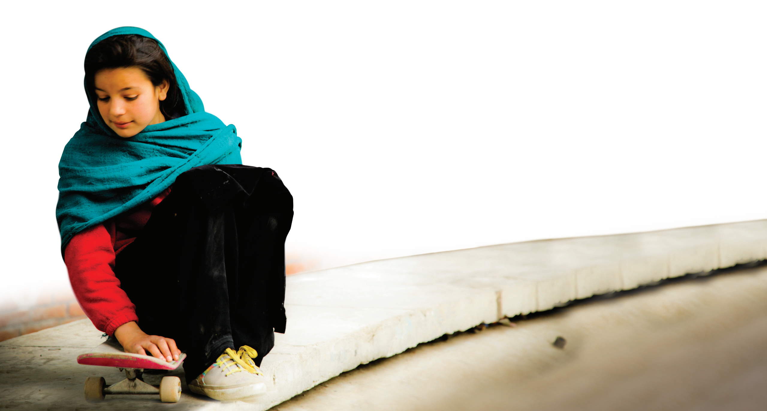
UNIT 9
I OFTEN PLAY GAMES AFTER SCHOOL.
VIDEO

Slide 15
UNIT 9
I OFTEN PLAY GAMES AFTER SCHOOL.
Thank you!

